Slide 1
Cartoon Slides to Use for other presentations
Caryn 11/20/2023

Slide 2
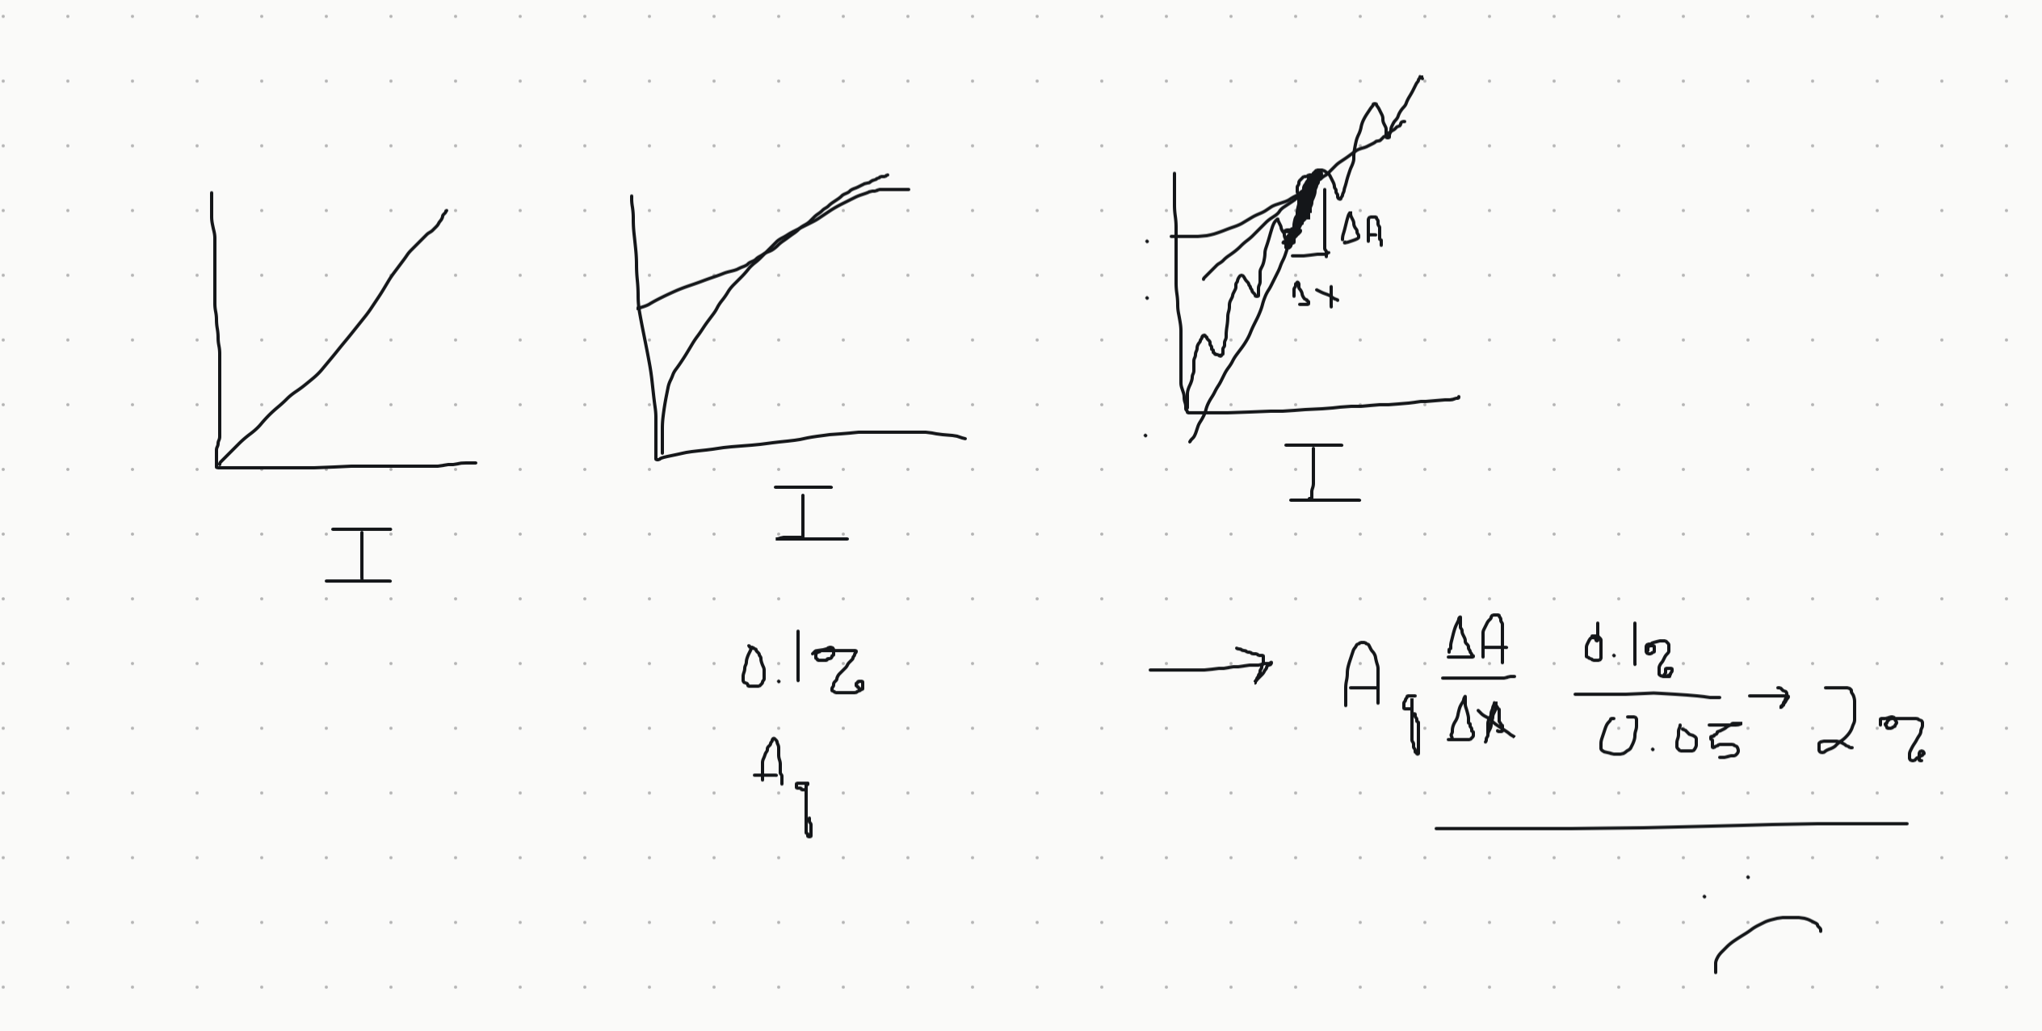
Cartoon
But Have This
Expected This

Slide 3
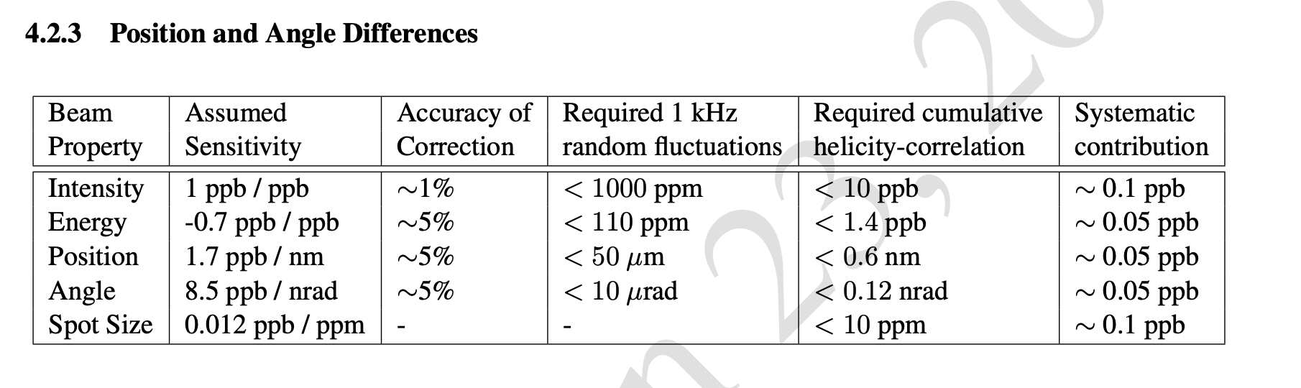
TDR

Slide 4
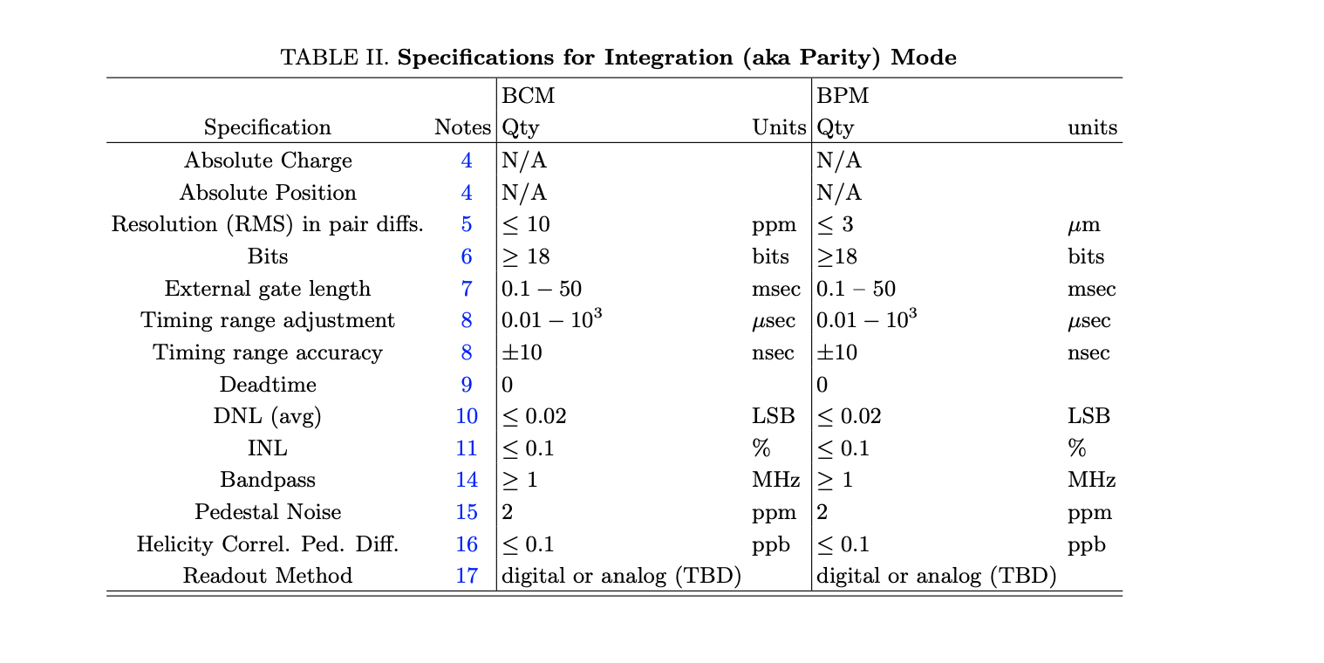
Requirements Doc

Slide 5
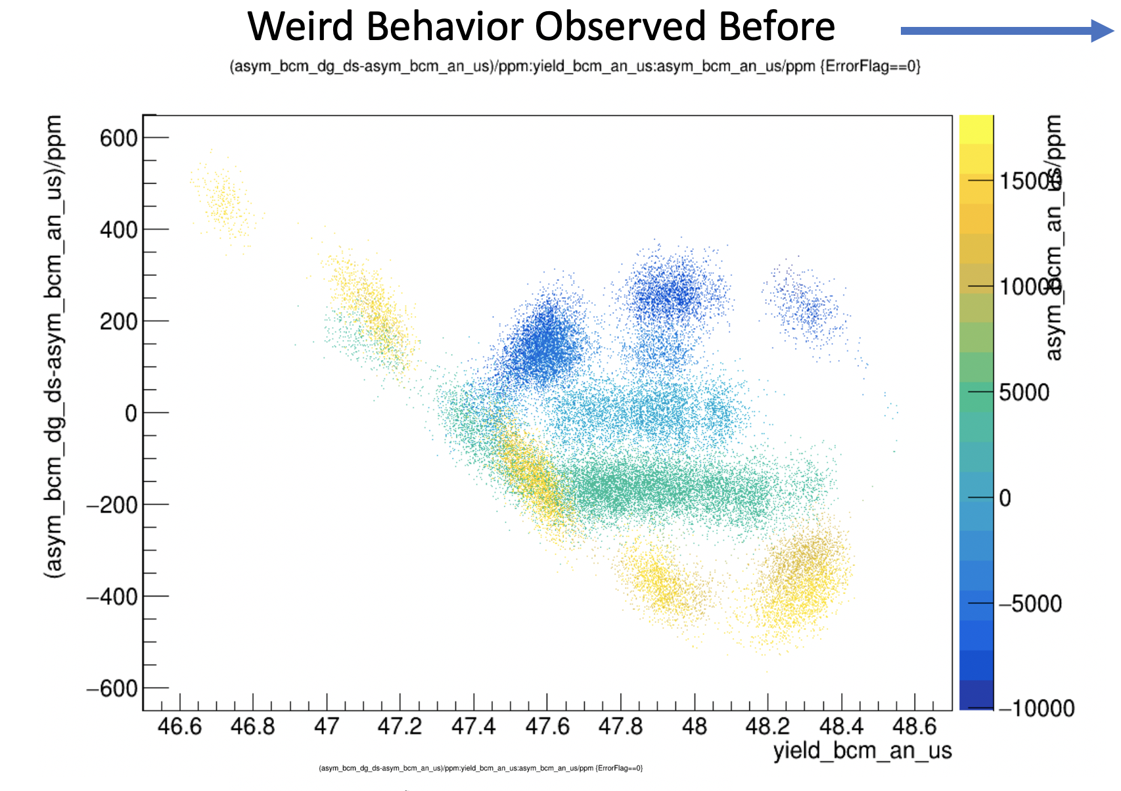
3% error on Aq

Slide 6
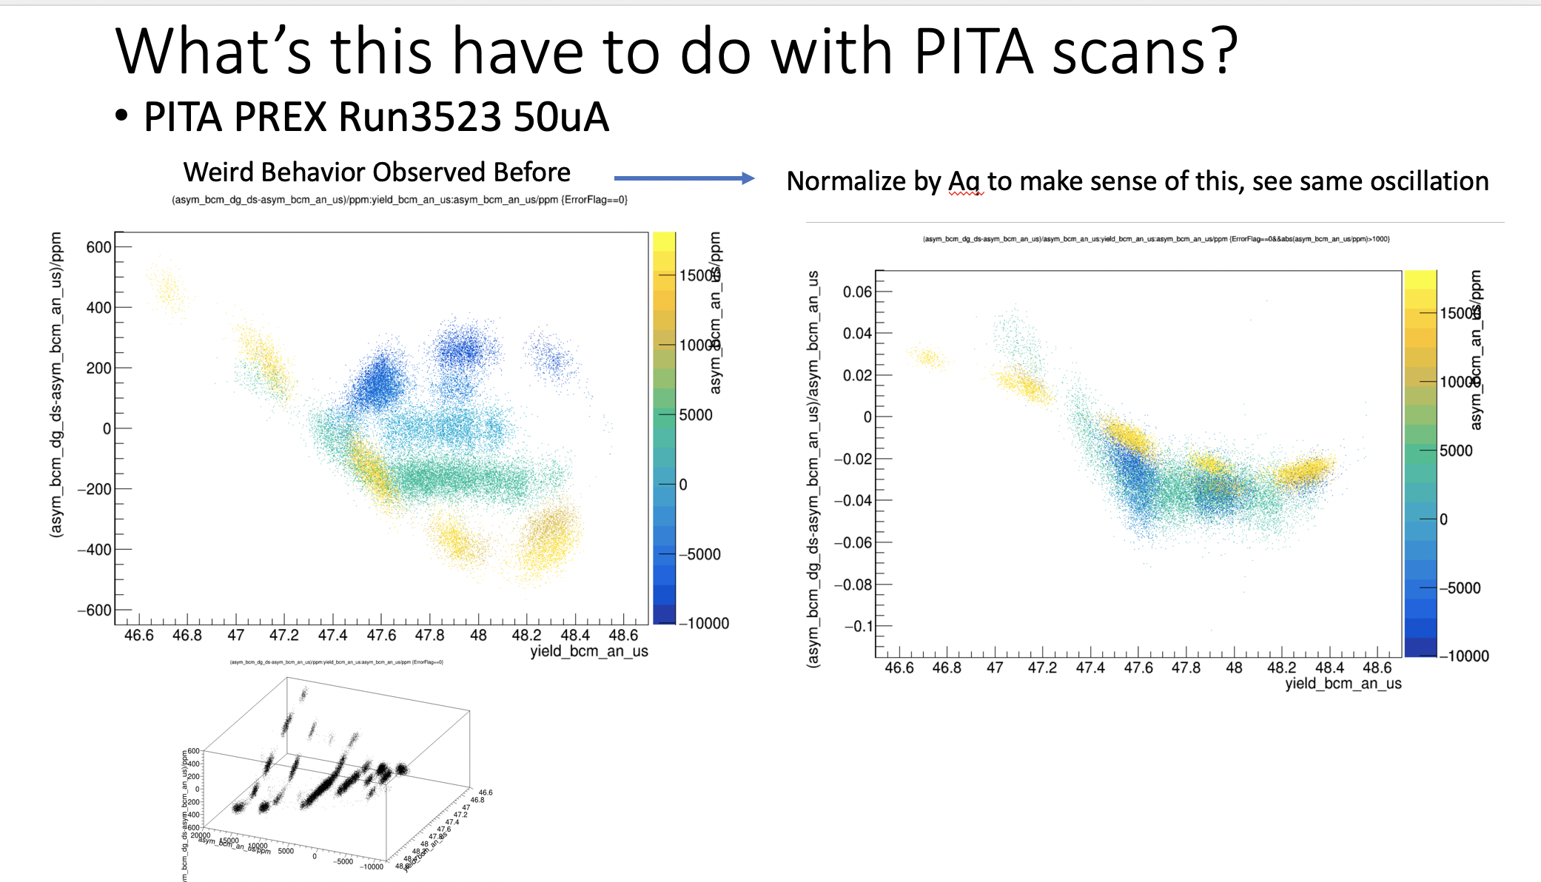
3% error on Aq

Slide 7
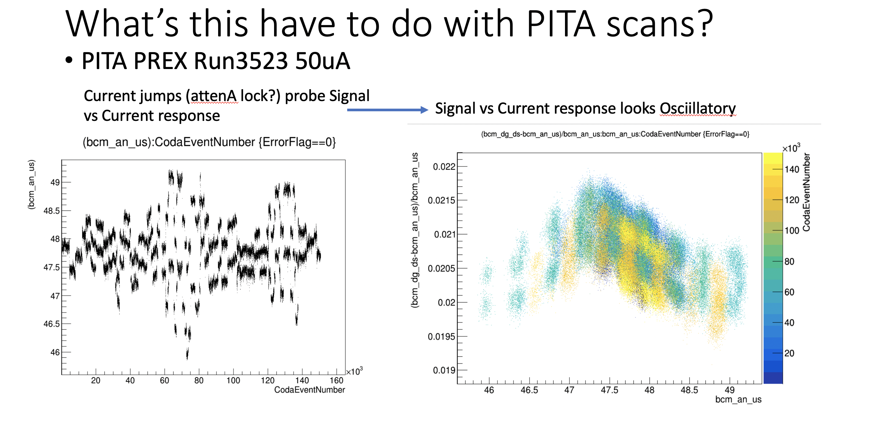
3% error on Aq arising from 0.1% local differential nonlinearity
0.1% local differential nonlinearity

