Slide 1


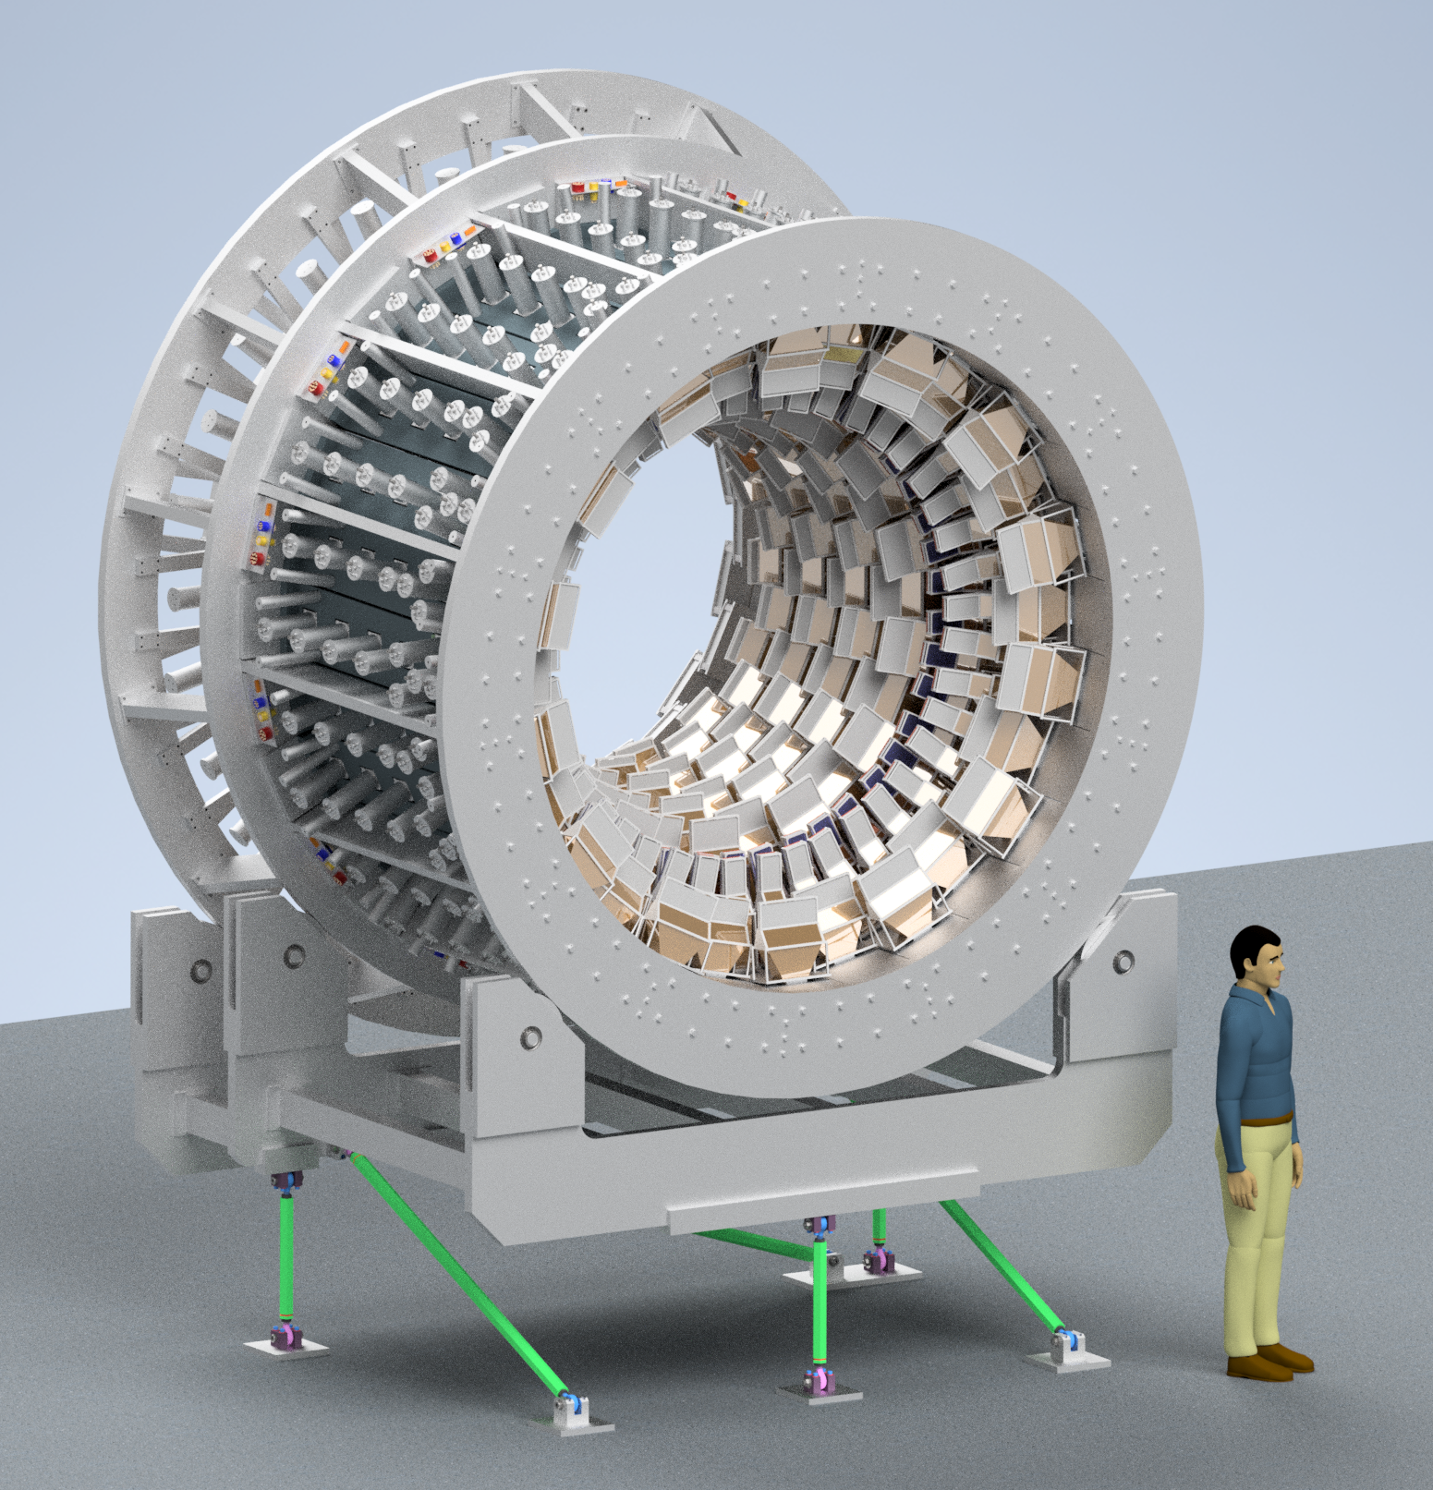
Integrating Detector & CFI Project Overview
MOLLER Collaboration Meeting
May 2023
Michael Gericke
WBS 1.04.02/03 and partial 1.07.02 Overview/Status
  Main Detector Design Status
  Remaining Design Tasks
  Equipment/Parts Purchase and Production Status/Schedule
  Quality Assurance Plans
  Assembly and shipment

Slide 2
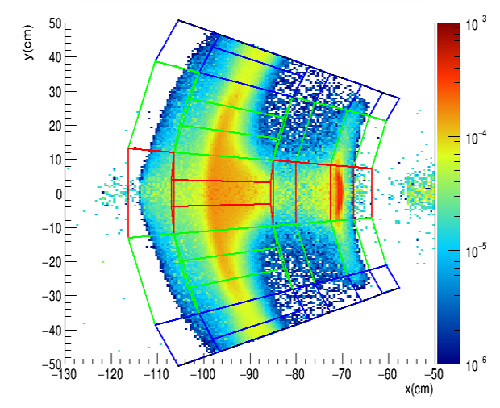
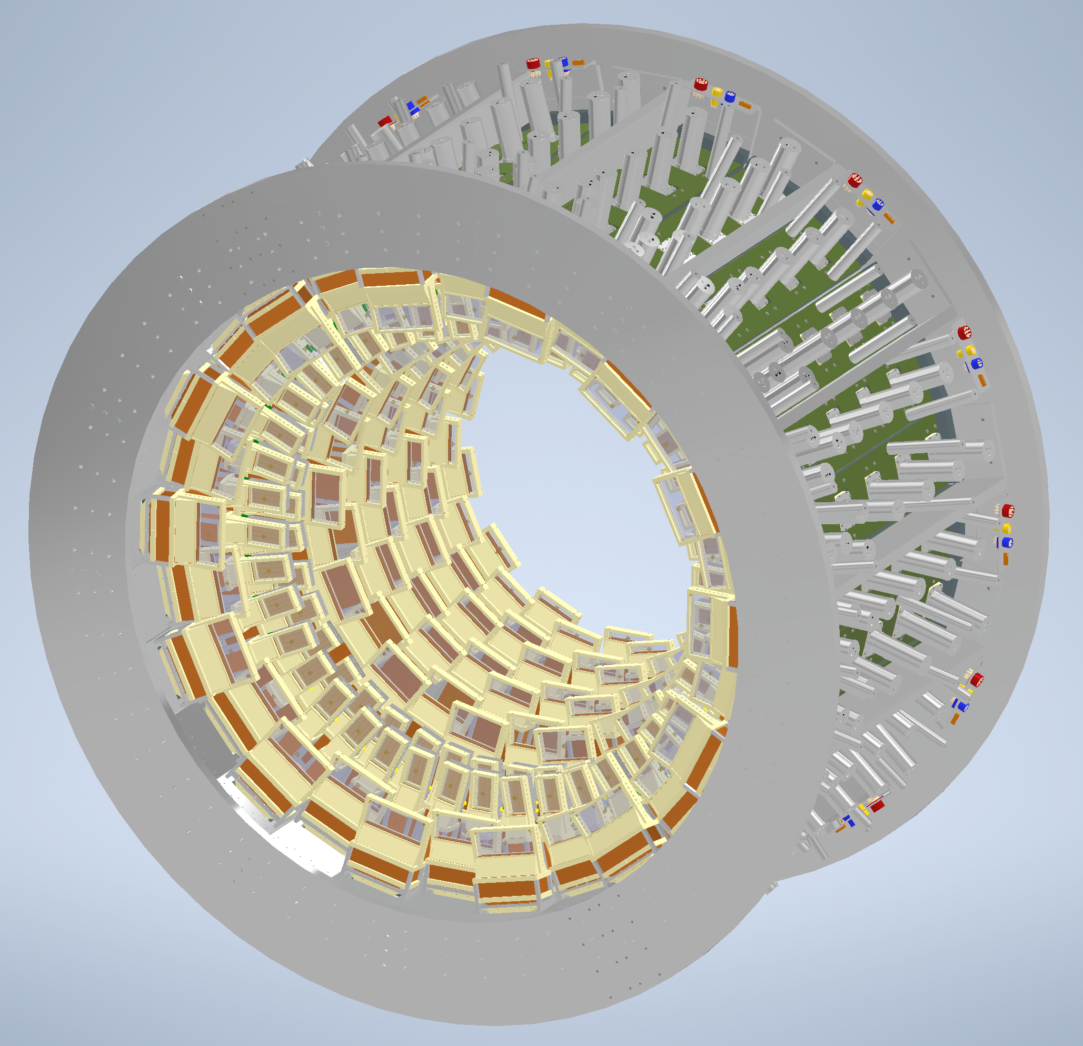
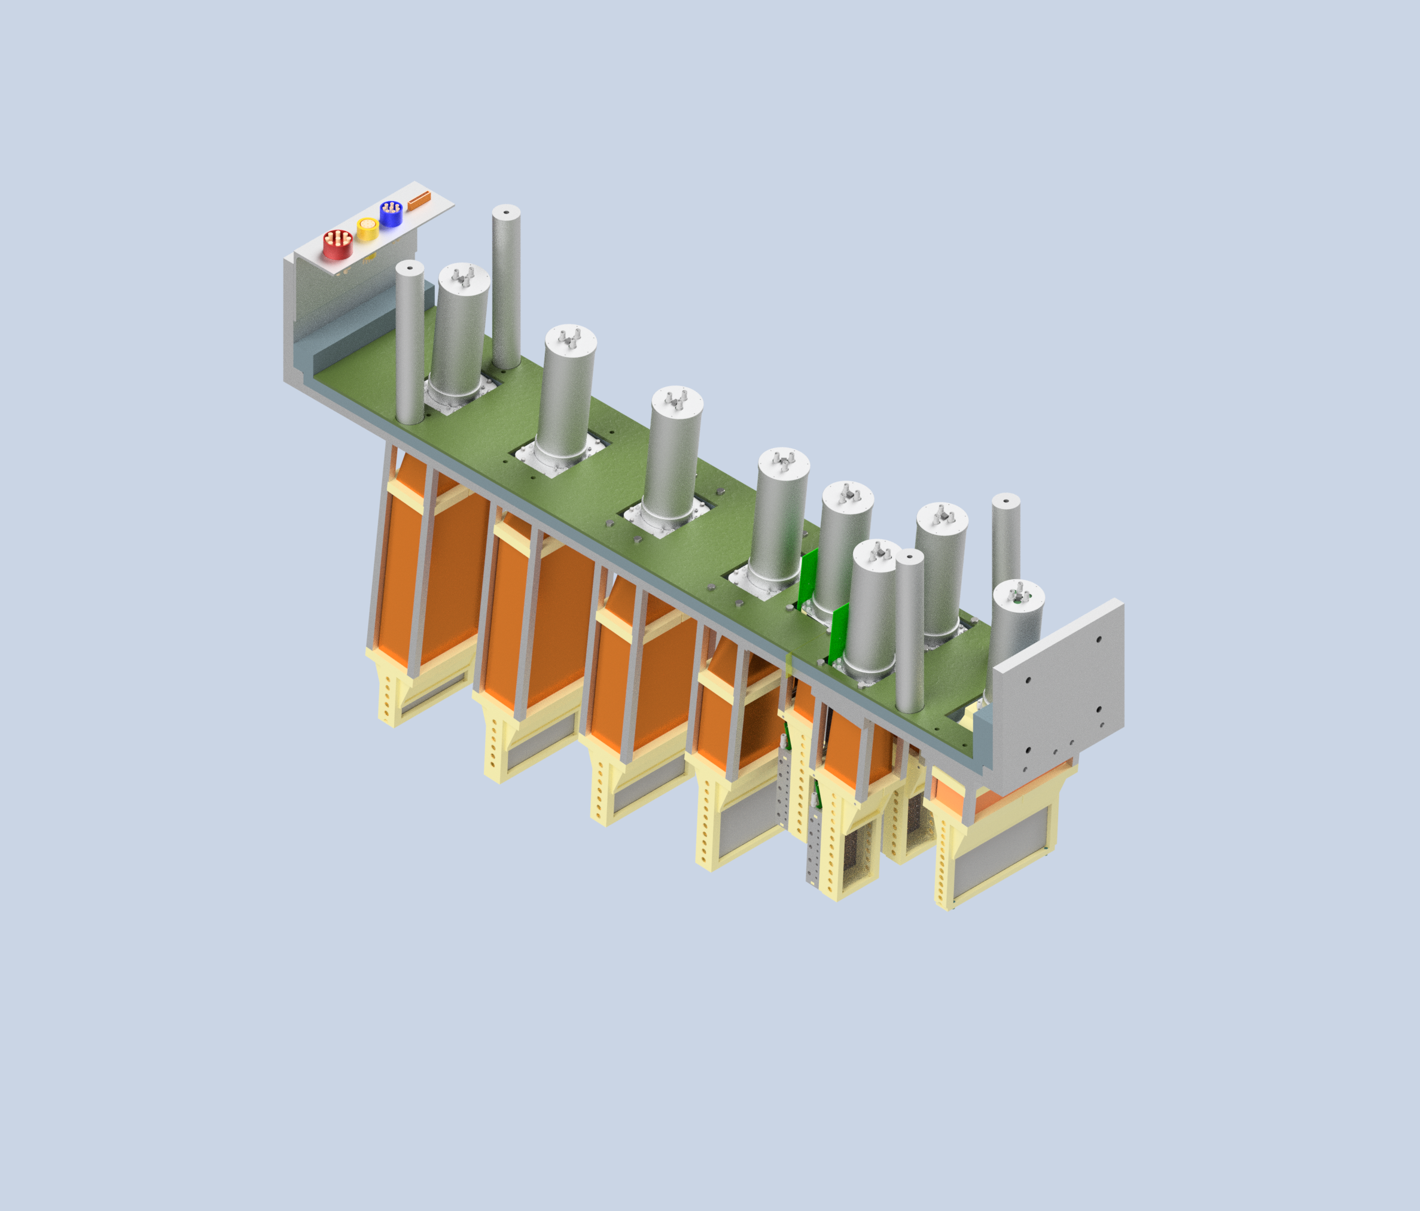
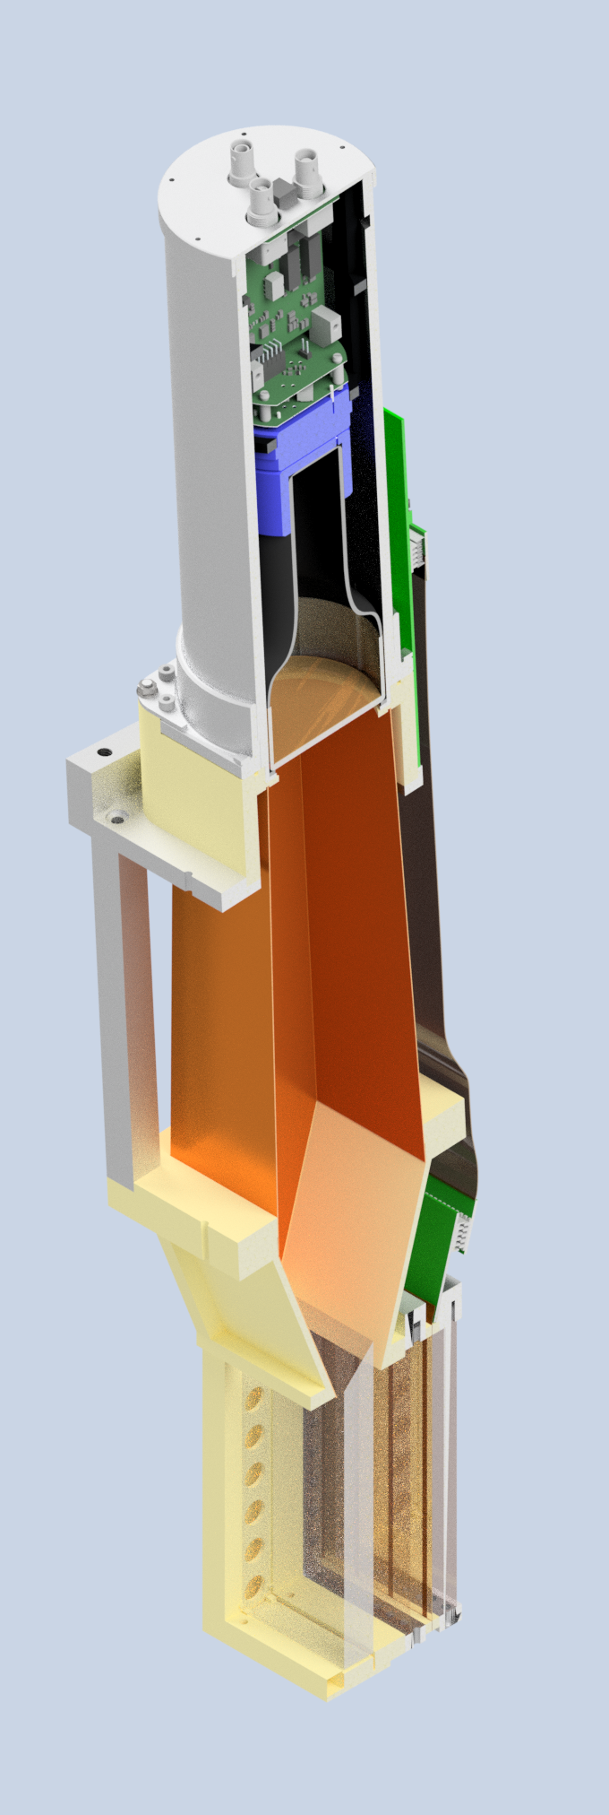
Detector Array Design
Proposed detector nomenclature and numbering:
  Septant
  Sector (open, transition, closed)
  Segment (one of 28)
  Module
Open
Transition
Closed

Slide 3

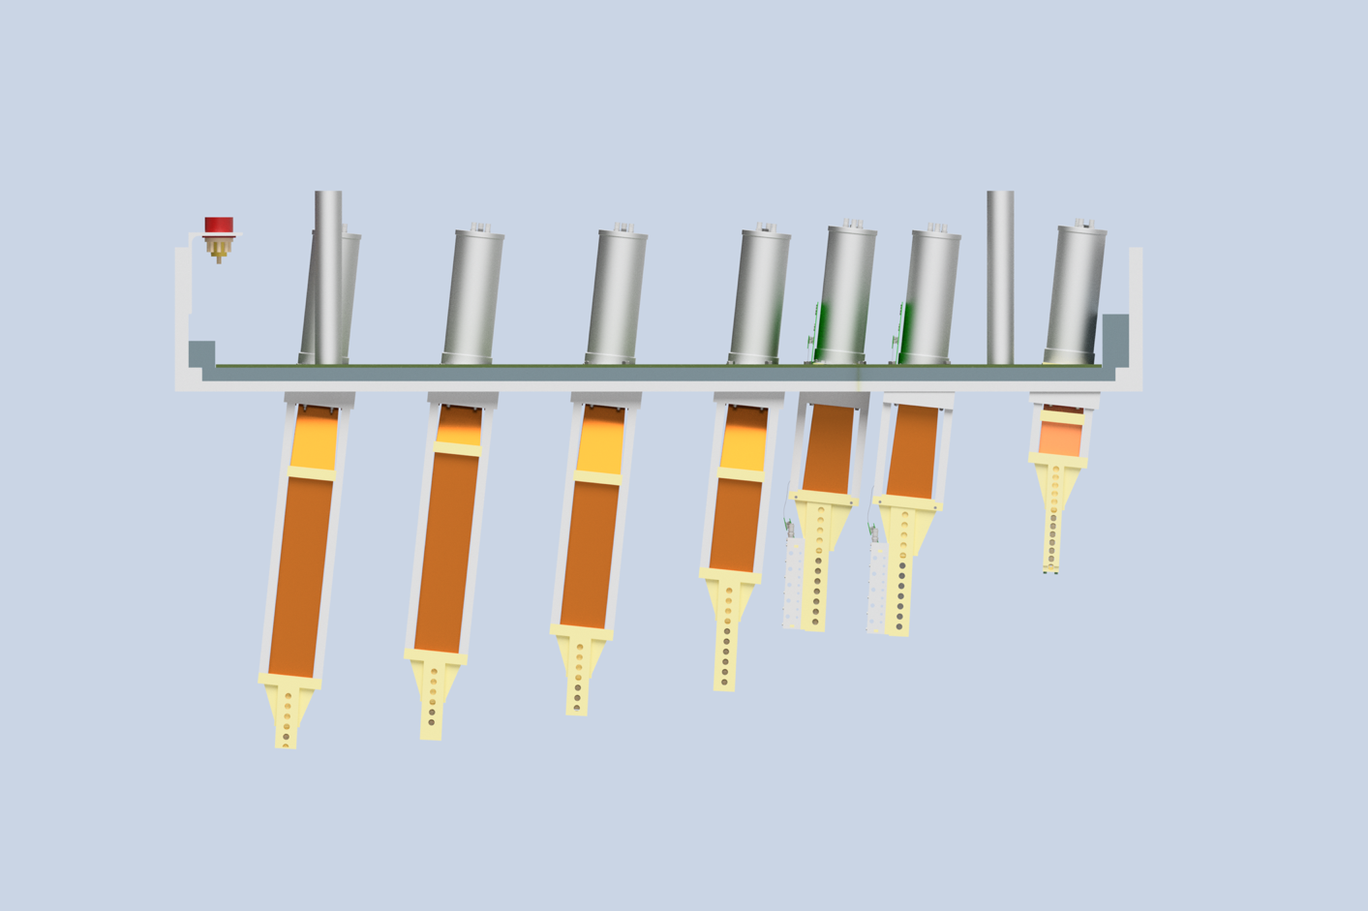
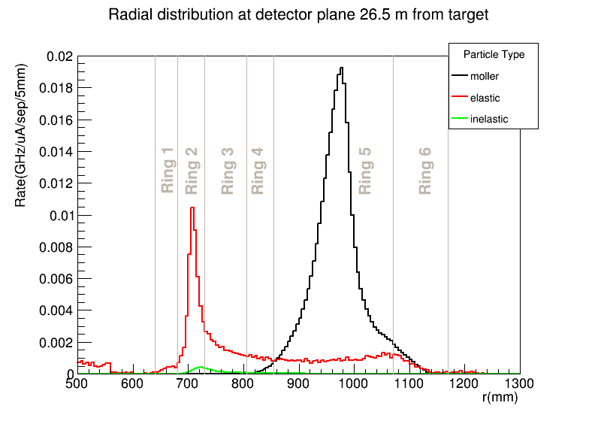

Requirements
Radial segmentation
  The detector array is separated into six rings:
    Ring 1- 4: $e+p→e+p$ and $e+p→e+X$
    Ring 5: $e+e→e+e$
    Ring 6: Radiative tail
Ring 6
Ring 5
Ring 4
Ring 3
Ring 2
Ring 1

Slide 4
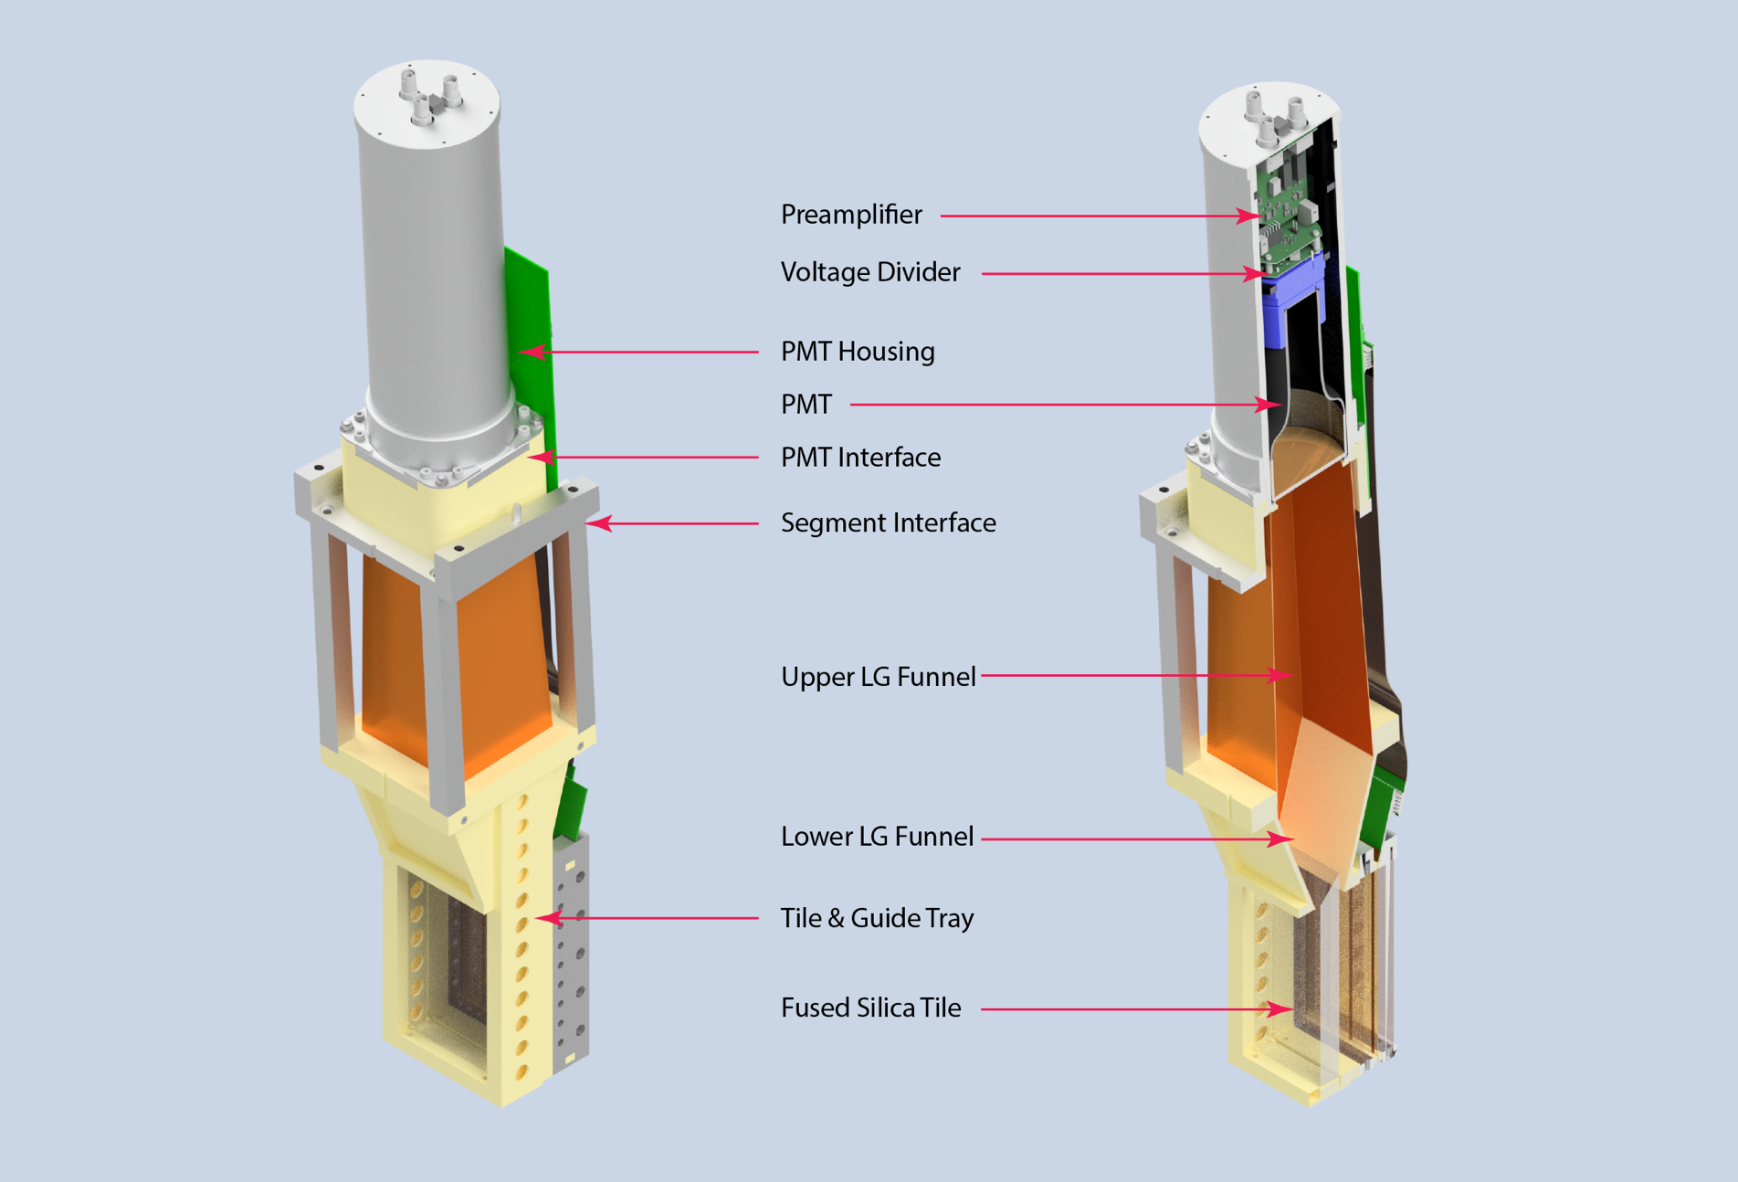
Overall Thin Detector Module Design
Module parts:
Fused silica active volume
Air core light guide
PMT
Front-end electronics
HVMAPS module
Rigid by light-weight structure
Shown here is ring 5 – the other rings have the same parts.

Slide 5
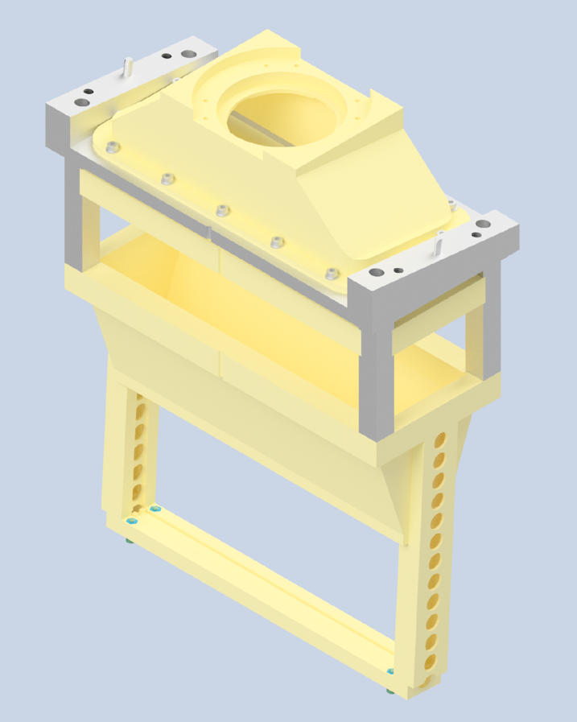
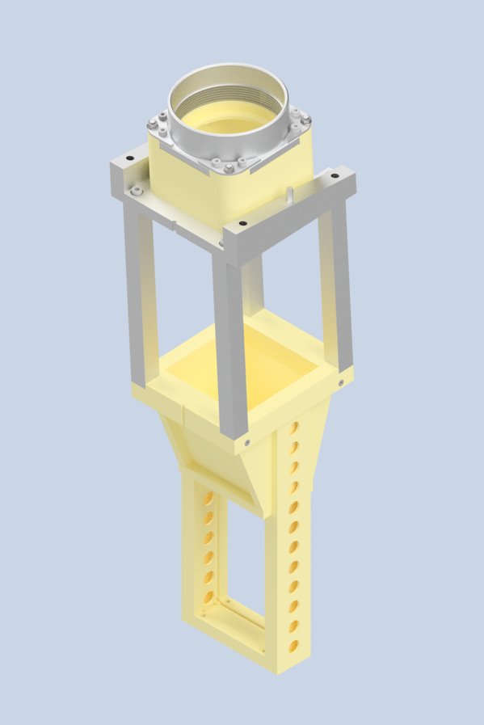
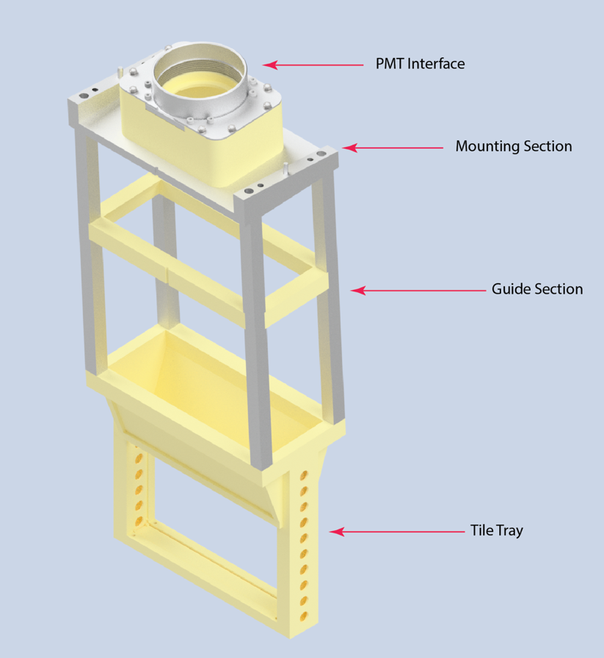
Module Mounting Structure Design
  For ring 5 several versions of the module mounting structure have been implemented in CAD and were constructed
  CAD design of the other rings is completed; rings 1-3 have same construction as ring 4 shown here
  Ring 6, 1, and 2 structures have been built
Ring 6
Ring 5
Ring 4

Slide 6
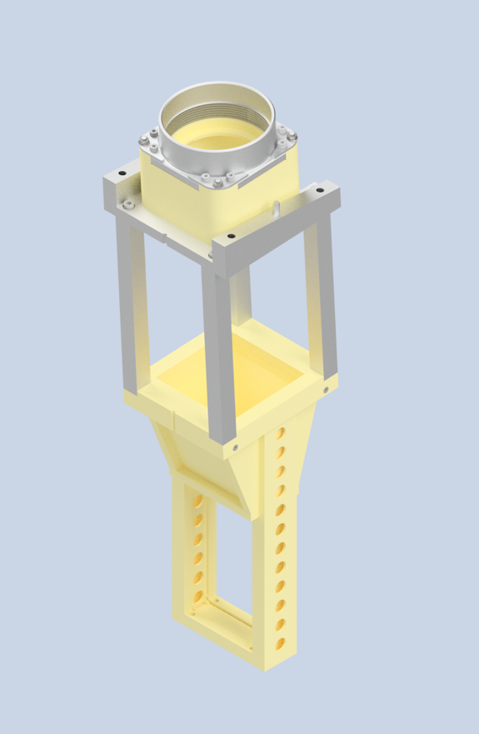
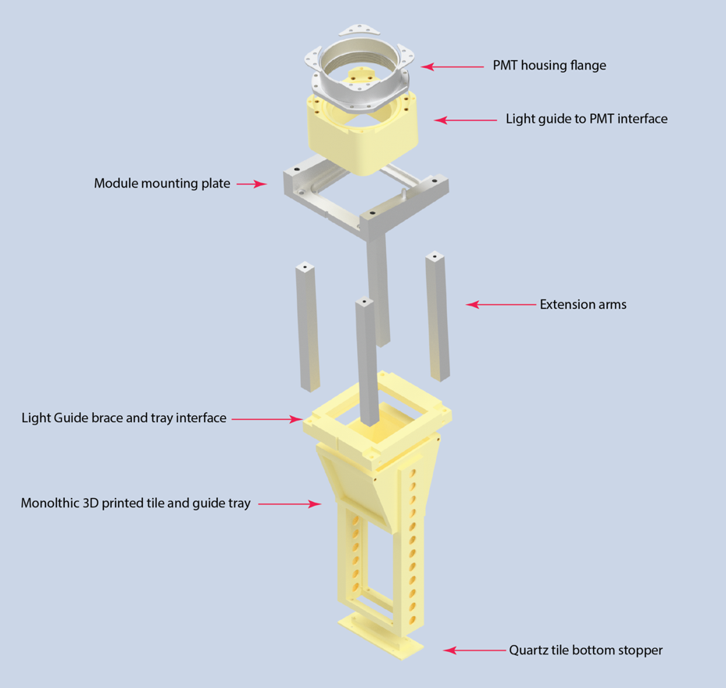
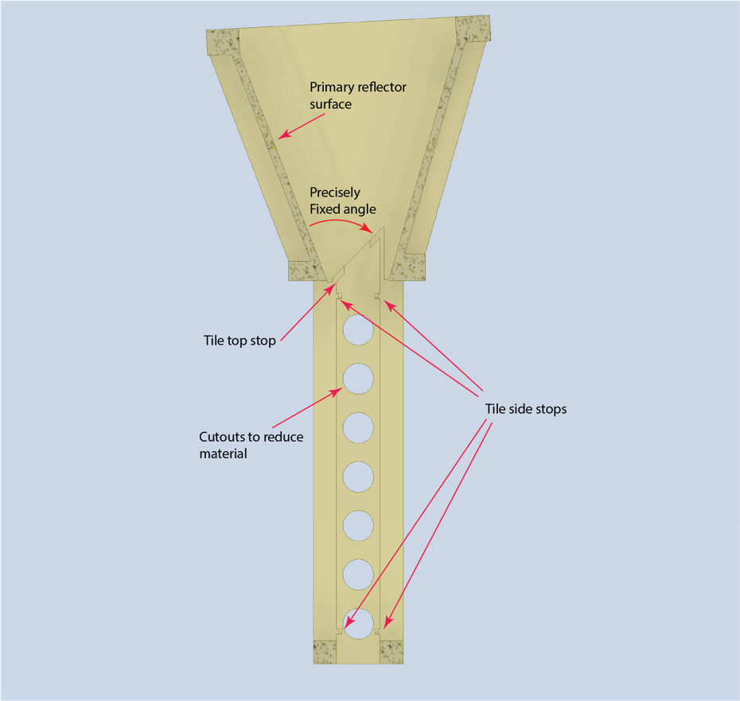
Module Mounting Structure Design
  The quartz tray (right) fixes the most important relationship in the design - the angle between the quartz tile and primary reflector.
  The middle section holds the light guide geometry defined and in place.
  The top section provides a secure and accurate interface with the PMT – easy attachment and removal

Slide 7
Main Detector Design Status:
  The detector tiling is nearly (~98%) finalized:
    The tiles are positioned and sized in accordance with the deconvolution/error analysis (Zuhal’s talk) and physical requirement
    Small tweak may be implemented (e.g. ring 1) to minimize cross-talk
    This means that the module/part sizes are final
  Module structure:
    See next slides and Brynne’s talk …
    Materials testing is progressing (radiation hardness and humidity) – carbon-fiber ABS seems material of choice
    Ring 1,2,5, and 6 modules were constructed for beam tests
    Ring 1 was tested for deflection (maximum cantilever)
    PMT housing redesign nearly finished (95%) – see Brynne’s talk
    Module cooling and air flushing simulations nearly completed (See Laheji’s talk)
  Mounting Structure and Cabling
    Mounting structure is nearly final (see Larry’s talk)
    Cabling planning in progess (See Dustin’s talk)

Slide 8
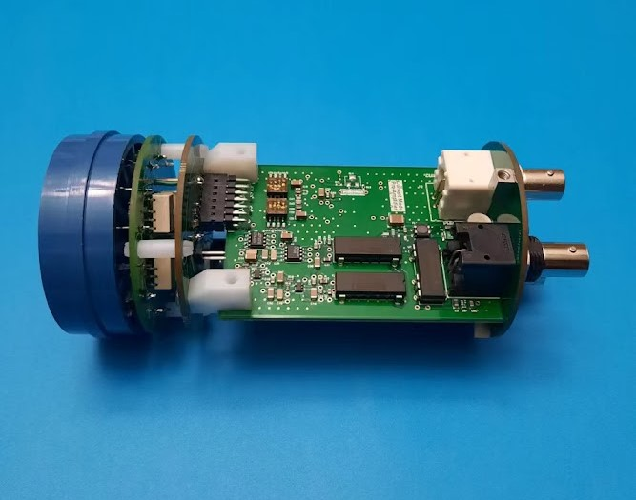
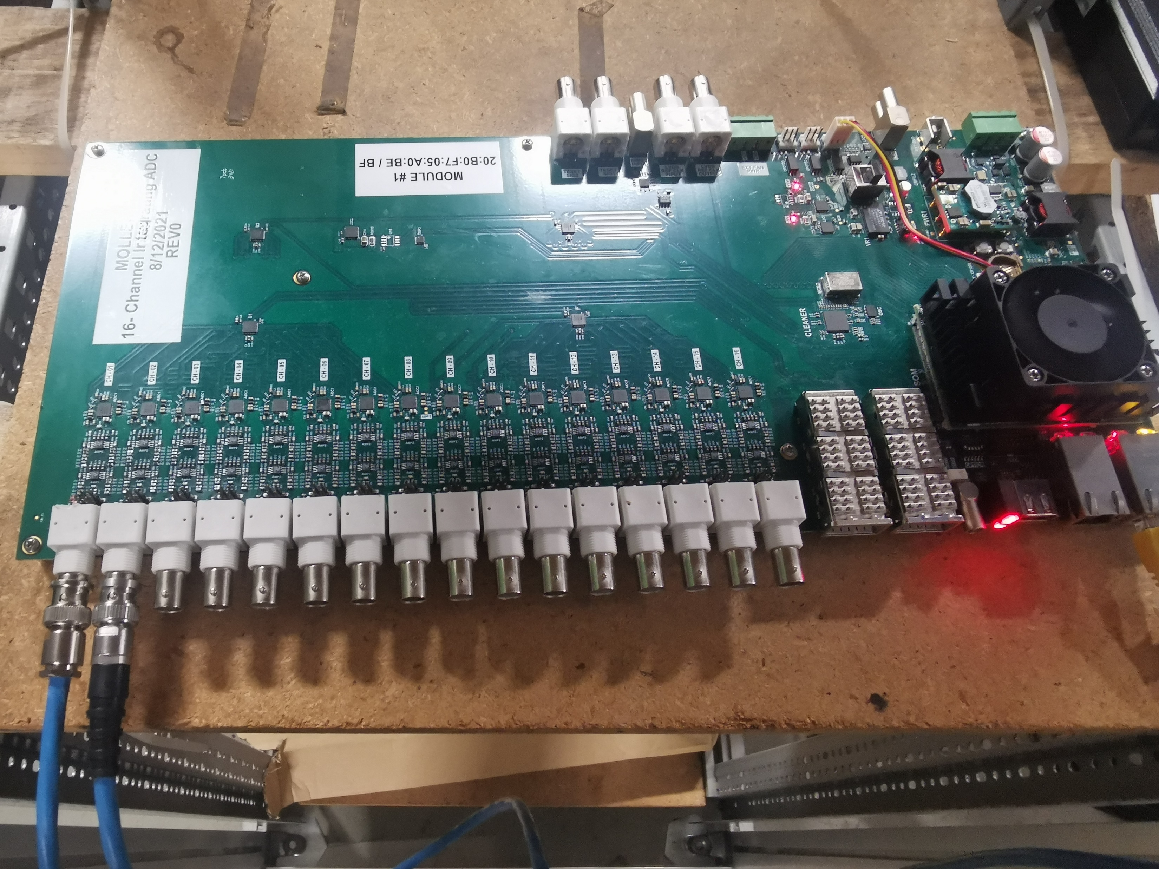
Main Detector Design Status:
  Front-end electronics (see Jie’s talk for details)
    Voltage divider design is complete – switching between event mode and integration mode included
    Event mode amplifier is undergoing small redesign to address high frequency noise
    Integration mode amplifier is undergoing DC/DC converter redesign to address radiation hardness concerns and improve power supply needs
    Power supply modules and cable needs have been identified (cables see Dustin’s talk)
  ADC board progress
    The ADC board is fully functional with Firmware running to take streaming data (firmware for helicity averages exists but is not currently read out)
    The board runs a full linux operating system and interfaces via fiber to the backend DAQ
    The TI interface has been tested and CODA has been implemented on the board SoC
    One more prototype needed to address minor issues of the front-end (filters etc.)

Slide 9
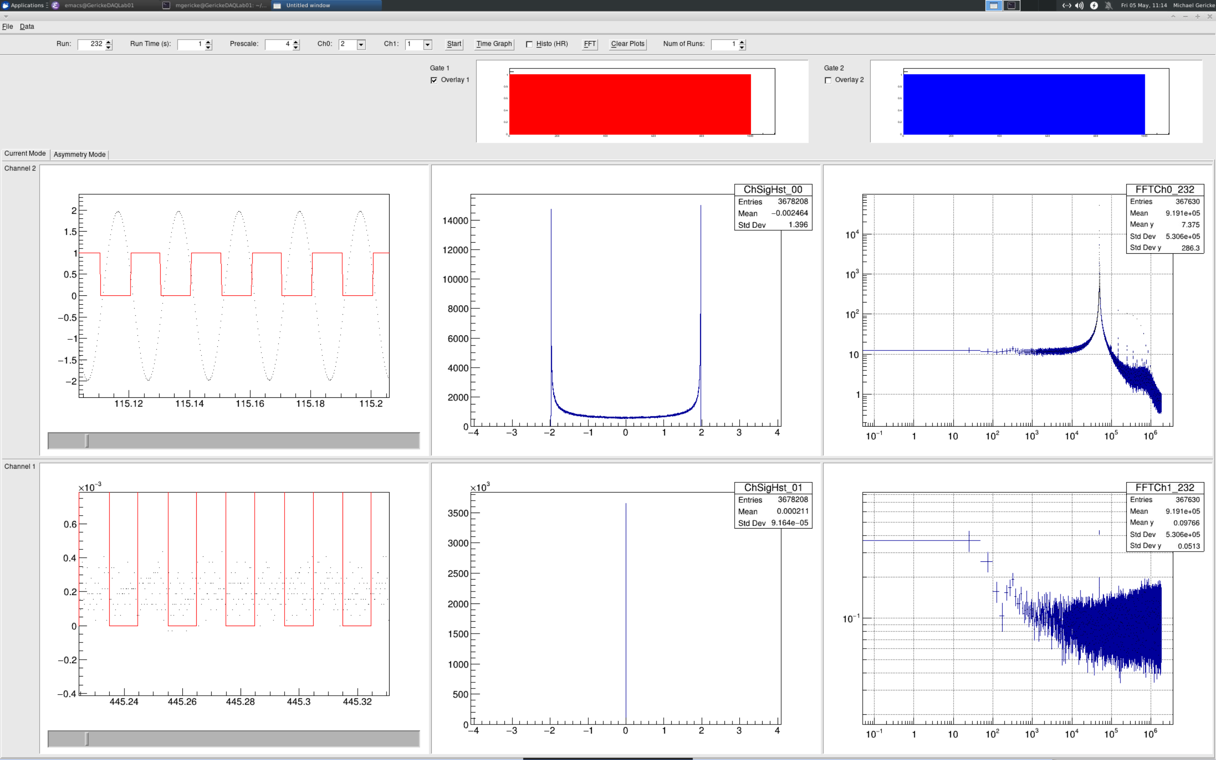
Main Detector Design Status:
  ADC board progress
    Readout software suitable for benchtop running and prototyping / Q&A testing of PMT electronics exists
    We have to take a second look at the front-end filter of the board to make sure that we have clean roll-off
    Presently a gate/trigger can be fed to the board via two lemo connectors at the back. Final trigger will come from the TI interface
We need a second prototype – to be done this summer

Slide 10
Remaining Design/Prototyping Tasks:
  Detector structure (all of these should be done by the end of the summer – most sooner):
    Minor tile position and size tweaks, based on tile overlap and deconvolution analysis
    Minor changes to the mounting structure (split the quartz tray structure)
    Light – tight sealing design (with air exit)
    Finishing the details of the PMT housing assembly
    Final choice of material for 3D printing (most likely carbon-fiber ABS, but need additional radiation tests of pieces exposed to various moisture levels)
    Final light guide material choice
    Verify final designs/prototypes in beam test and with cosmic rays
  Front-End Electronics
    Small changeout for the modified amplifiers (event mode and integration mode)
    Verify and implement changes to the ADC board front-end and build a second prototype
  Mounting Structure and Cabling
    Complete mounting structure and cabling infrastructure (again, see subsequent talks)

Slide 11
Equipment/Parts Purchase and Production Status/Schedule:
  Quartz tiles:
    Raw material suppliers have been identified (Heraeus, Corning) - either Heraeus for all tiles or only for the high-rate tiles and Corning for everything else
    Potential company to do the polish is has been identified – we are getting a number of tiles from the company (Corning now and shortly also Heraeus)
    We need one more beam (June 2023) test to make final decision on the polish quality – requested CFI to cover associated cost overrun and need to make a decision in June, before request goes to CFI board for approval.
    We foresee placing the full quartz order by early Fall 2023
  Mounting structure/ PMT housing:
    These will be in-house production at UManitoba and UMass with the possible exception of some of the aluminum parts that require high precision CNC
    Purchase of 7 new large production volume 3D printers is imminent – anticipate a full year of 3D printing effort split between UMass and UM
    Light-guide material will be a standard item purchase (generally available)
  PMT/Front-End Electronics
    The PMT order has been placed – we are scheduled to start receiving 20/month starting in July – to have final shipment sometime in early Fall 2024
    PCB production: many companies to choose from – we have several that we have been using for prototypes
    Chip level components – many with long lead times are on order (e.g. ADC chips) – or will be ordered shortly (amplifiers)
    ADC board FPGA modules are all on hand

Slide 12
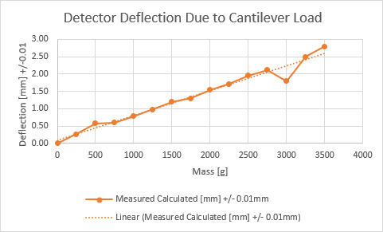
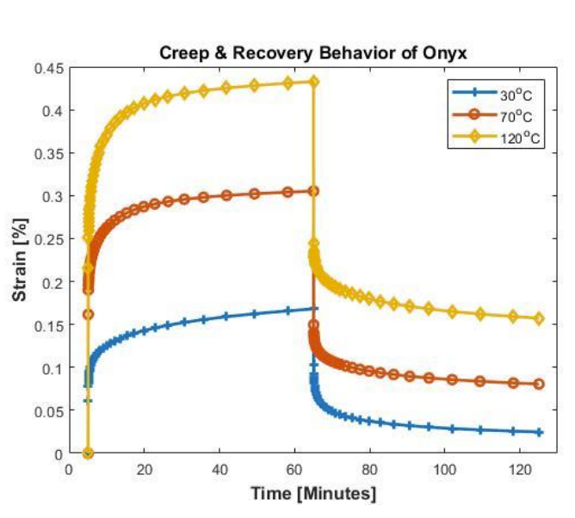
Quality Assurance Plans:
  Quartz tiles:
    Visual inspection
    We have access to a high-quality laser reflectometer we can use to spot check the quality of the received quartz tiles
  Mounting structure
    Visual and fit tests as we go along in the production
    Thinking about computerized vision with a high-resolution camera to verify dimensionality of items
    Strength/deformation/deflection tests (spot check – after assembly)
  Electronics
    Test bed exists from prototyping – establish a procedure to measure noise performance on the bench
    With the ADC board and the first PMTs in hand, we can test the electronics in a realistic setup (see also PMT test setup next slide below)
  PMTs
    Single PE rate and Gain tests
    QE measurements
    Linearity measurements (exercises the FE electronics chain)
Measured roughly 0.1 to 0.2mm increase in deflection over 6 days under its own weight. Never exceeded 0.5 mm

Slide 13
Quality Assurance Plans:
Slide from
Savino Longo

Slide 14
Assembly and Shipment:
  Module assembly will take place at UofM and UMass
  If everything goes well a partial number of modules can probably start to be shipped to W&M by June 2024
  Quartz tile shipment will likely continue throughout 2024, with the last ones arriving possibly as late as May 2025 (pessimistic view)
  UofM students to temporarily relocate to W&M to finalize assembly into the segments
  Suggest to wait with PMT module installation until segments arrive in Hall A
  In segment cable routing can be done before PMT installation

Slide 15
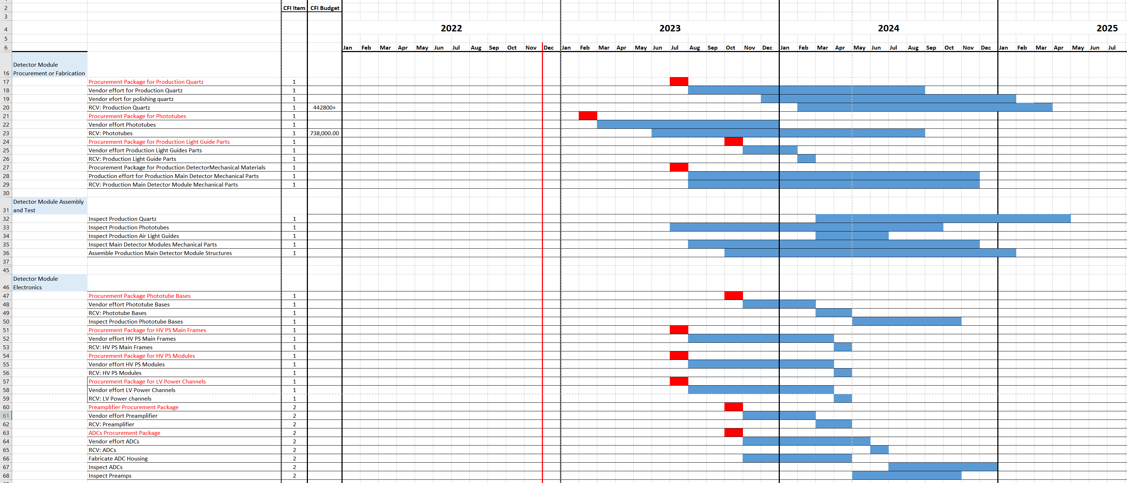
Reasonable Schedule:
  Segment and module test assembly will take place at UofM and UMass

