Slide 1
MOLLER – Collaboration Meeting
Spectrometer Engineering Highlights, Status and Downstream Torus System Prototyping
May 5-6, 2023
David Kashy – JLab Magnet Group
(+ Large Team)

Slide 2
Outline
Where were we at the last collaboration meeting (June 22)
Prototype Coil Fabrication
Prototype Coil Testing
Spectrometer Assembly Area
Prototype Test Results (limited)
Magnet Coil Alignment
Detector Window Prototyping
Material testing
Status of Analyses and Drawings
Summary
Team Members:
  L2 Manager, Control Account Manager
    Michael Dion, Jefferson Lab
  L2 Technical Lead
    David Kashy, Jefferson Lab
  L2 Physics Lead
    Juliette Mammei, University of Manitoba
  Technical contributors
    JLab Magnet Group Engineers and Designers
    JLab Survey Group
    Halls A, B, D Technicians
    JLab ME Group Engineers and Designers
    JLab Detector Support Group
    JLab Procurement Group
    JLab Machine Shop
    MOLLER Collaboration- Physicists, Post Docs and Students

Slide 3
Summary from June 2022 Collaboration meeting
How to apply and support proposed 3mm shield (Belly Plates) the inside surface of the coils is not clear (SOLVED – Master Bond EP33 Epoxy)
  Heat load is expected to be quite high (>10W) and needs to be provided ASAP (SOLVED Actual are lower ~1W each and FEA completed)
Prototyping effort has shown that “ideal” coils are not possible. We have not figured out in detail how accurately we can build or need to be able to “map the coil turns”. Even if we do have precise turn geometry how will we use that data to determine the proper coil alignment (4 coils received, Coil quality improved during the run with last two being quite good. Width is excellent and understanding of inner conductor position is very good) (Sandesh will give more info)
Need to complete the System Requirement Document (SRD) (Goal was 6/30 not late yet!) (Completed, but needs continuous updates)
Need to complete the Interface Control Document’s (ICD) (Goal was 6/30 not late yet!) (Completed)
Hall A Beam Dump inlet Pipe (SAM pipe is connected) (SOLVED and ALL drawing complete)
  Have a potential solution for supporting the ~4000lbs vacuum load
  Located in a Radiologically Contaminated area and thus working there requires Rad II work
Design/Engineering Team is much larger than last year ( This made a huge impact and team size is now shrinking as work is being completed)
Progress on all topics (More on status later)
Getting all components to 90% level by late fall 2022 will be a challenge (But we did it and passed our FDR reviews and CD3a in January)

Slide 4
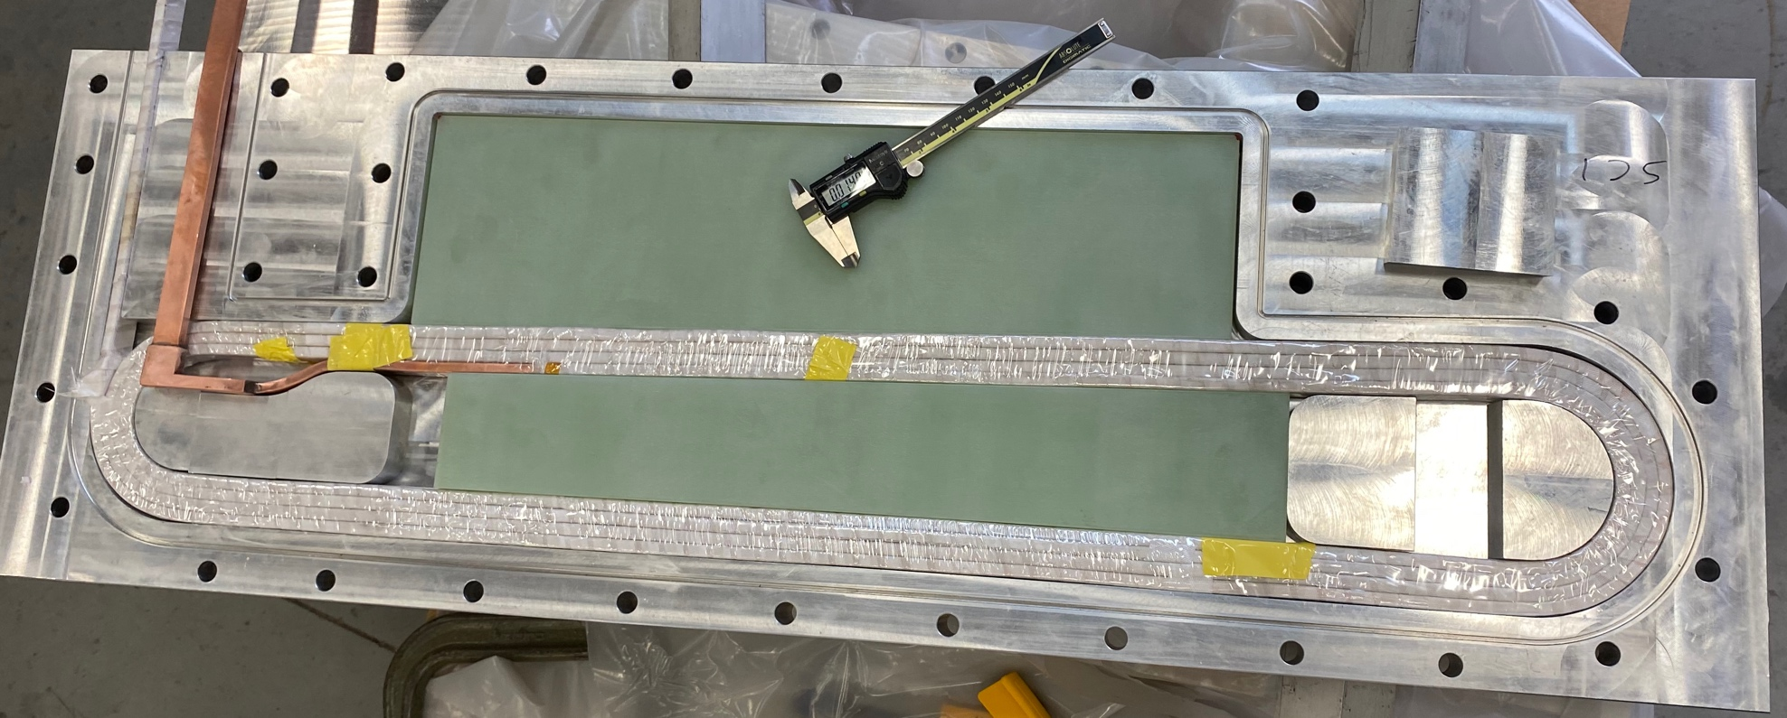
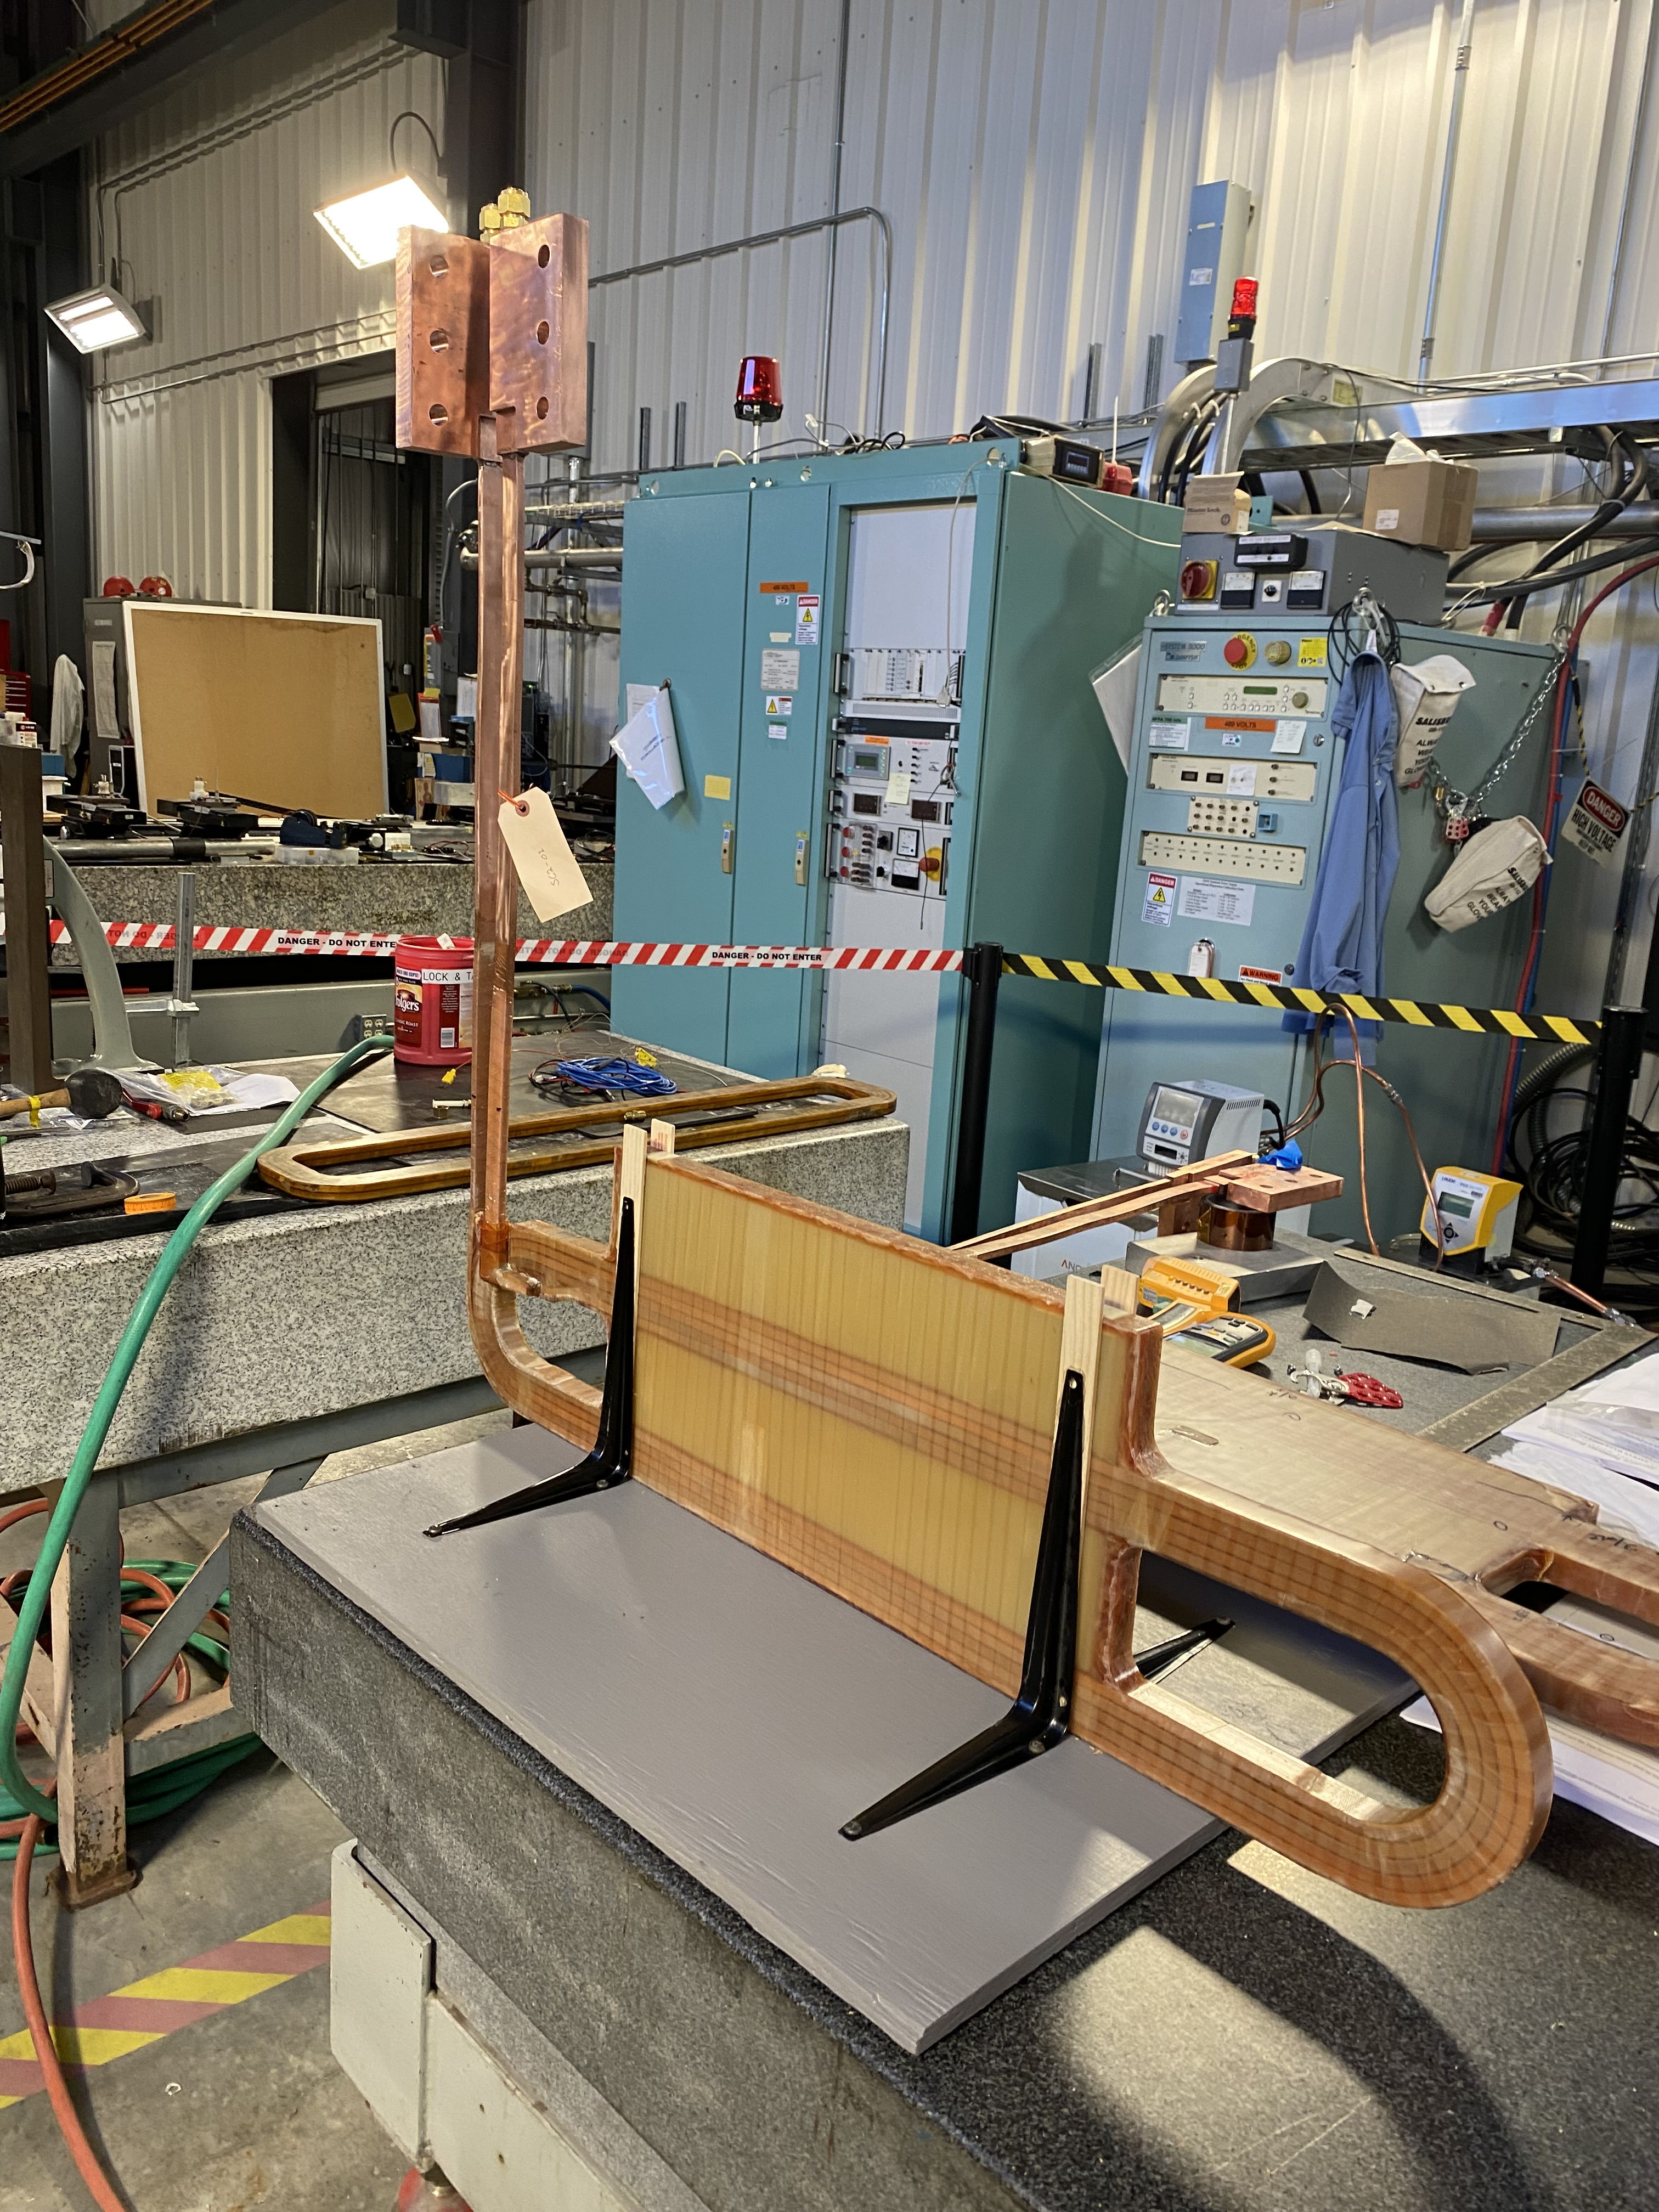
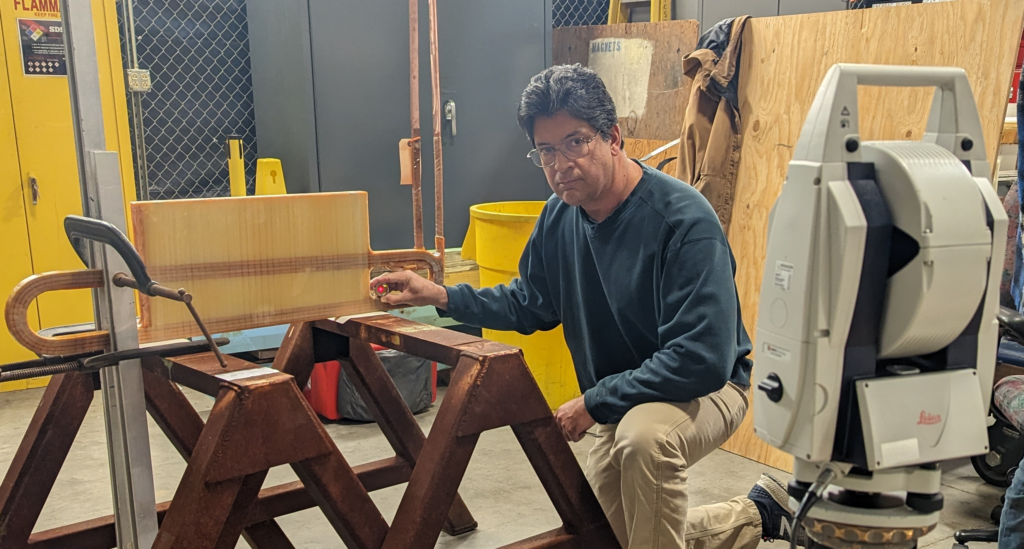
Prototyping - Coil Fabrication
Coils are single pancake (SC1, 2, 3) or double pancake (SC4)
Coldest turn on the outside
G10 filler blocks in “window” and outside
S-Glass used for construction
CTD403 Cyanate Ester resin
Very little key-stoning of conductor due to ample bend radii (min 3-5x of conductor height)
One layer of 0.25mm of S glass on outer surface of coil sides to effectively center turns to avoid shift due to key-stoning
SC1 initial test fit in Mold – Minor tweak in G10 was needed
SC2-01: At JLab in Magnet Lab
SC1-01: At JLab being surveyed on 12/9/22

Slide 5
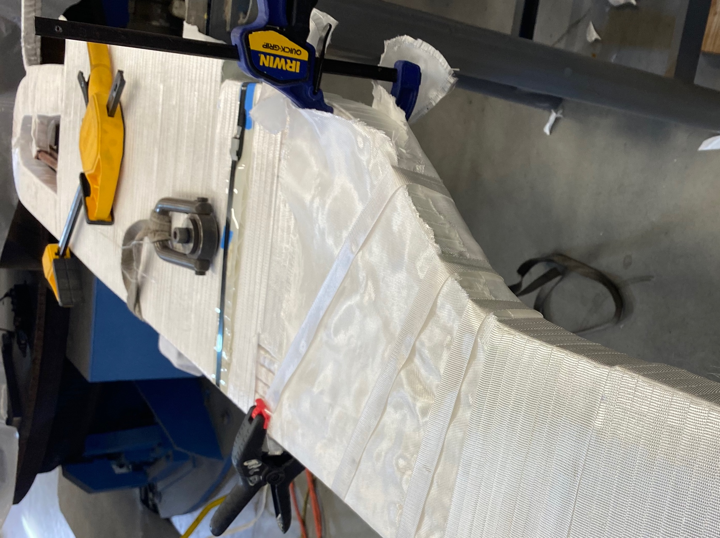
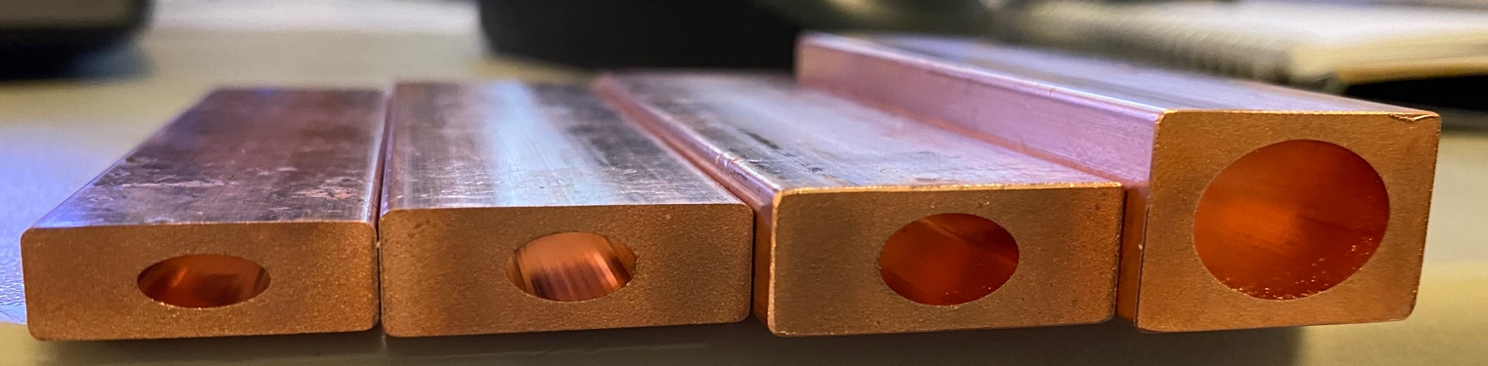
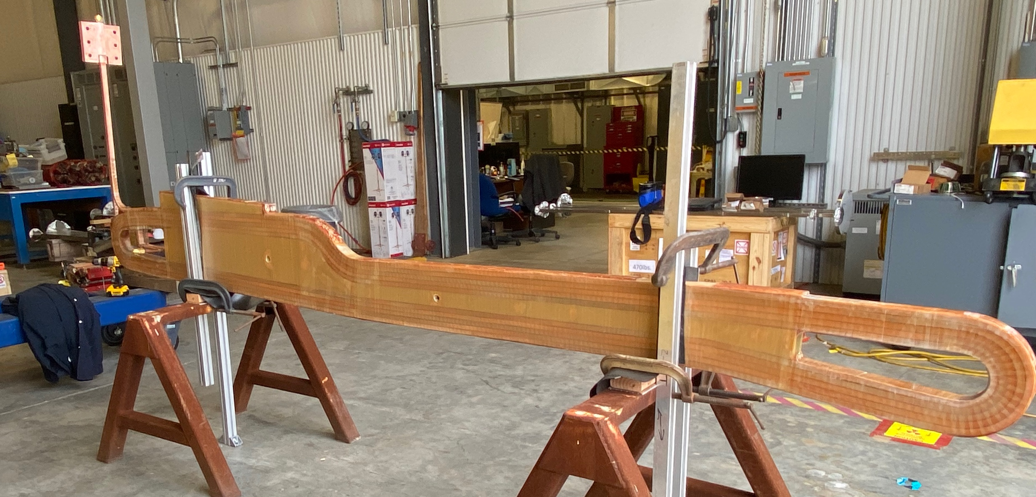
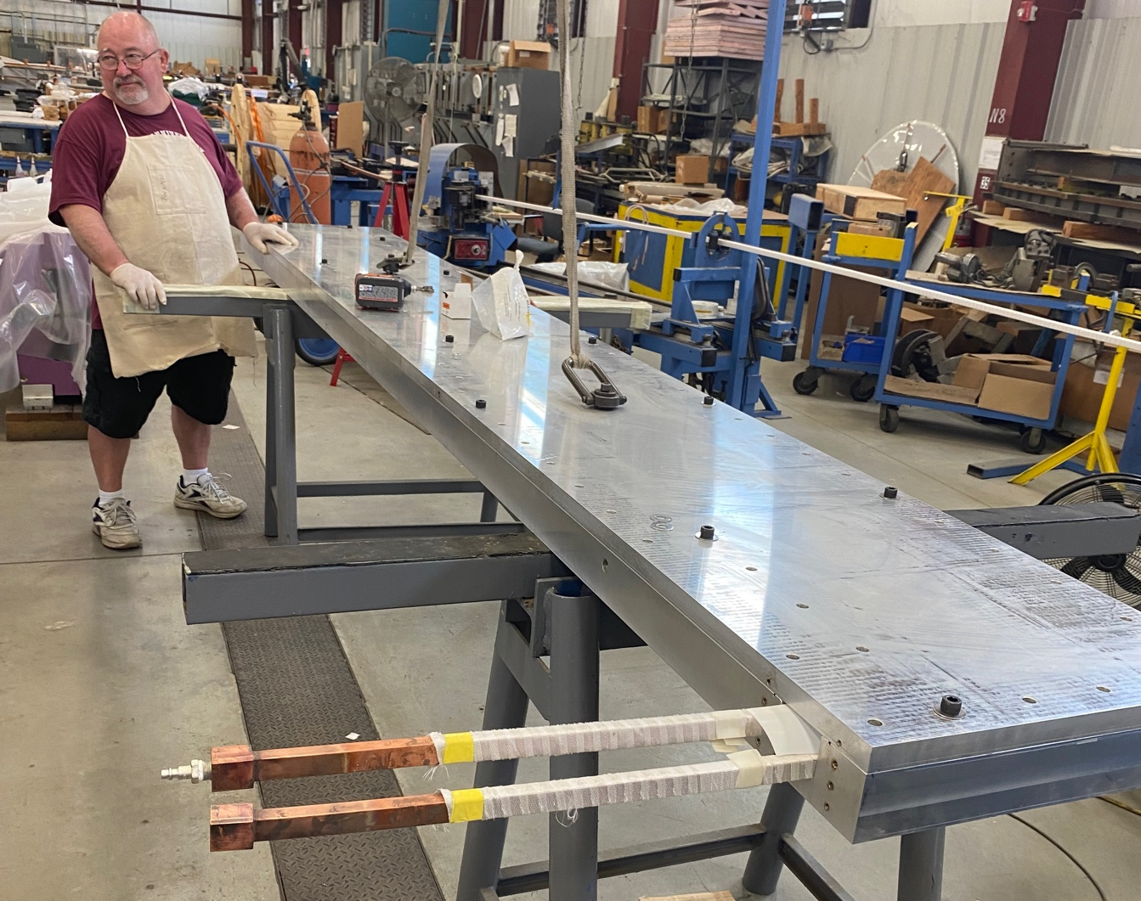
Prototyping – Coil Fabrication
SC4 With final Ground Wrap
Coil designs all based custom conductors
Conductors optimized to reduce max temperature f(Q, Ac, L)
Two of 4 prototype coils completed SC3 and SC4 by vendor (ETI)
Conductor clean, dimensionally accurate
SC4 at JLab as setup for Survey
SC4 at ETI in Potting Mold

Slide 6
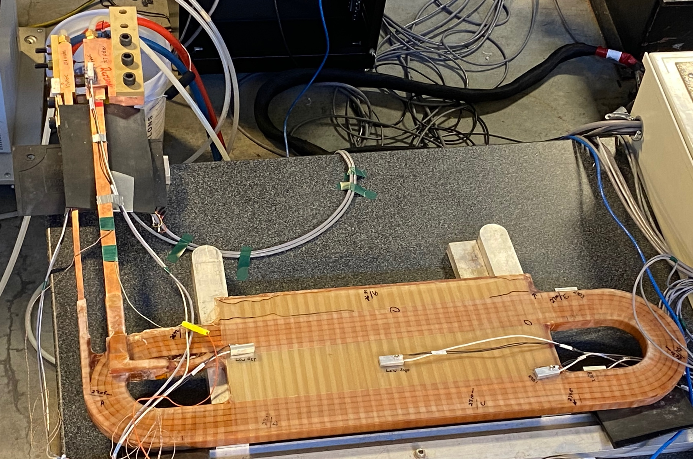
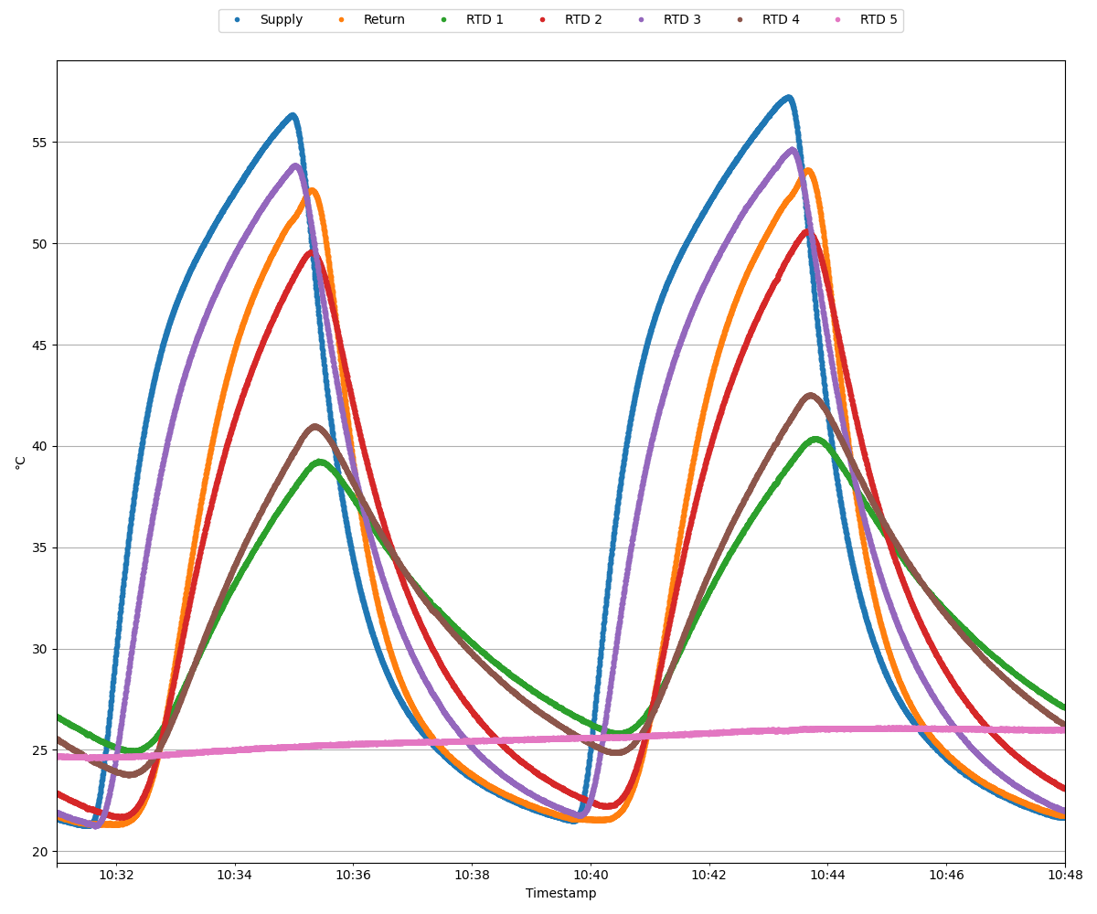
Prototyping - Coil Testing and QA
Coils Pressure, Leak and Flow tested, Resistance and Inductance, Hi-Potted and Ring tested at ETI, JLab confirmed all but Leak and Ring tests
  Nearly identical results
SC3 and SC2 coil thermal cycled rather quickly (9 minutes round trip) approximately 70 times at JLab using 2 chillers in heating mode with cold tap water to re-cool
IN
OUT
3
2
4
OUT
55
~9 Minutes
IN
5
1
T (Cº)
3
4
5
20
1
2

Slide 7
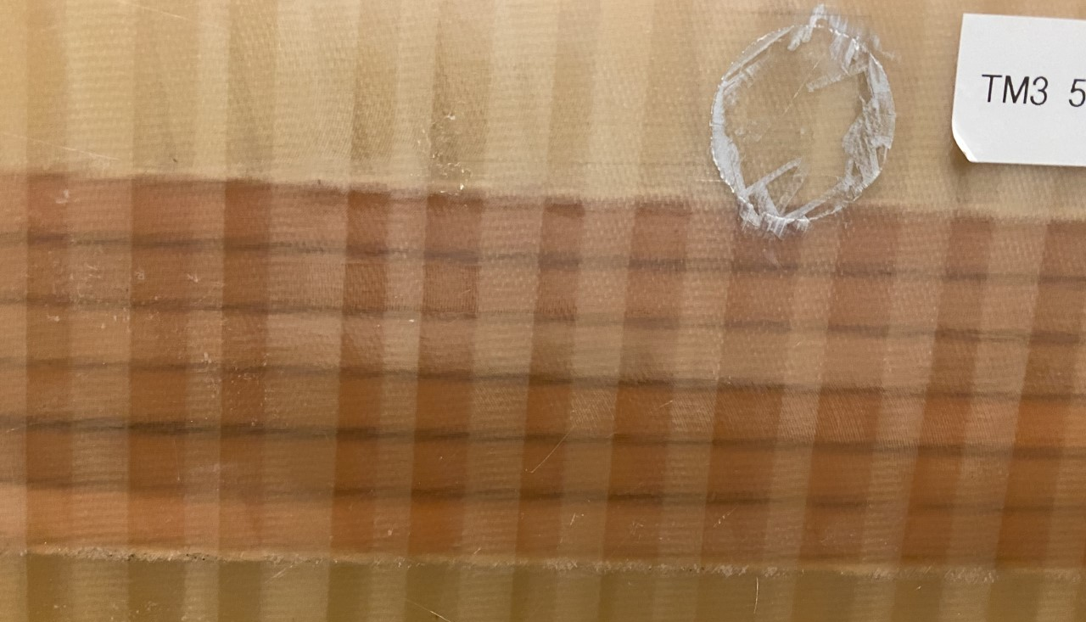
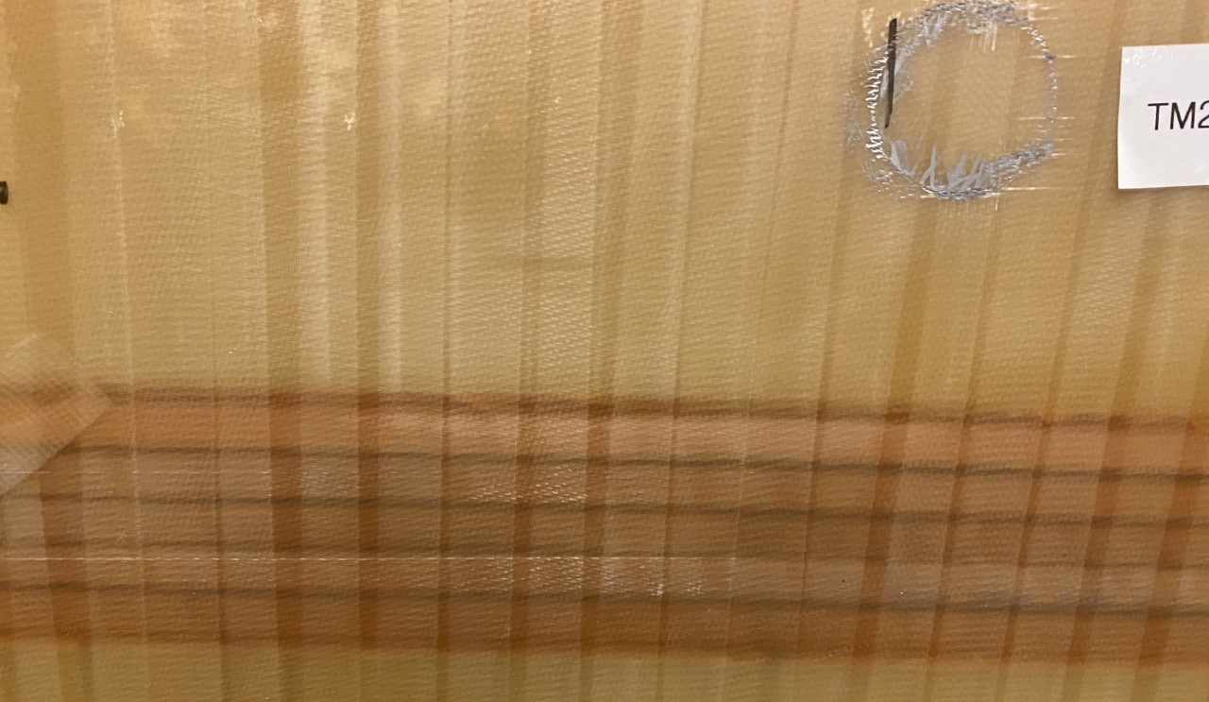
Coil Prototyping - Continued
Topic | TM3 – SC2 coil | TM2 – SC2 coil
Winding | Multiple areas with too much glass tape | Very little excess glass tape
G10 Parts | Less sanding and 1mm corner bevels | More coarse sanding and 3.2mm corner bevels
De-bonding during Molding Cooldown | Some | None
Debonding during thermal cycling 20-60C | Nearly everywhere | None

Slide 8
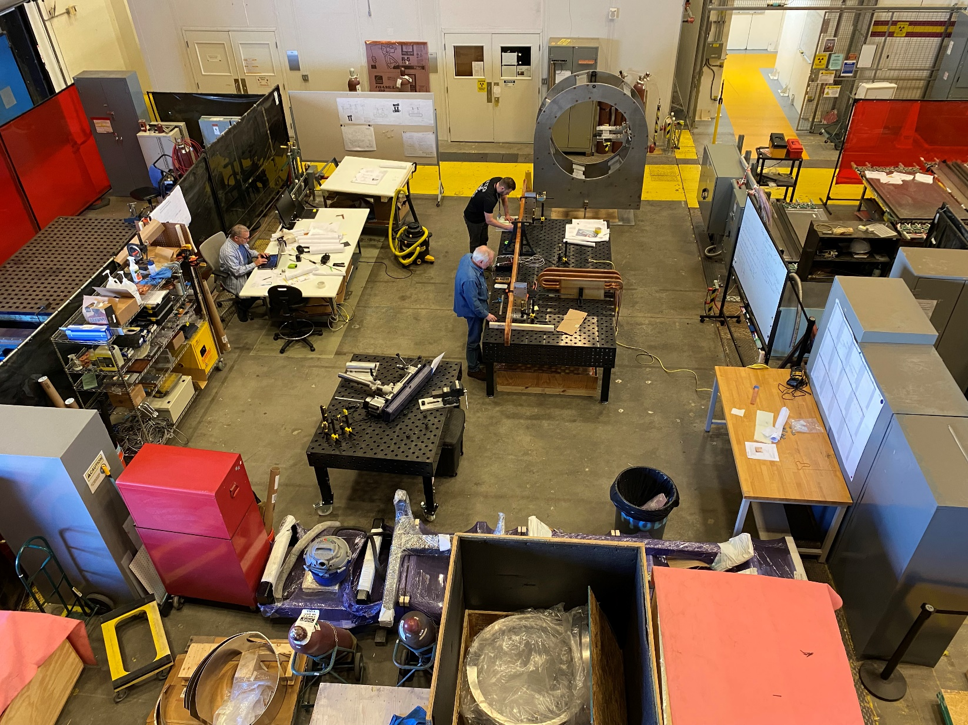
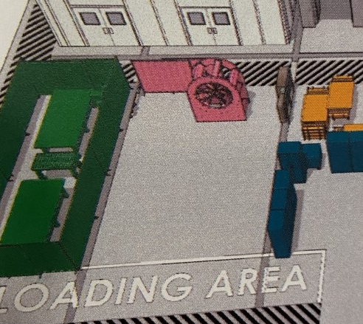
Spectrometer Assembly Area – Test Lab High Bay North End
Visitors Welcome – Stop by – But Keep Hands OFF

Slide 9
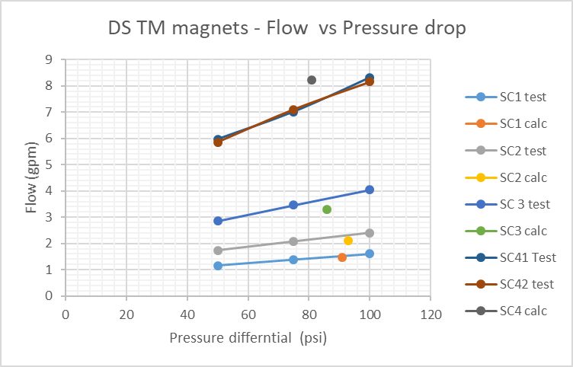
Coil Prototyping – Some Test Results
Main reason to prototype was to verify that the designs developed would meet MOLLER’s requirements:
  Coils could pass flow needed to cool them
  Coil potting would result in no dry (resin free) areas
  Coil bonding would withstand cool down with multiple different materials in the structure
  Withstand thermal cycling
Also to assure:
  Geometry will be repeatable
  Understand how to measure conductor placement (Sandesh will be telling more)
  Develop survey techniques and understand detail geometry
Sub coils 1-3 pass sligthtly more flow than calculated
Subcoil 4 passes slightly less flow than calculated
At 100 psid the flow to TM4 coils will match the design

Slide 10
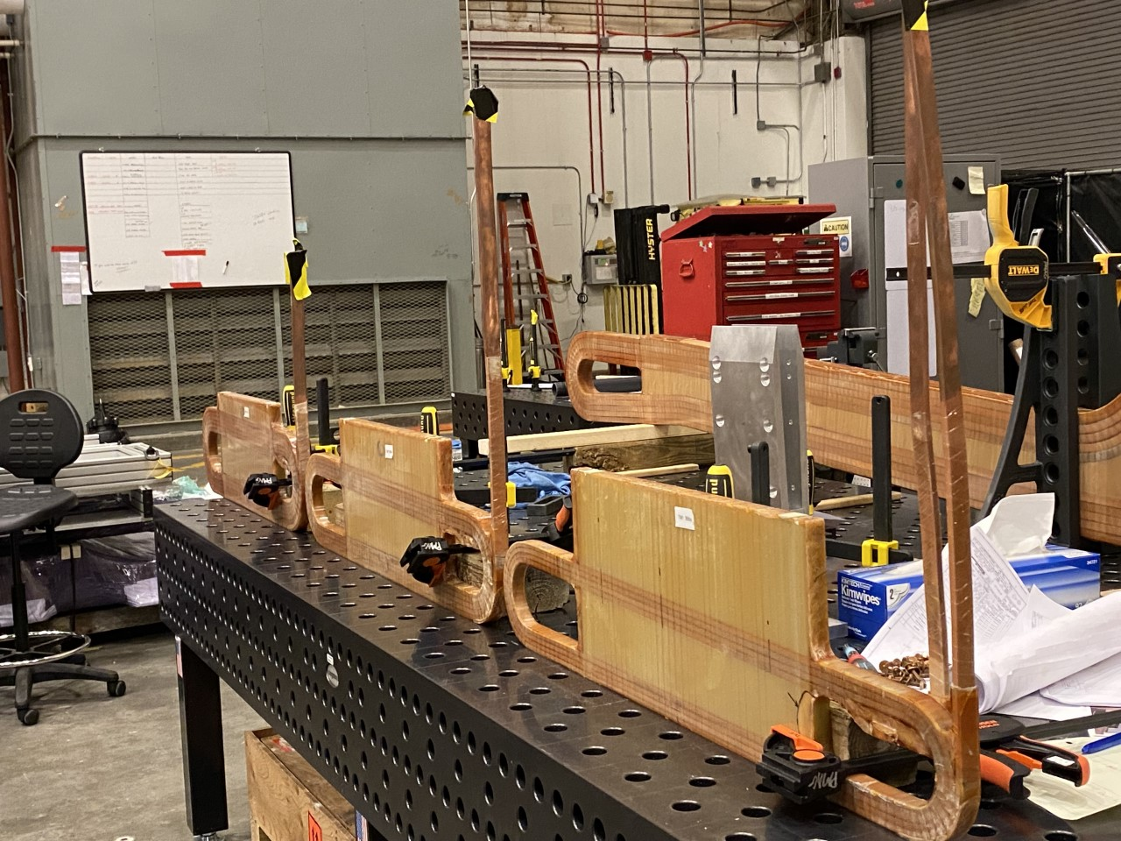
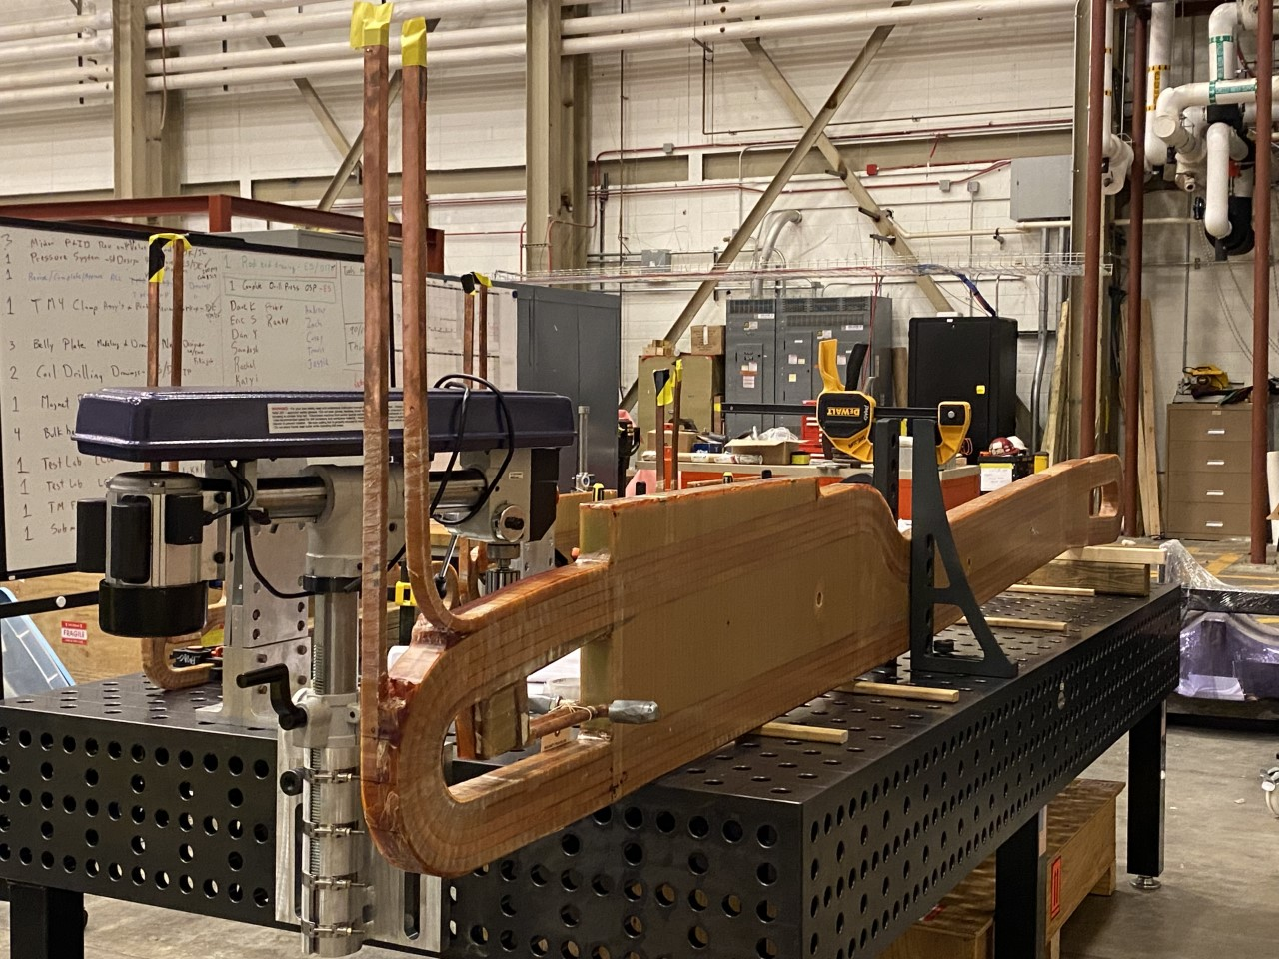
DS Coils in MOLLER Assembly Area
Full Report on Prototype Coils written and approved
  PMAG0000-0100-R0035
3 batches of coils went through production
  SC3 first
  SC4 next
  SC1 and SC2 last
Coil got continuously better in each batch
Lots of lessons learned and productions coils are expected to be quite good and meet MOLLER requirements

Slide 11
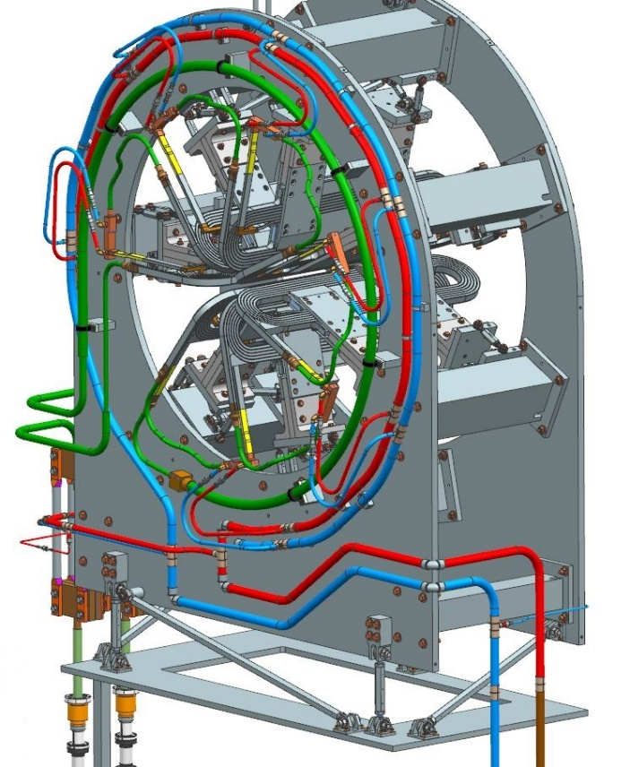
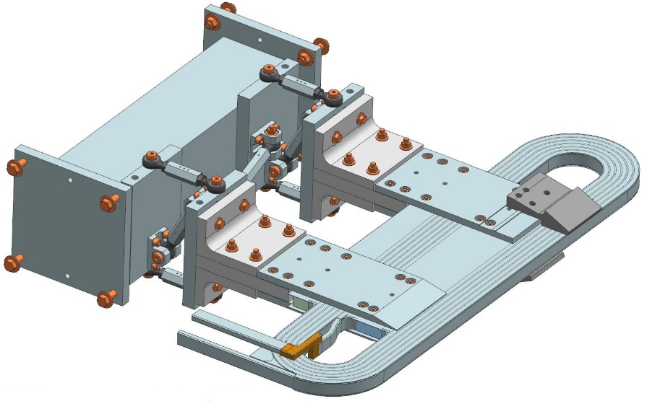
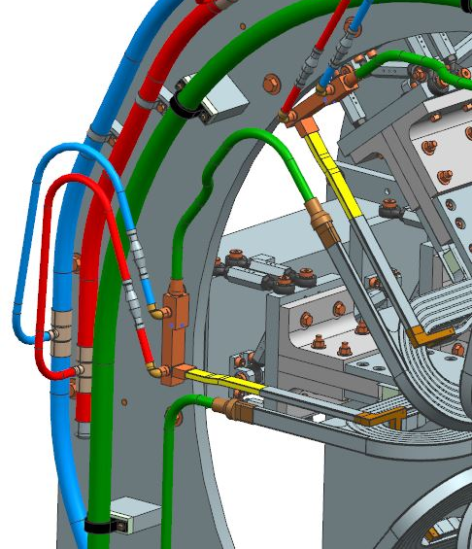
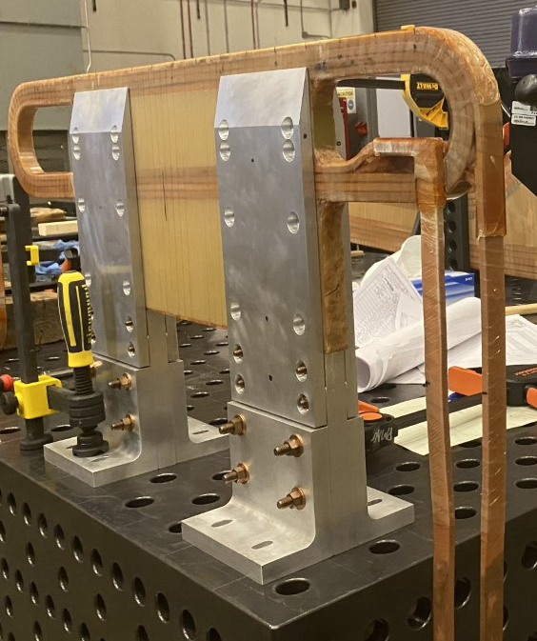
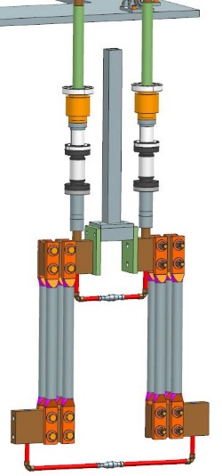
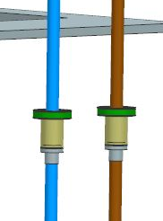
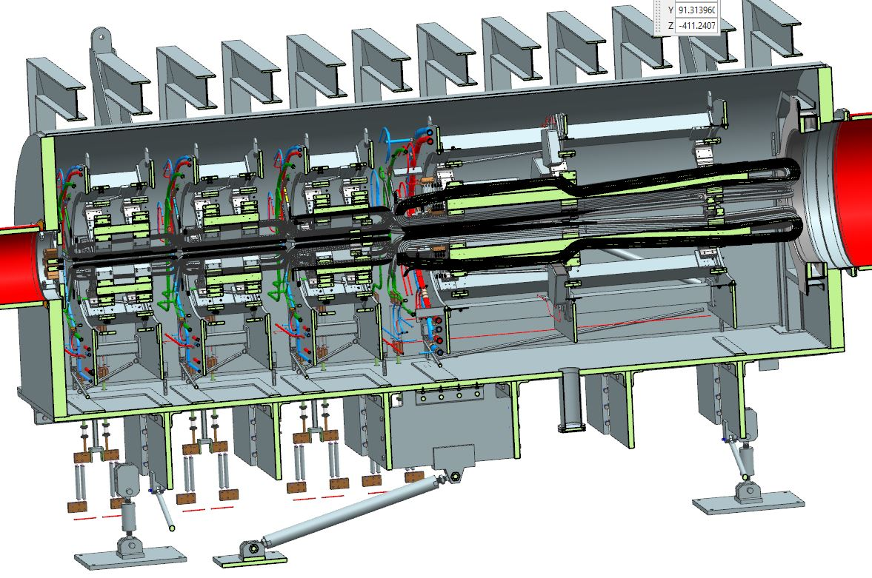
DS Magnet System
Torus Magnet Details
4 Torus Magnets magnets with many common parts made design simpler and reduced the quantity of different parts
All magnets designed to run at 100psid at max operating current
Coil, Clamps and Adjusters
Most parts identical for all 4 TM’s
Coil Water and Current Headers – 2 sizes
DP of headers 3-19 psid
DP of current Jumper 0.3-2.2psid
Magnet Assembly
TM1 – TM3 nearly identical
TM4 longer and wider
ACTUAL TM 1 in clamps
Current Leads x 4 sets – 1 size
Power dissipated 0.4 to 1.0kW (each)
Downstream Torus Assembly
Water Feeds x 4 sets – 2 sizes
1” CWT – TM1-TM4
2” CWT: TM4

Slide 12
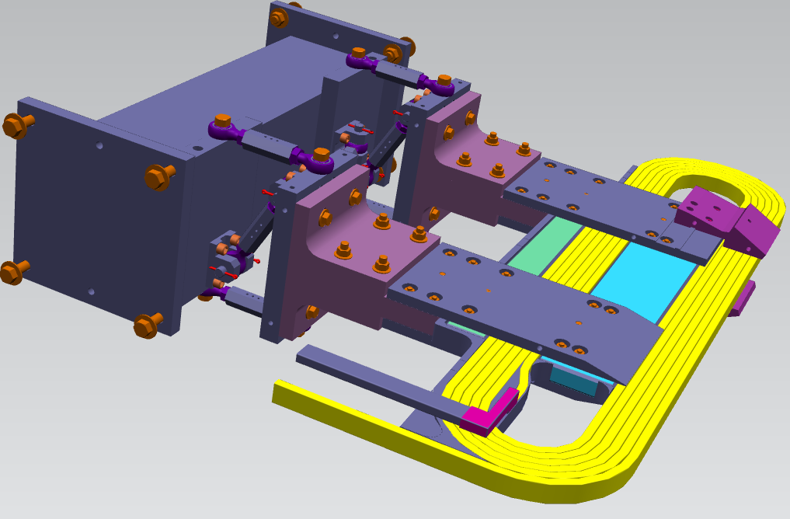
Magnet Coil Alignment
Fudicials will be put on:
  Collimator parts
  Clamp parts
  Coil ends (not in model yet)
  Once mounted and pinned the coils will be fiducialized by the Survey Group
Stick “Micrometers” will be used during magnet assembly to reduce survey time and cost
Tooling ball holes

Slide 13
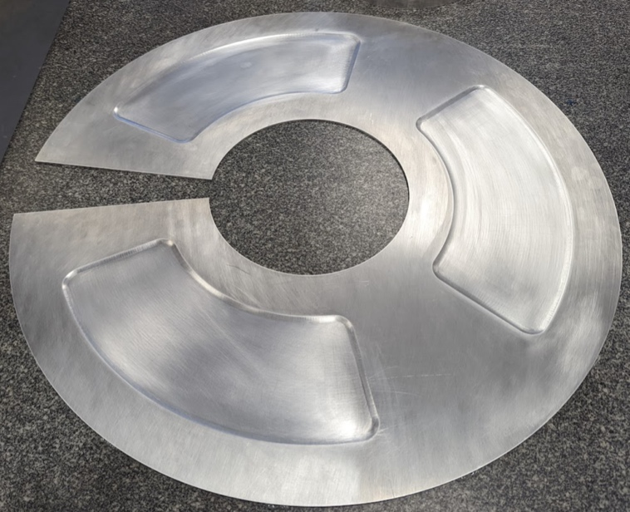
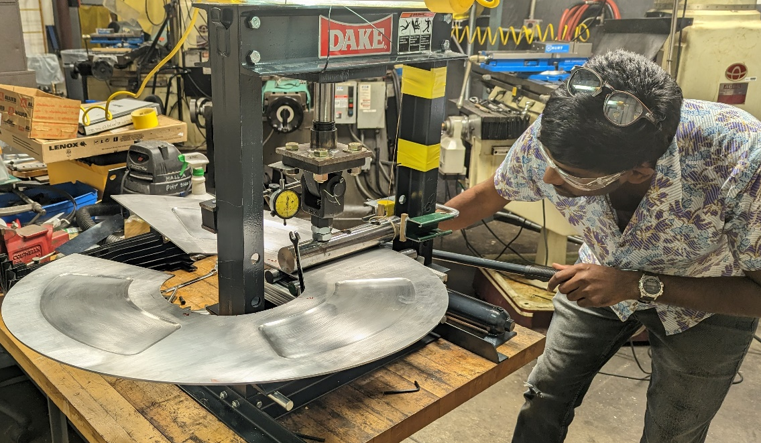
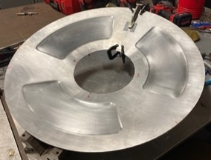
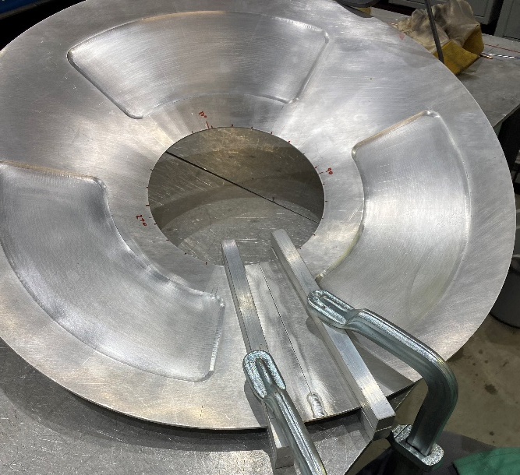
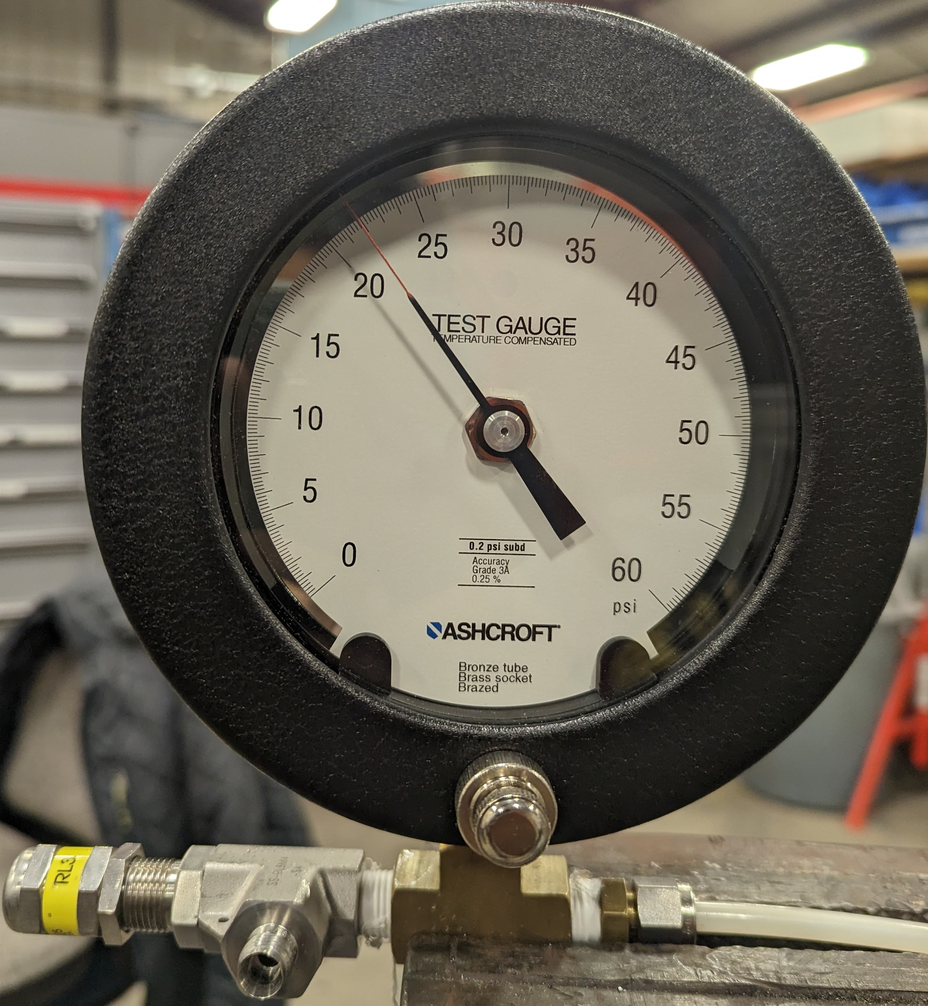
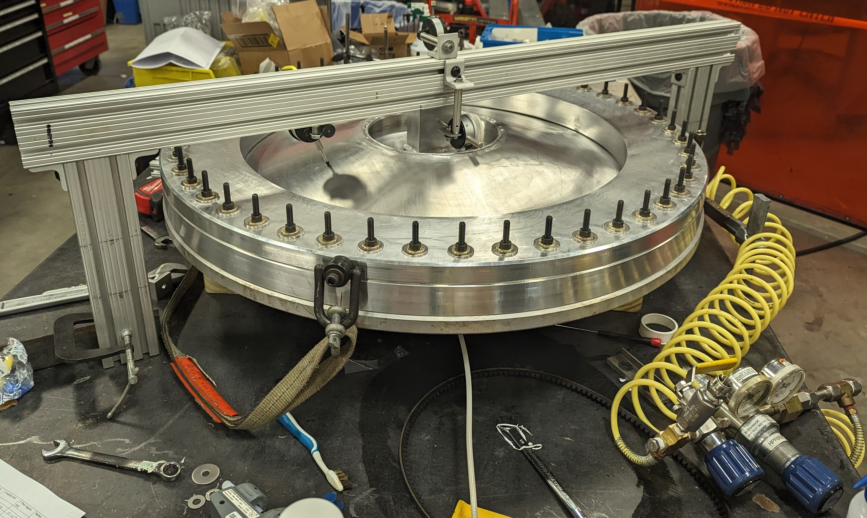
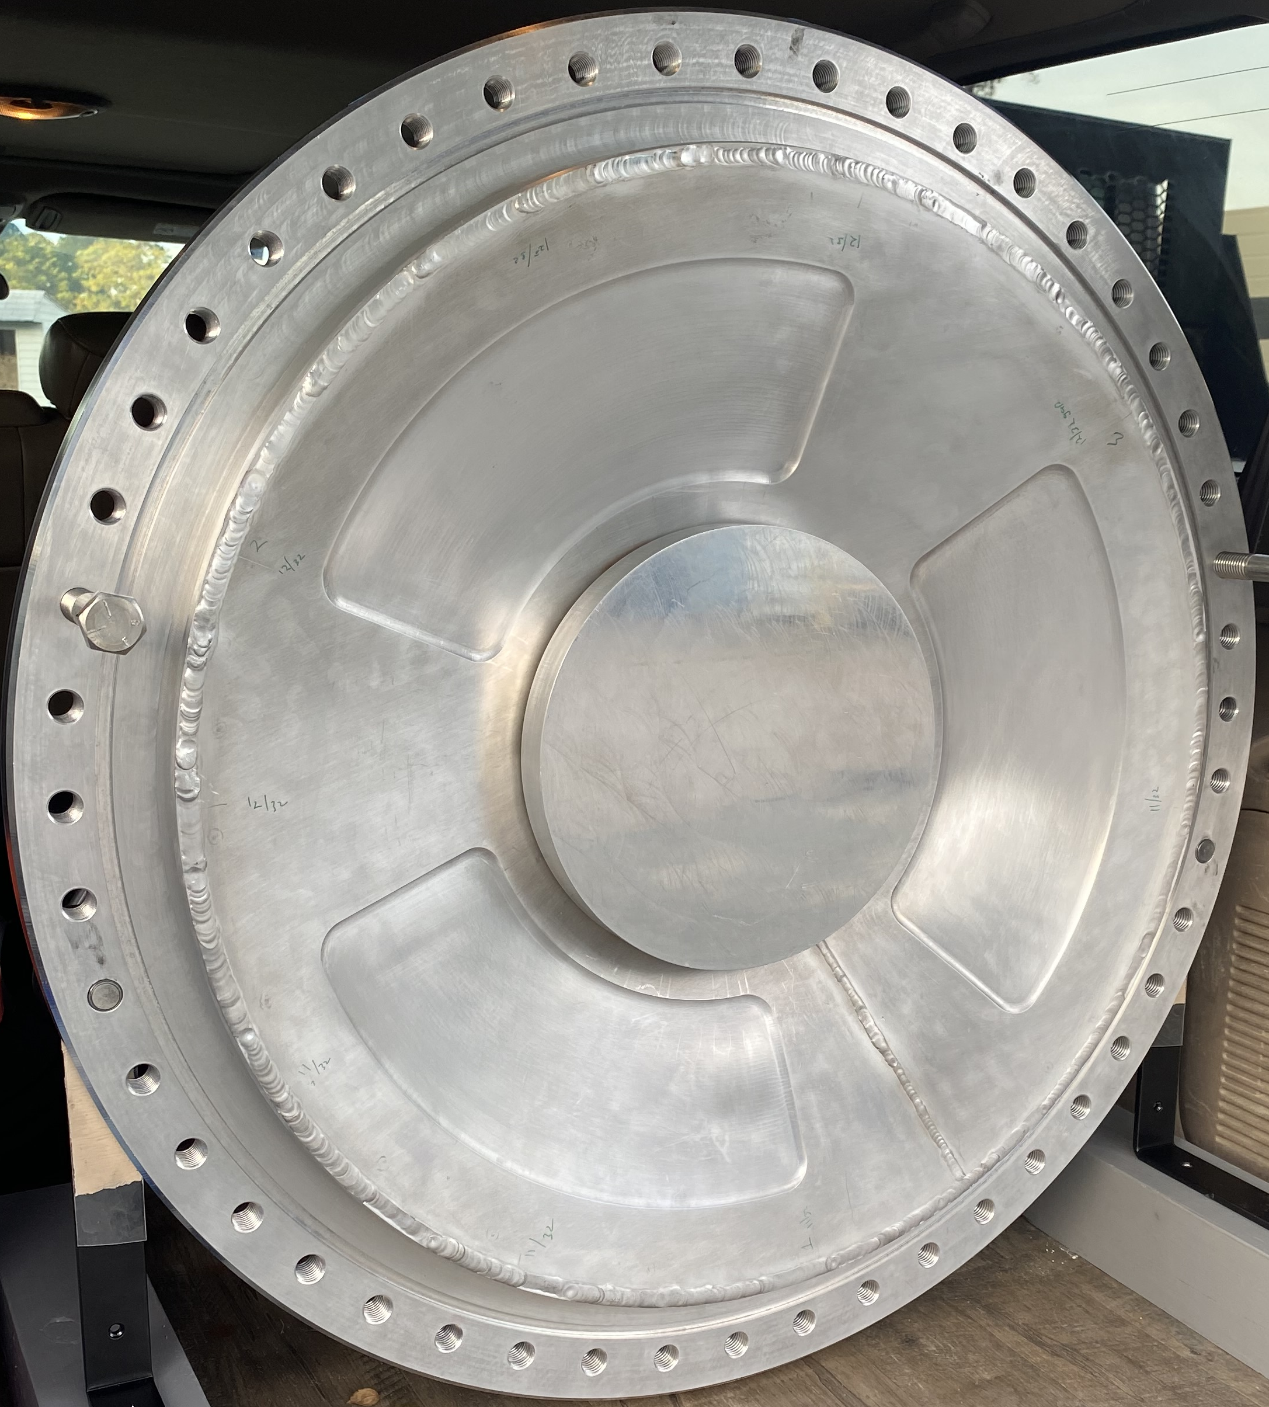
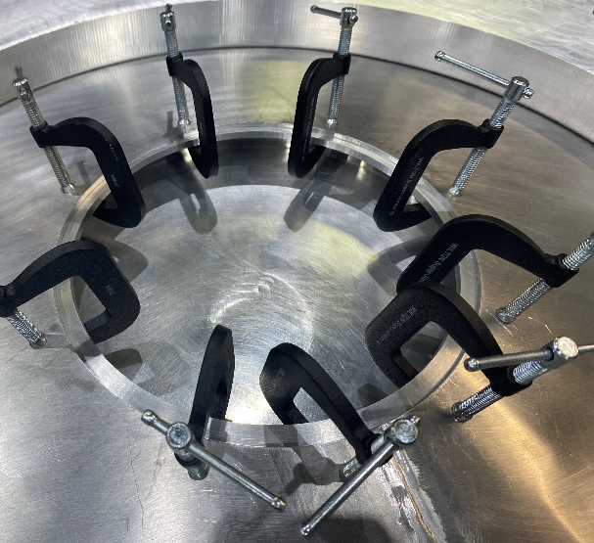
Window Formed
Window Sheet Machined
Forming Fixture
Welding Window
Prototype Detector Window Fabrication
  All work at JLab except machining (flanges and sheet)
  Tests to date 125% over pressure no yielding!
  Motion during vacuum loading less than 100μm
Gauge at 22 psi
Clamping Window Frame
Test Assembly
Welded Prototype

Slide 14
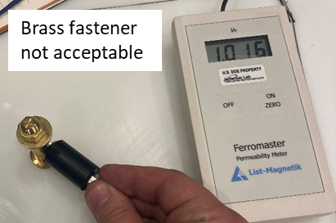
Material Acceptability
Only one metal chosen for potential use had unacceptable magnetic permeability
  Brass 360
Brass 485 was found to be a good replacement
Other materials tested ALL acceptable
  Aluminums (2024, 6061, 5083, 7075)
  Silicon Bronze
  Other Bronzes
  Coppers
  Titanium
  Brass 260
  Brass 464

Slide 15
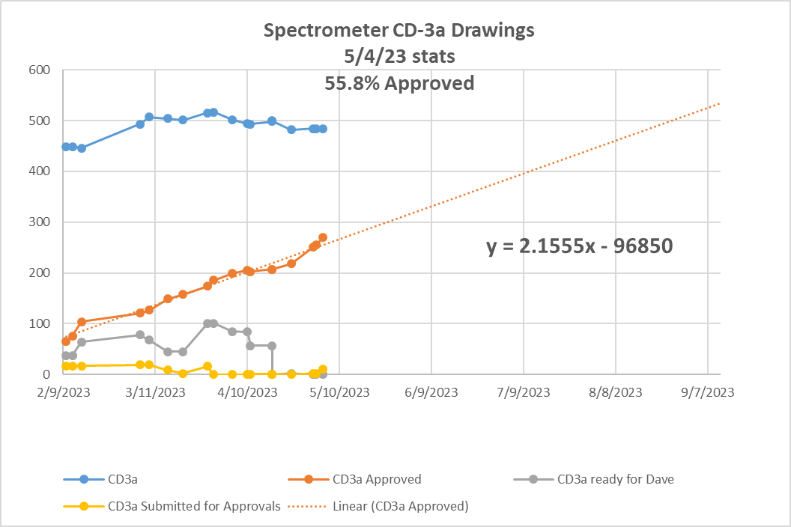
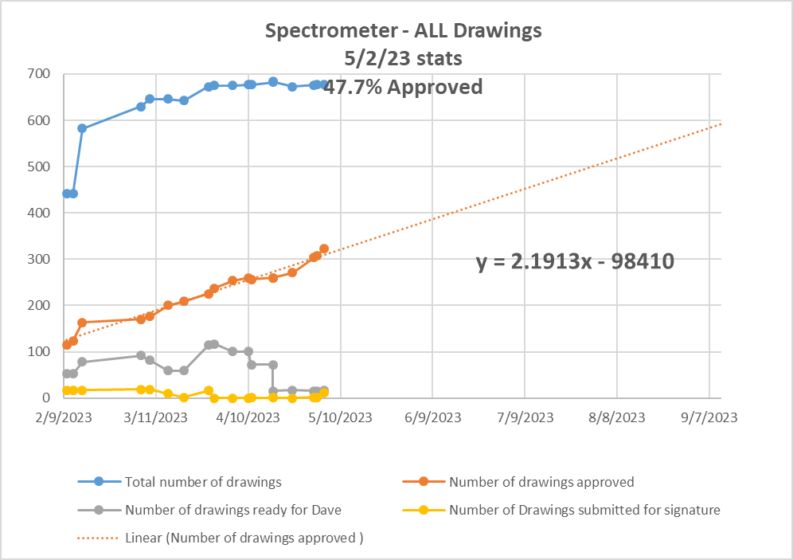
Spectrometer Overview – Status of Analyses and Designs – JLab Scope
99% of engineering analyses needed for CD-3a items is complete
99% of drawings for CD-3a items are created and ~70% have been checked
53% of CD3a items have been approved
Main objective is to get drawings signed
Some value engineering is continuing

Slide 16
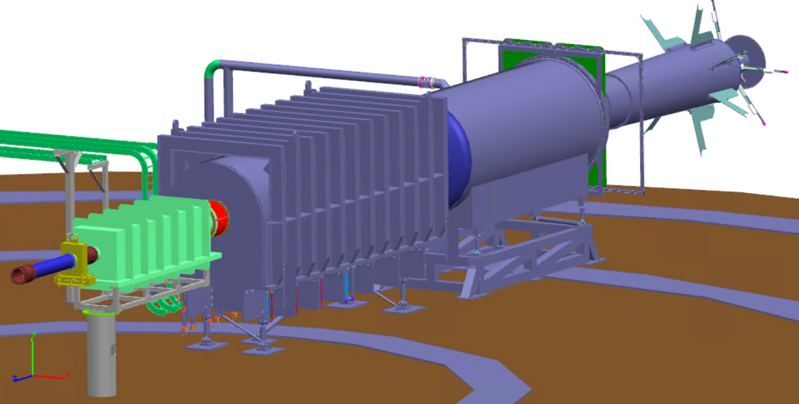
Summary
The spectrometer team and the supporting groups have been working effectively and have made great progress since the 2022 collaboration meeting
One magnet frame has been built
Prototype of Detector Window was built successfully
Four prototype Coils received. All passed QA tests at vendor, SC3 and SC4 tested at JLab – Ready for full production run to start
Spectrometer design at >99%
All CD-3a drawings are our highest priority and we are increasing our rate of approval

Slide 17
Thank You
Questions?

