Slide 1
MOLLER Collaboration Meeting
Magnet Power Supply and I&C
Dave Kashy (for Brian Eng and Probir Ghoshal)
JLab
On behalf of Magnet Group, DSG, DC-Power

Slide 2
Outline
Magnet Power Supplies (MPS)
  Prototype
  Factory Acceptance Test (FAT)
Magnet Interlocks
Instrumentation and Controls (I&C)
  Overview
  Sensors
Summary

Slide 3
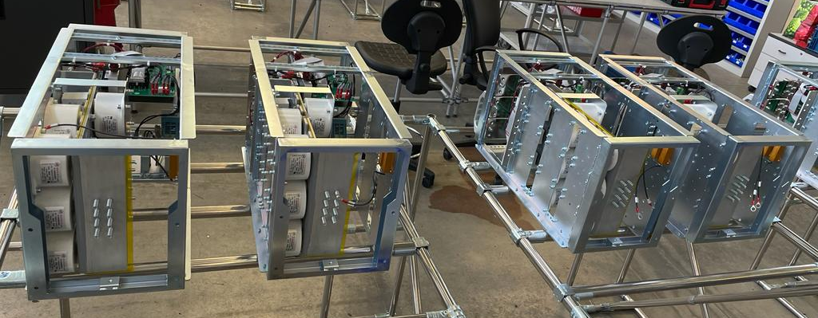
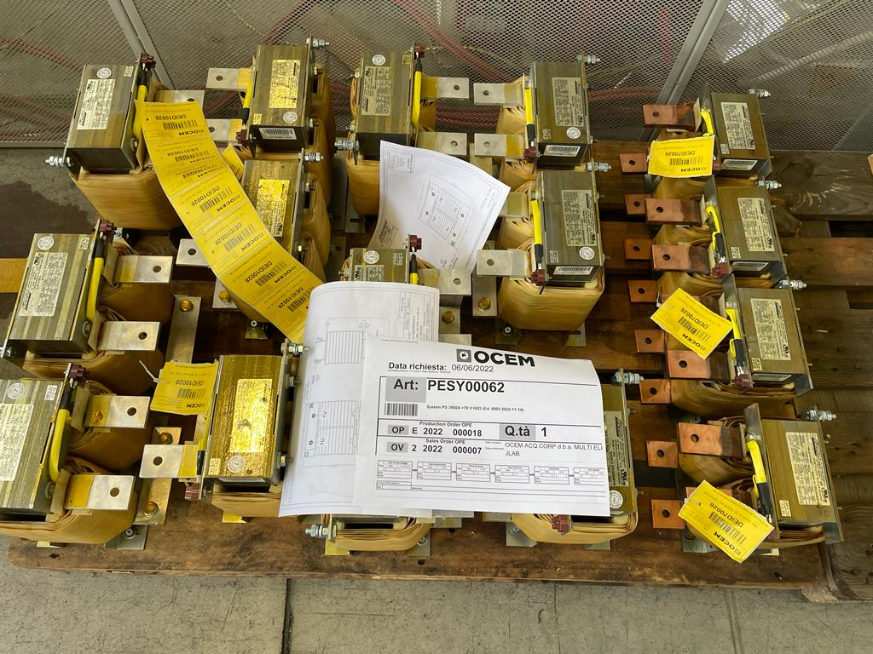
MPS Prototype – TM3
Schedule
  Order placed April 2022
  Design review completed Aug 2022
    Document UT-RT-0872
  Critical components procured by vendor
    DCCT and FPGAs in hand
  Completion is delayed; FAT is late, present schedule is (mid to late) July 2023
    Procedure documented in UT-SP-0679
    JLab staff to be on-site (Italy) for subsequent FAT
Dimensions
  2.8m (L) x 1.6m (D) x 1.9m (H)
Weight - 2500 kg
Power Modules Assembled
Inductors
Note: TM3 MPS chosen for test lab because it can provide full current to TM0-TM3 and partial power for TM4 to due to wall power and LCW availability in the test lab!

Slide 4
MPS Factory Acceptance Testing and Testing at JLab
OCEM has prepared FAT procedure which was reviewed by JLab staff
Some highlights from the functional test portion
  Voltage Accuracy ±500 ppm (±35 mV)
  Current Accuracy ±50 ppm (±195 mA)
  24 hour stability < 100 ppm (390 mA)
    Factory testing is limited to 2900 A (out of the nominal 3235A) by external test load size
  Current Ripple < 3 A_{RMS} (spec is < 1.5 A_{RMS})
    Also limited by test load which is ~3x higher than final load
  Efficiency (> 80% @ 200 kW output) and power factor (> 90%)
Will be tested to full current at JLab (SAT)
  With shorted leads
  Possibly also on one TM4 coil (well matched!) ( approximately 3.7kA x 24 V)

Slide 5
I&C – Protection System Layout - Interlocks
Primary Control provided by master processor with 1Gbit Ethernet Interface
Dual Ethernet Interface – (i) JLAB: IOC/EPICS and (ii) Private Local Network (PLN) for critical instruments
Direct Interlock capability 5 or 24 VDC (e.g. voltage, temperature, field, flow, etc.)
Hardware voltage tap comparator calculations completed, used for RFI of CD2/3
Magnet | Single Coil Voltage (V)
DS1 | 4.04
DS2 | 4.17
DS3 | 6.36
DS4 | 13.93 (per pancake)
10 mV threshold for all magnets/coils
Summary of VT Comparator Limits

Slide 6
I&C – Sensor Types/Location/Channel Counts
DS Torus Magnets
Drawings A09005-15-00-0101 through 104
  52 RTDs (52 redundant sensor will be installed but not cabled to PLC)
  10 Klixons (thermal switches)
  56 voltage taps (56 redundant taps will be installed and cabled to VT chassis)
  3 vacuum gauges
US Torus
  7 each: Flow switches, Klixons
  1 DP sensor
  8 RTD’s (redundant sensor will be installed but not cabled to PLC)
  2 voltage taps
US Collimators
  4 Each Limit switches, Flow switches, Pneumatic valves, Temperature Switches
  5 RTD’s (+2 for Collar 0 – JLab Scope)
  1 each Flow meter, Liquid Level
  2 Pressure transmitters
Water Distribution
Drawing A09005-15-00-0111
  7 RTDs
  5 each: flow meters, control valves
  6 pressure transducers

Slide 7
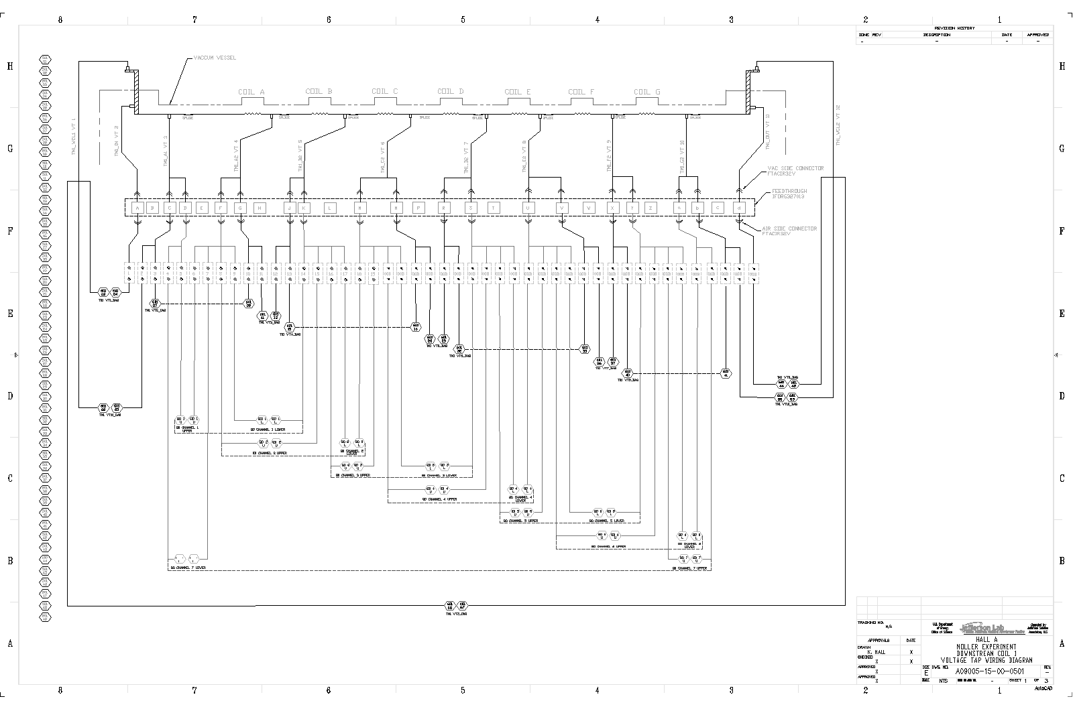
PLC Wiring Diagrams
Use approved P&ID to develop wiring diagrams
Temperature sensors complete, hardware voltage taps complete
Voltage taps for PLC in progress

Slide 8
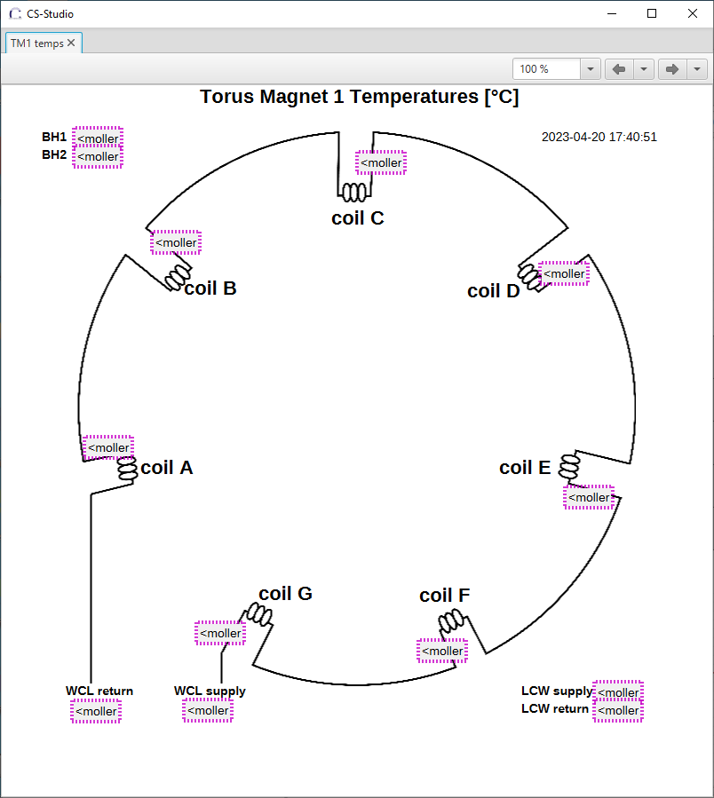
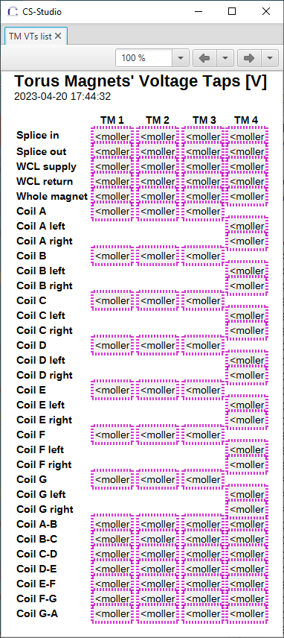
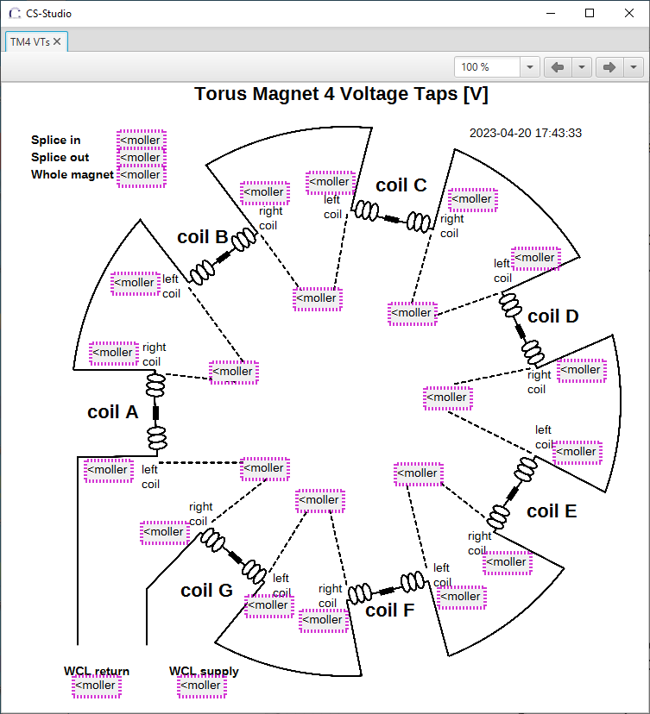
EPICS Interface
Verified communications between Siemens S7-1500 PLC controller and softIOC
CSS Phoebus screens development in progress (temperature and voltages completed)
Values outlined in magneta due to disconnection, i.e. no softIOC running

Slide 9
Summary
MPS – Order in place for the prototype MPS (TM3)
Instrumentation and control philosophy is defined
P&IDs are in place and list of instrumentation is complete, wiring diagrams are in progress
Magnet Protection/Interlocks fault logic has been generated
Hardware and software development required for the system are identified and the work is in progress
  Removal of closed loop LCW system simplifies overall system

