Slide 1
MOLLER Spectrometer – WBS 1.03
MOLLER Collaboration Meeting
June 21-22, 2022
Spectrometer Engineering
David Kashy
Team - Magnet Group/ENP/Engineering and MIT
Jefferson Lab

Slide 2
Outline
Upstream System
  Enclosure and Upstream Torus
  Collimators and Blockers
Downstream System
  Beam Pipes and Bellows
  Windows
  Downstream Torus
    Magnet Piping
    Collimators and support
    Lintels
    Collar 1
    Coil Prototype Progress
  Summary
NOTE!
This presentation will not cover everything in the MOLLER Spectrometer but will give many examples of recent progress

Slide 3
US Enclosure in Shielding
MOLLER Collaboration Meeting, June 21-22, 2022

Slide 4
US System Components

Slide 5
US Enclosure FEA

Slide 6
US Torus Magnet

Slide 7
Blocker and Sieve

Slide 8
Collimators 1-2

Slide 9
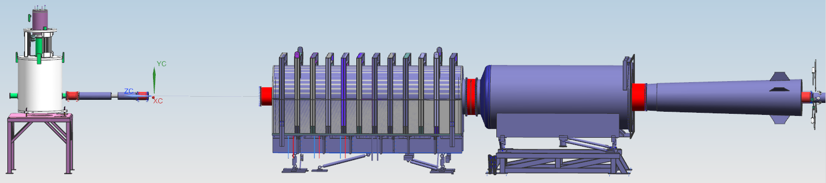
Overview of Bellows, Beam Pipe, Drift Pipe, and Detector Pipe
One of two mating aluminum flanges of each bellows is rotatable.
12’’ beam pipe
Drift Pipe
Detector Pipe
Rotatable Al flange
DS enclosure
US enclosure
Beam direction
Bellows 1 and 2
Inconel 625
ID = 12’’
Length = 18’’
Bellows 3
Inconel 625
ID = 26’’
Length = 20’’
Bellows 4
Inconel 625
ID = 54’’
Length = 15.75’’
Bellows 5
Inconel 625
ID = 41’’
Length = 24.5’’
Bellows 7
Inconel 625
ID = 16’’
Length = 22’’

Slide 10
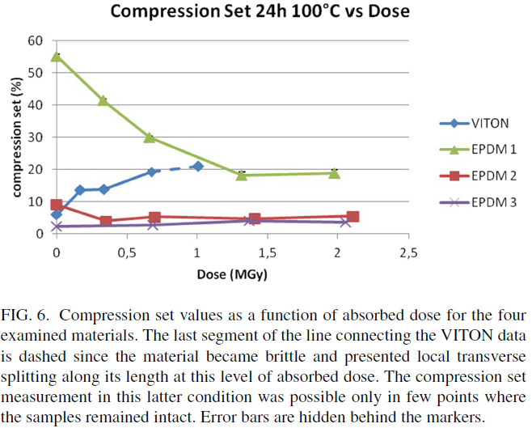
Responses to Recommendation 1 and 3 of 60% Review of Beam Pipes Bellows and Windows
Recommendation 1: Evaluate and document pressure relief system.
  Response: In progress. We have designed a parallel plate (OD = 9.76’’) for any potential pressure rise.
Recommendation 3: Document failure conditions of materials, such as gaskets.
  Bellows 1, 2, and 7
    CF design with one Inconel flange and one aluminum flange
    Aluminum 1100-O gaskets
  Dosage results from MOLLER simulation
    Bellows 3 US/DS: 0.12/ 0.3 MGy
    Bellows 4 US/DS: 0.01/ 0.05 MGy
    Bellows 5: 0.9 MGy
    Detector window: <0.01MGy
    DS torus box bottom seal: 0.01 – 0.05 MGy
  Bellows 3, 4, and 5 and detector window
    EPDM2 is radiation-resistance up 2.0 MGy
    Peroxide cured EPDM 2 1/4’’ O-ring is used.
    500 ft EPDM2 O-ring has been ordered.
Radiation resistance of elastomeric O-rings in mixed neutron and gamma fields: Testing methodology and experimental results, A. Zenoni, Rev. Sci. Instrum. 88, 113304 (2017)

Slide 11
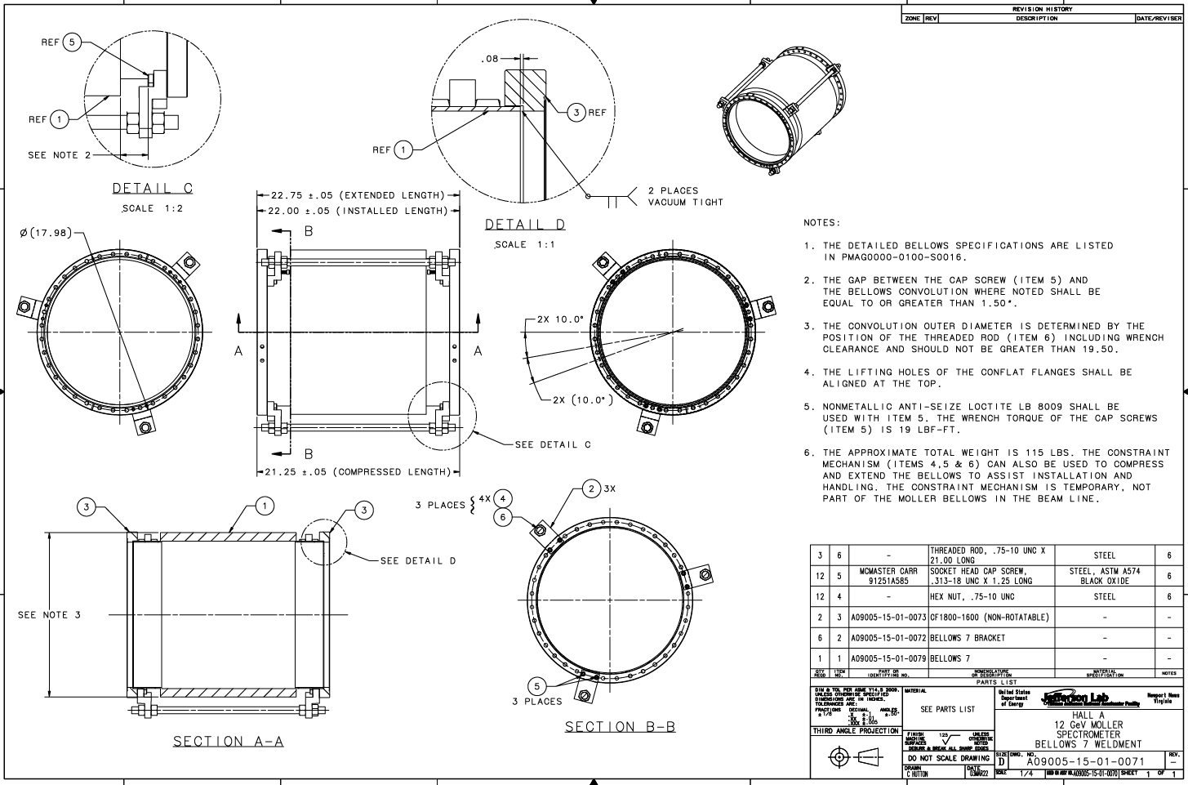
Progress since 60% Review – Drawings of Bellows
Drawings for bellows 7 were signed and approved. Going for a prototype of this bellows, two vendors have provided budgetary pricing
Drawings for bellows 3, 4, and 5 were reviewed multiple times and are nearly complete. Bellows 4 being made slightly longer to increase stroke capability
Flexibility of all bellows better than requirements
Only one set of updated drawings for bellows 1 and 2 is needed; they are identical.

Slide 12
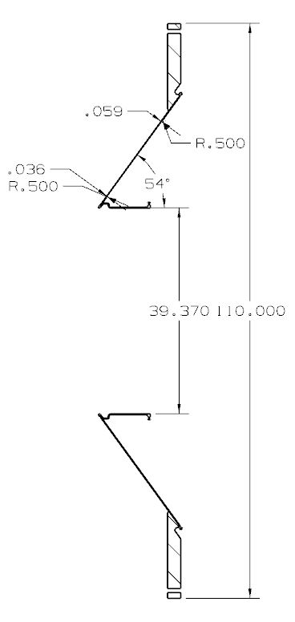
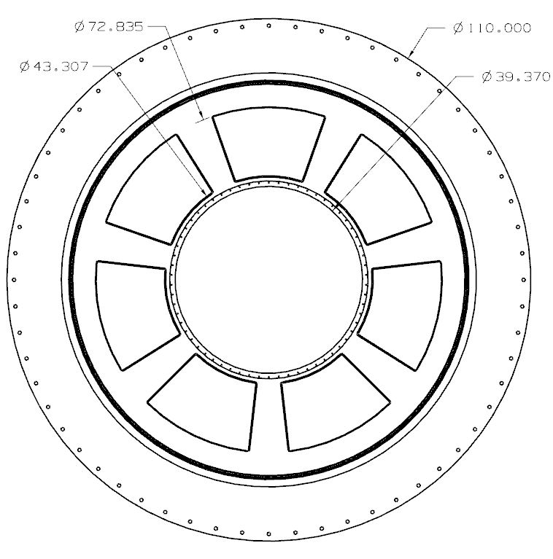
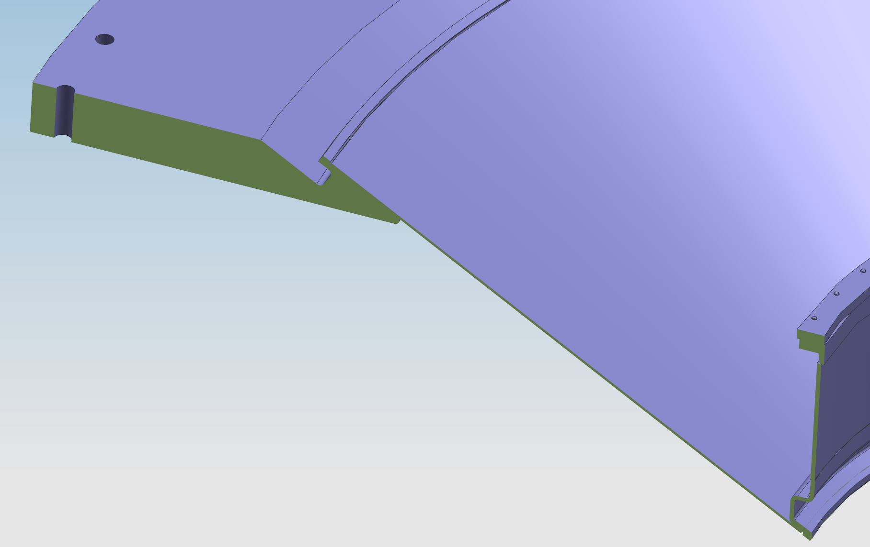
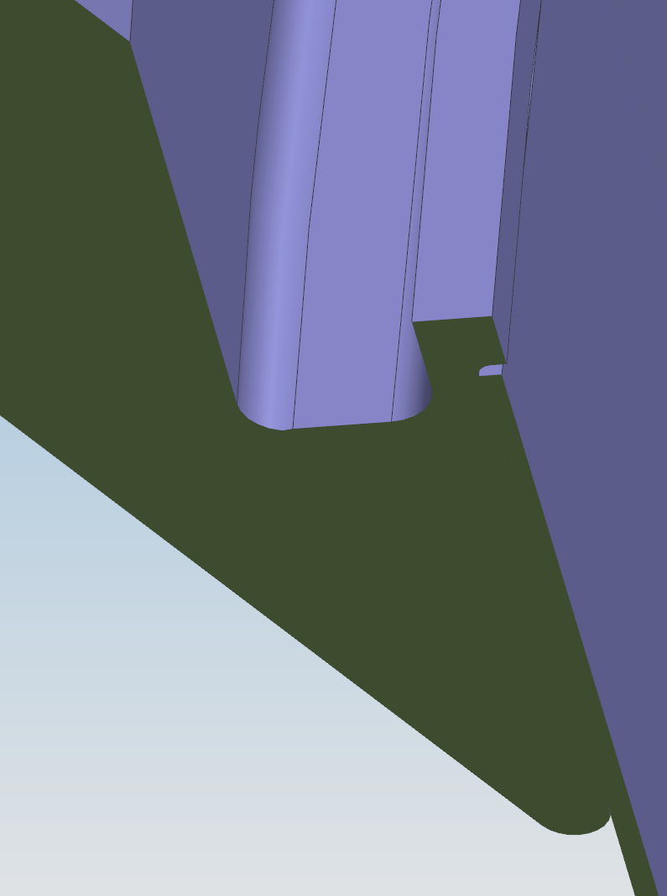
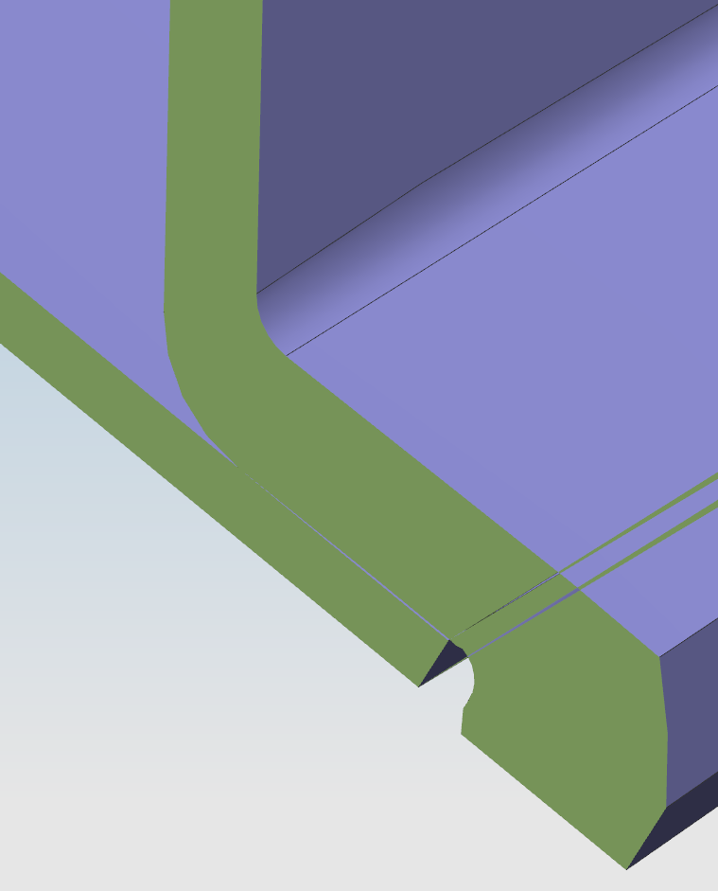
Summary of 60% Beampipe, Bellows & Windows Review Sep 2021
Al5083-H116
3.18 mm
Atmospheric
pressure = 14.7 psi
Full strength properties of the 5083-H116 material was used.
Thin
Ribs are located in the sector where the particle flux is very low.
Two groove welds
One
Radial weld
0.894 mm
= 0.035’’
1.503 mm
= 0.059’’
JLab Welder qualified to weld using WPS/PQR #005 (6061 P-No. 23) will be allowed to weld 6061 to 5083 or 5083 to 5083.

Slide 13
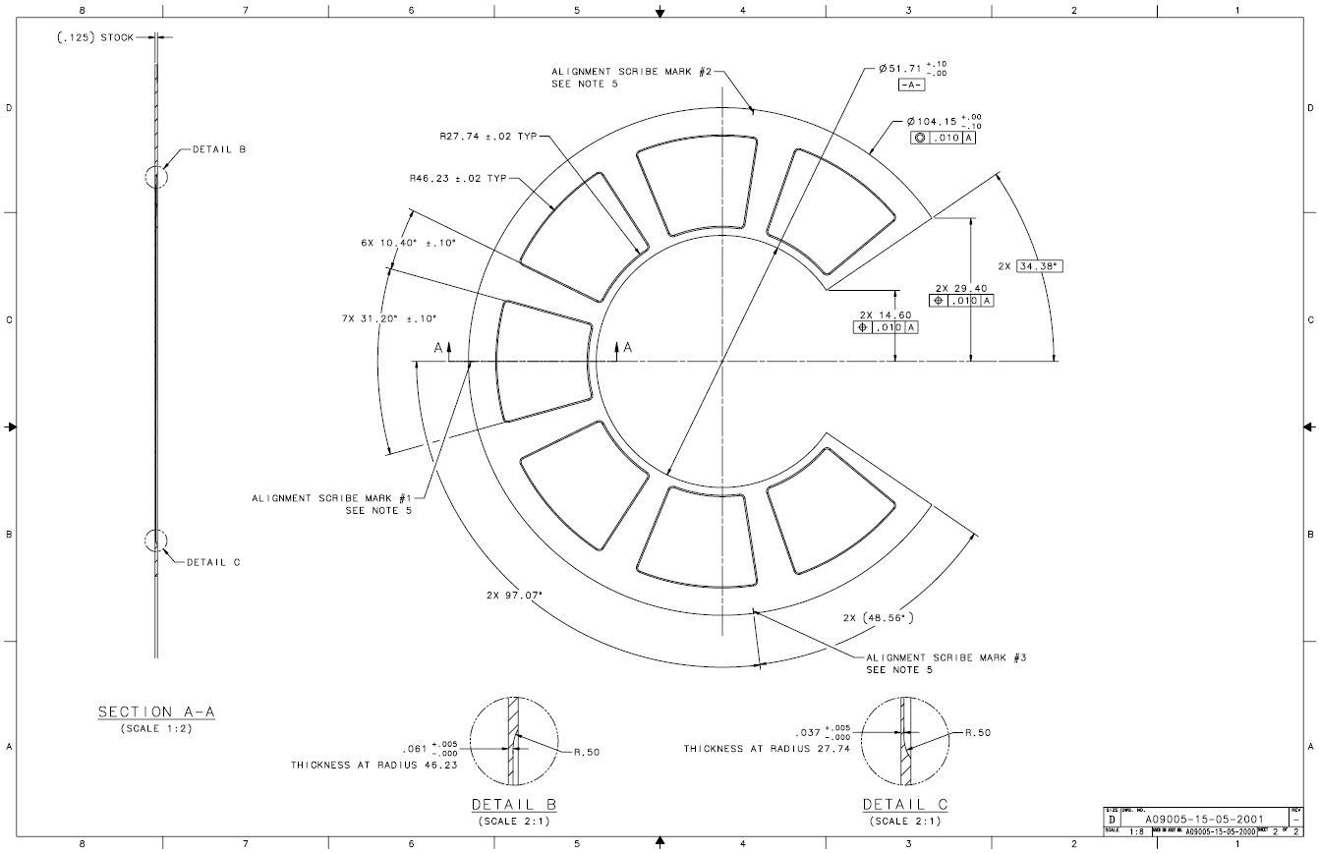
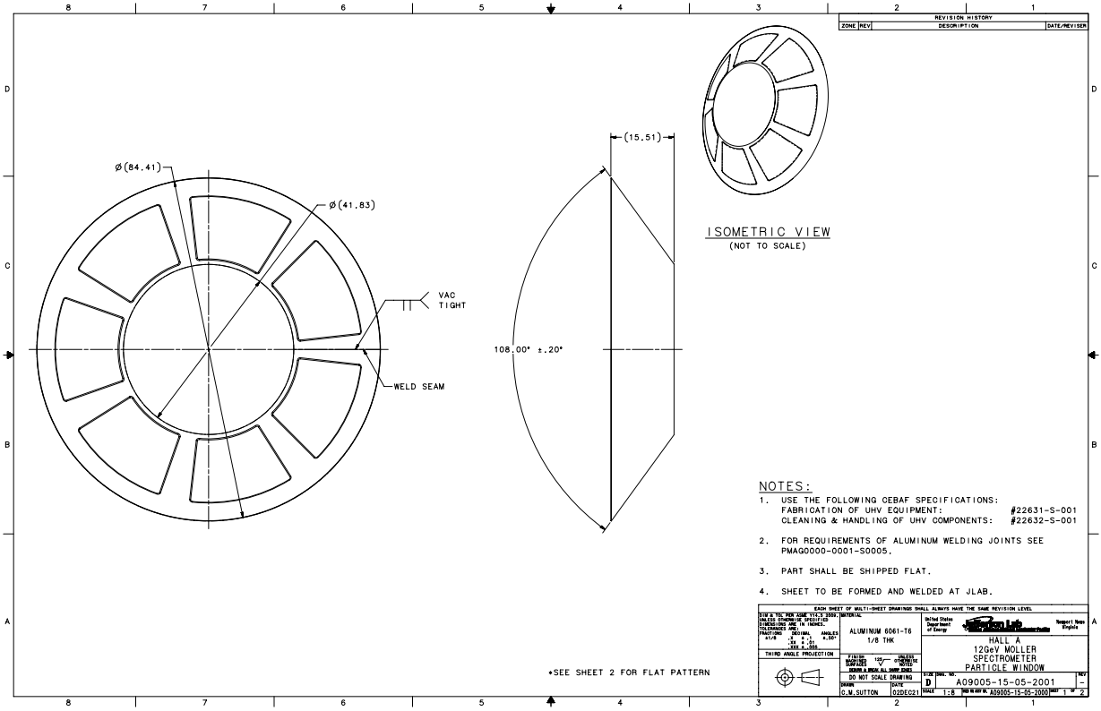
Detector Window – Drawings complete with tolerances
Detector window flat pattern
Detector window cone

Slide 14
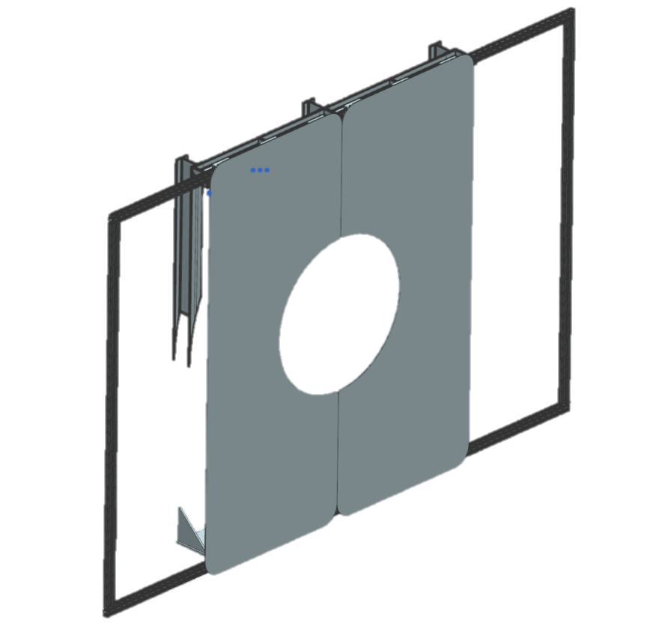
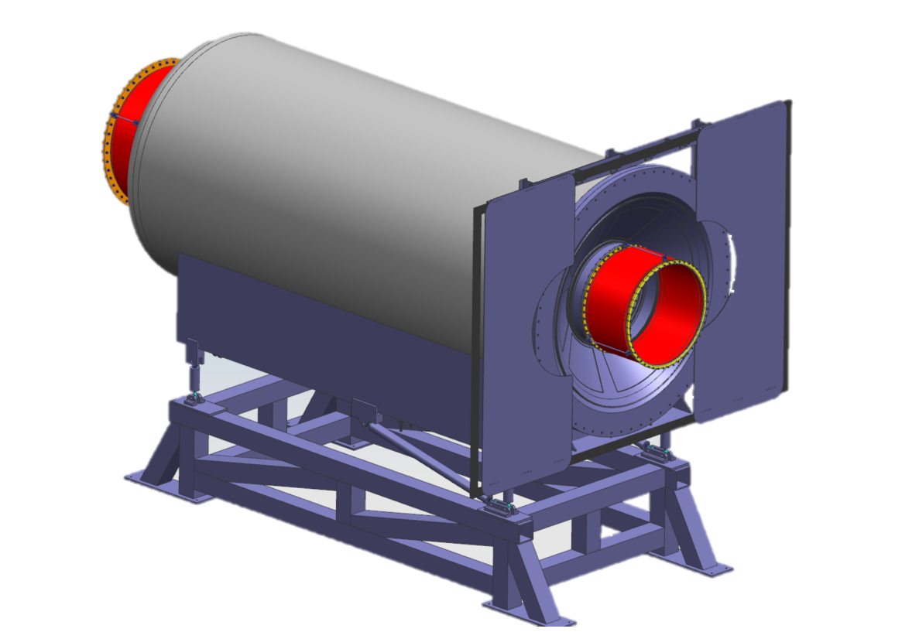
Detector Window Shutter Design
Purpose: The window shutter shields the window from any accidental contact or loading, thus greatly increasing the overall safety of the equipment and ensuring the safety of personnel.
Operation: The window shutter is manually operated; the doors can be pushed or pulled into position depending on whether an “open” or “closed” orientation is desired.
Utilization: The shutter will be closed during assembly and installation. Interlocks will be put in place to check the position of the window before vacuum pumps start. The shutter will be open during beam.
Upper Support Structure
Aluminum Framing
Doors
Installed Window Shutter (Open)
Drift Pipe
Window
Lower Support Structure

Slide 15
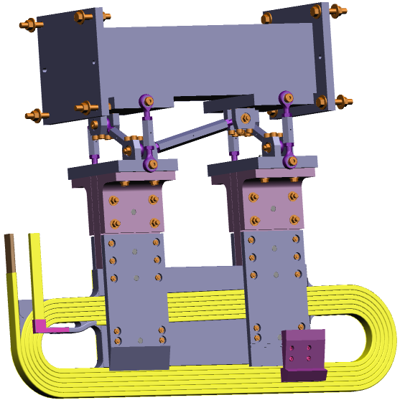
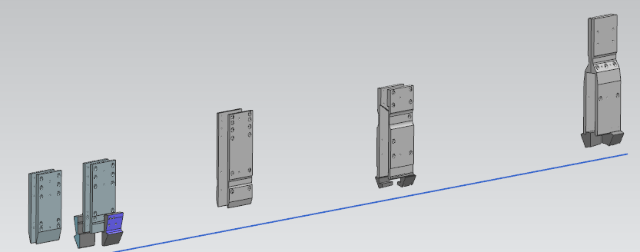
DS Coil Support and Alignment
Each Coil is supported from a set of clamp plates
Clamp plate system supported by adjustable links from box beam
The collaboration Ferrous Materials Group has confirmed that no carbon steel is allowed inside the enclosure thus specialty rod ends are needed in the support. They have also confirmed that brass, bronze fasteners are acceptable
Clamps of TM3 and TM4 also support the collimators 5, 6a, 6b
Support system prototype is in procurement process
  This will help with determining how to survey and align it and locating fiducials
  Drawings for TM1-TM3 and bulkheads have been checked and sent out to potential vendors for pricing
Met with entire survey group (engineers, manager and techs) we all viewed a laser scanner device
  Measured sample coils
  Looks promising in helping with aligning coils
  Especially useful to track motion during energization
Coil and frame deflections are small (<1mm)
7 Links
Collimator 5 section
Dual Clamps
Single layer coil
TM3 Coil Clamped with Collimator 5 section
Collimator 5
Collimator 6b
Collimator 6a
Collimator 6b

Slide 16
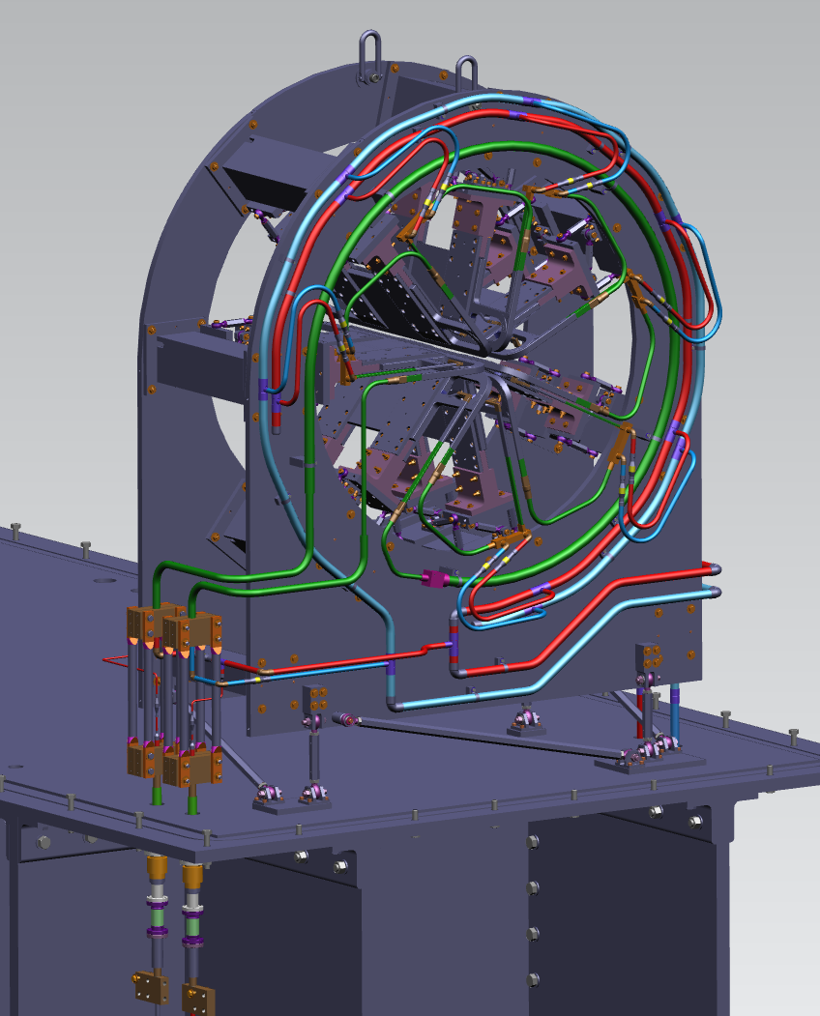
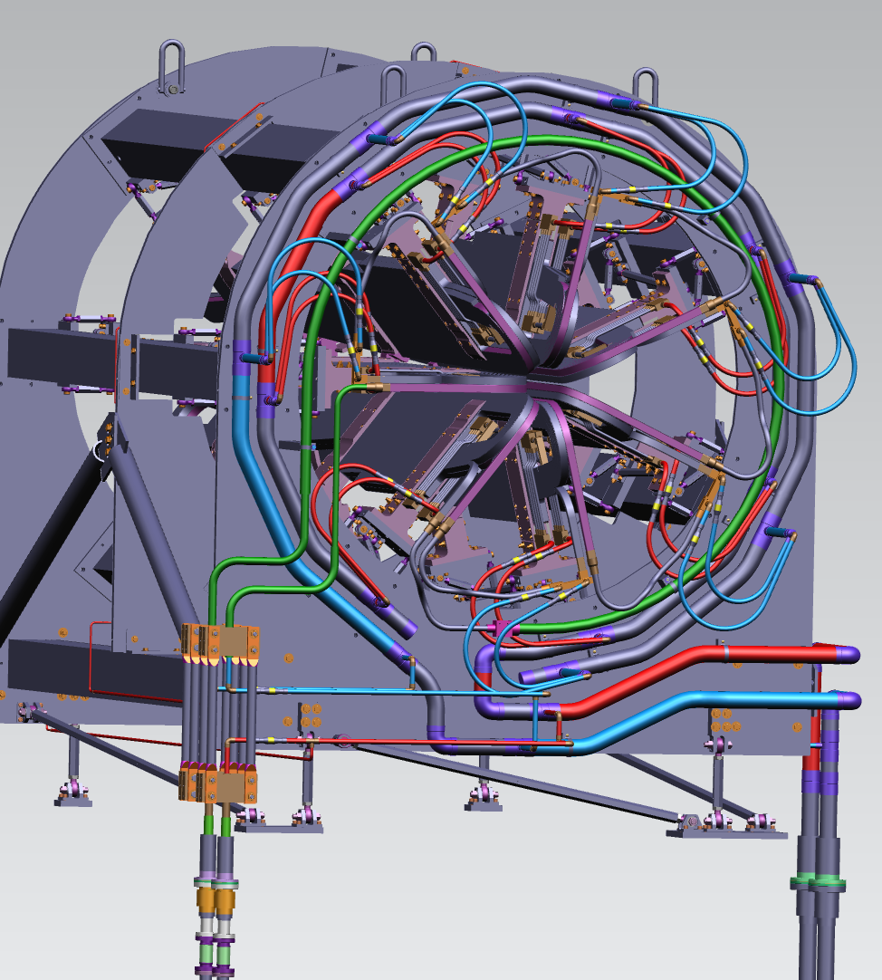
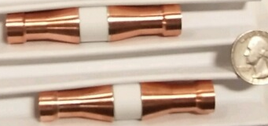
DS TM Magnet Water Piping and Electrical Bus
TM1 has 7 flow paths, 1 per coil plus the DS bulkhead trace tube
TM2 and 3 piping nearly identical to TM1
TM4 has 14 main flow paths (double pancake coils each with its own cooling path), water headers are 2”
Ceramic break passed 1500psig hydro test
TM1
TM4

Slide 17
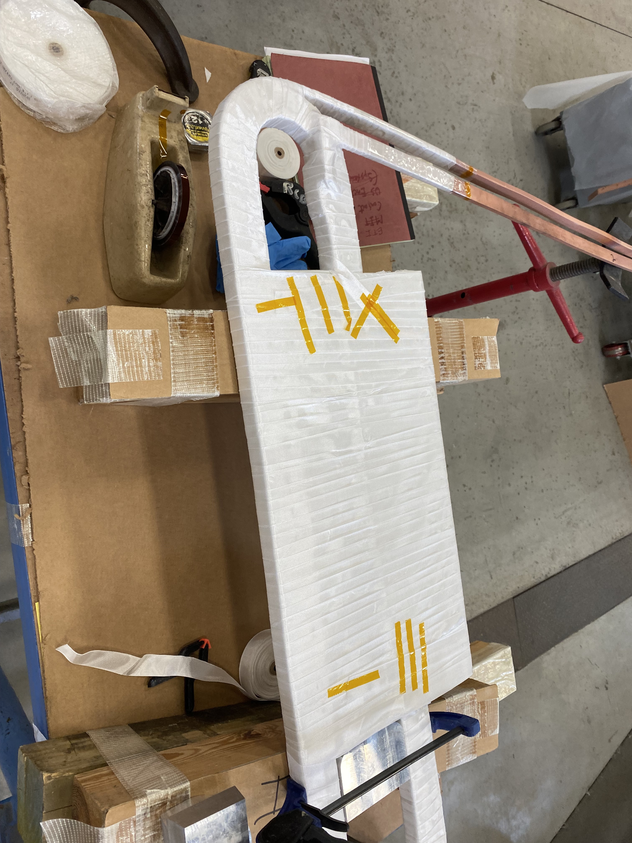
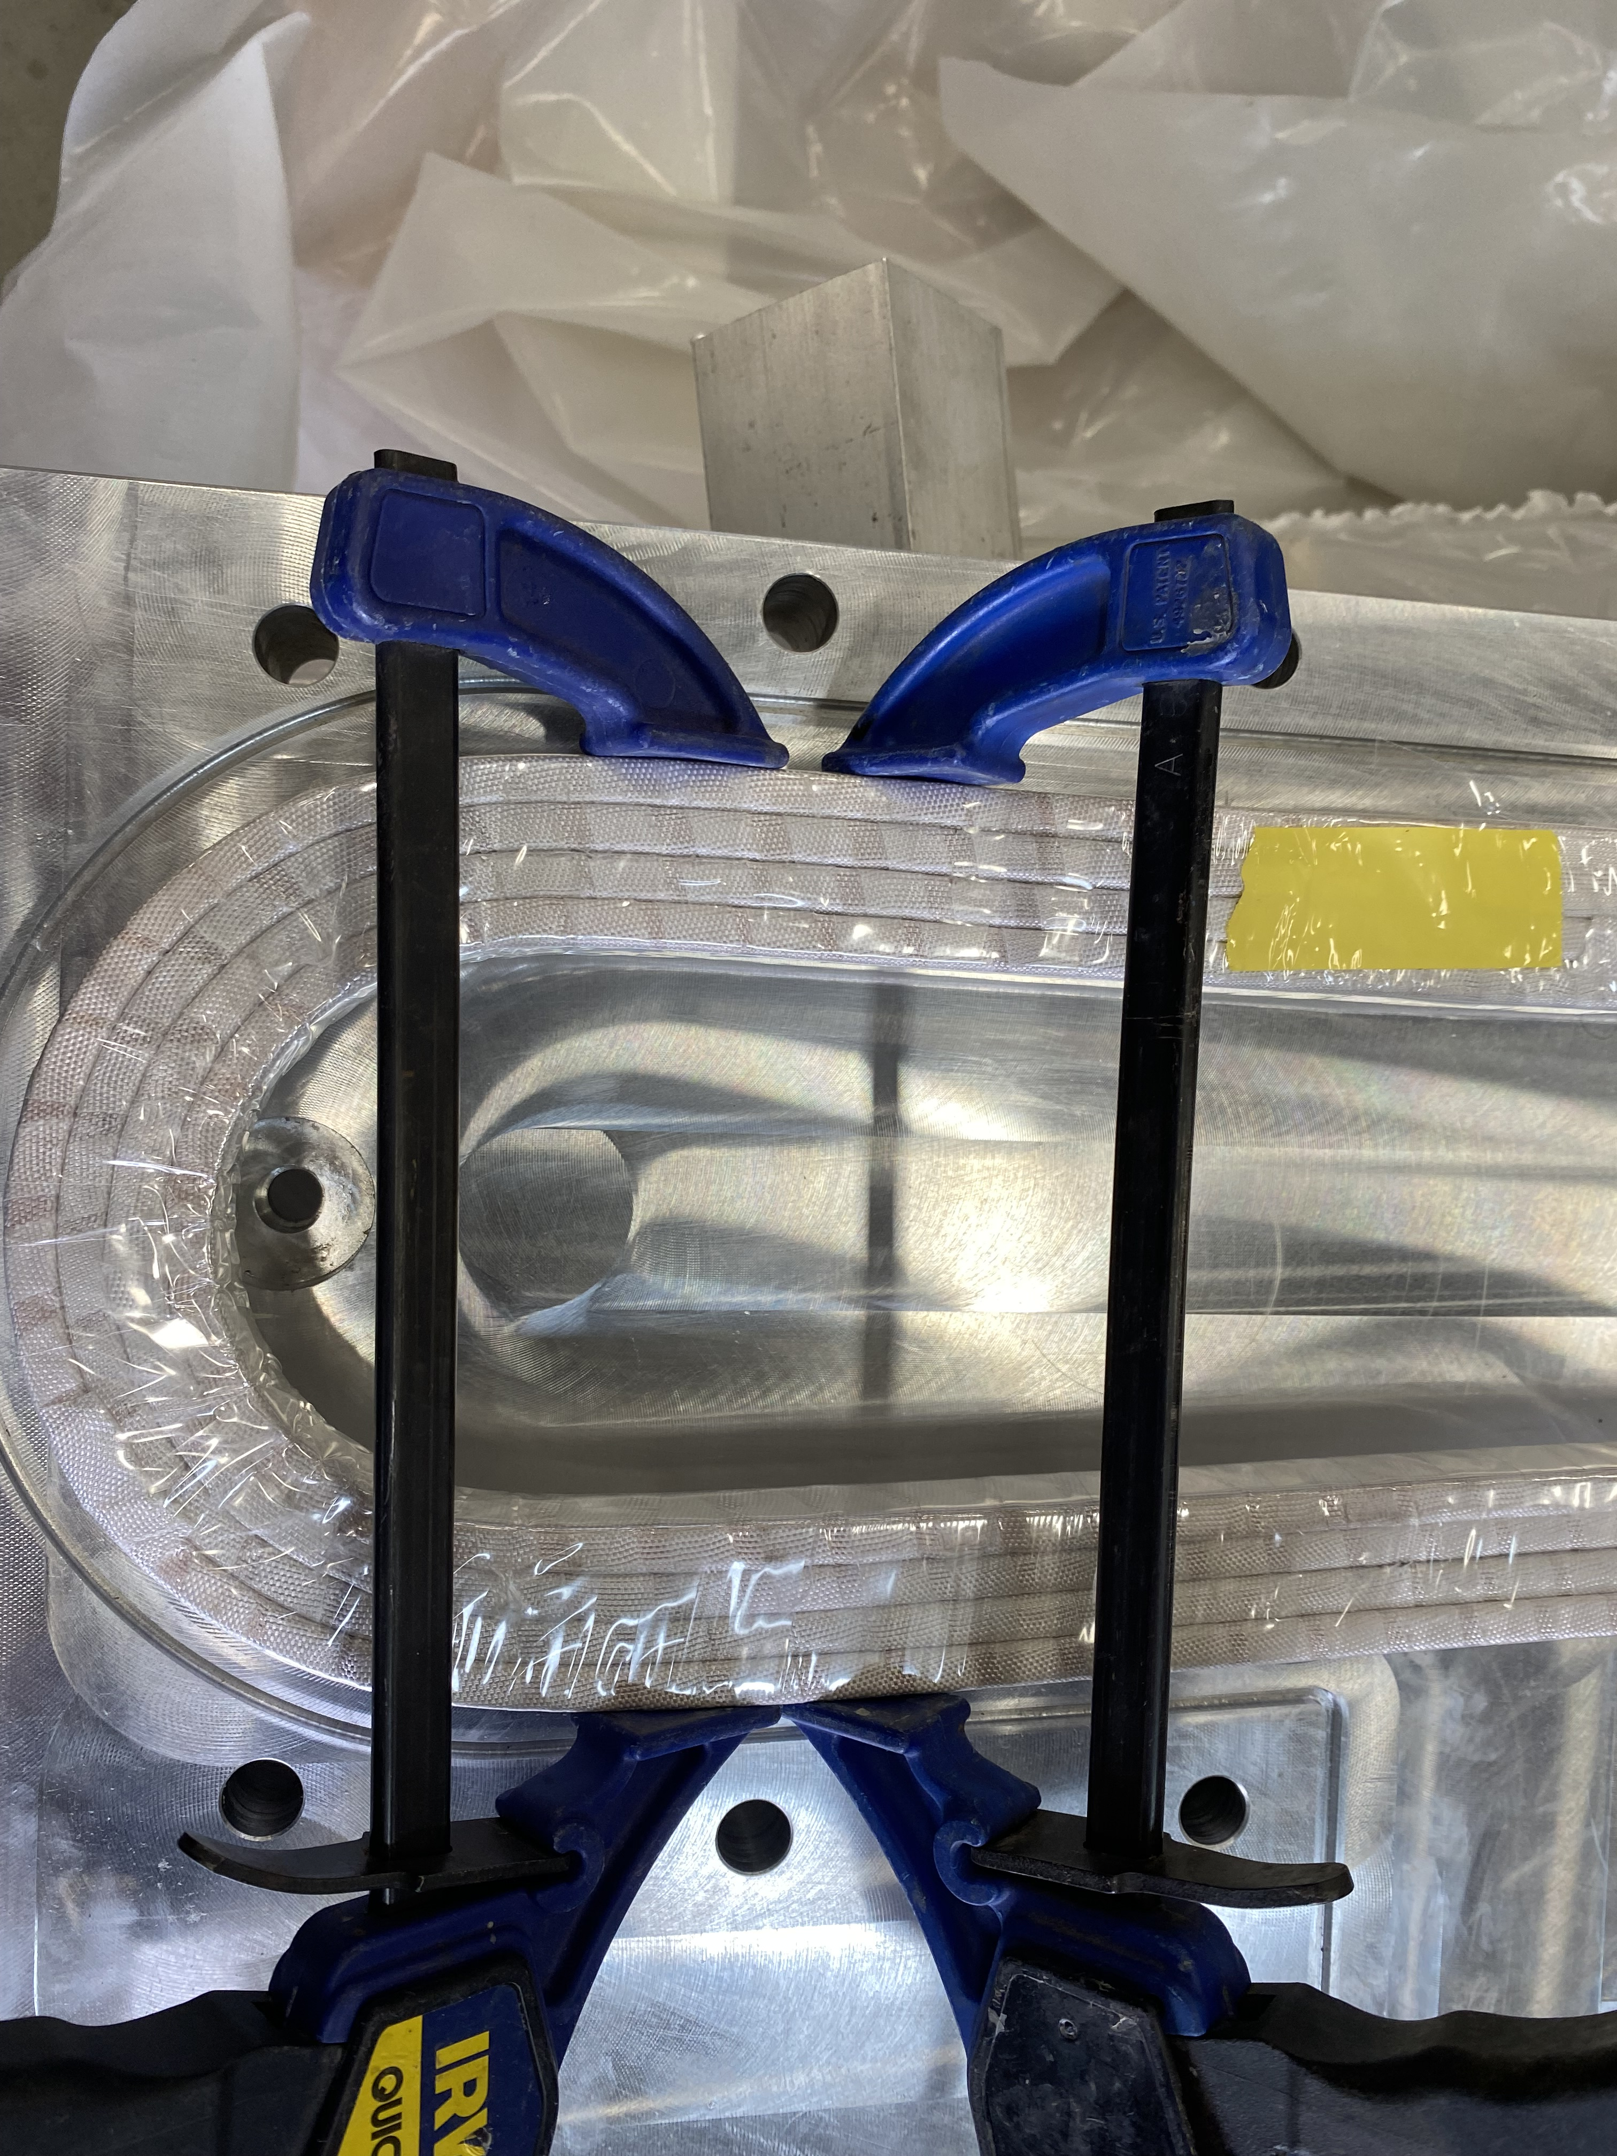
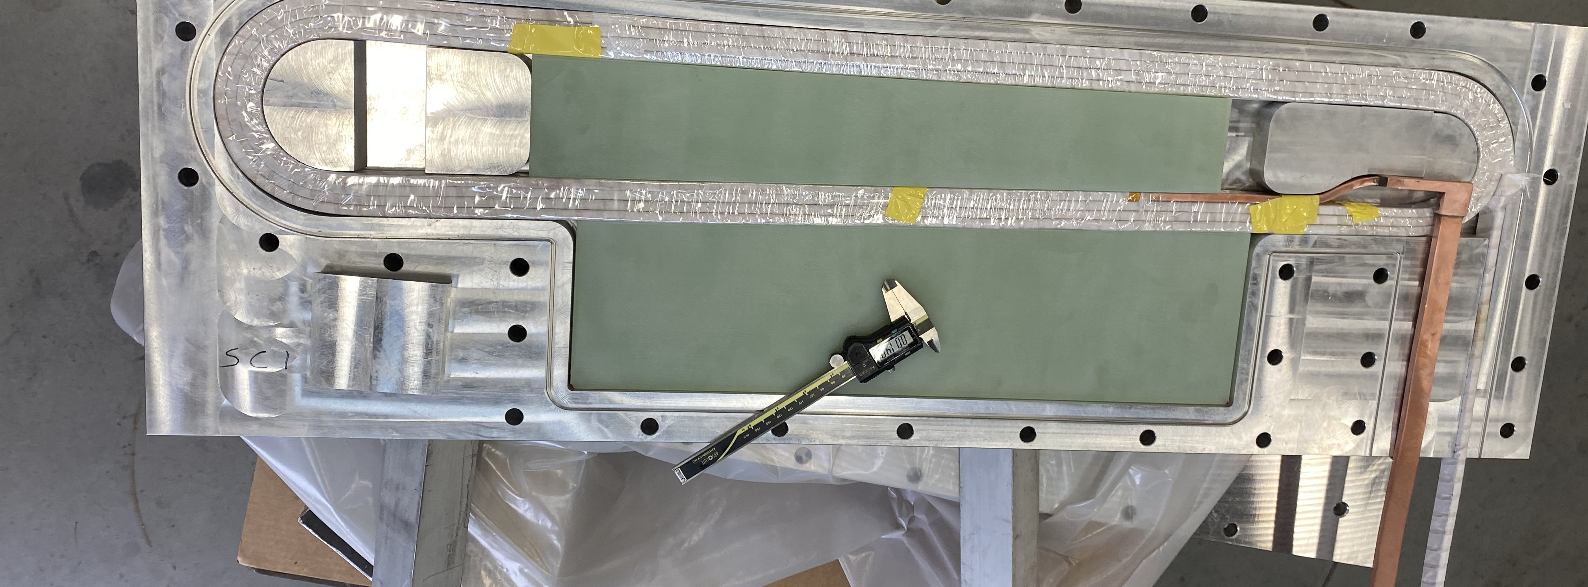
Prototype Coil Progress
Traveled to ETI to see progress on Coils June 7-10
Coil Stack Heights bigger than designed
  Ground wrap and conductor camber causing this
SC2 with Ground wrap – Did not fit in Mold
SC1 w/o Ground wrap – bending to attempt fit
SC1 w/o Ground wrap – almost fit into mold but w/o ground wrap

Slide 18
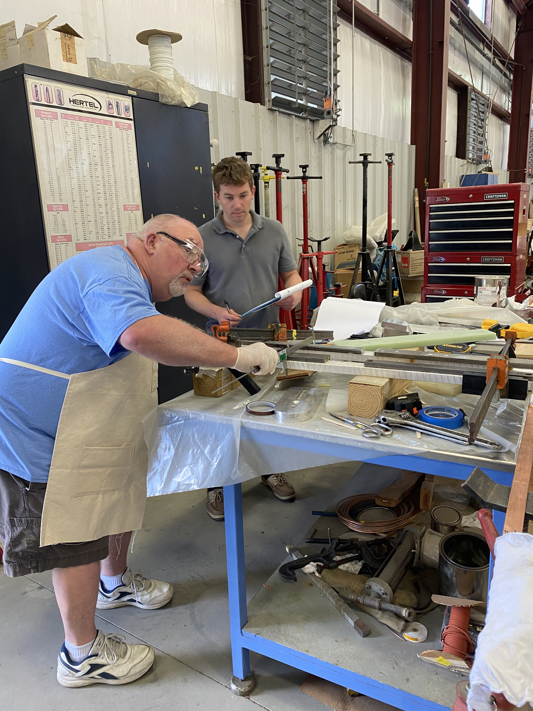
Prototype Coils - Continued
Coil shape and stack height keeping them from proper fit in the molds
Procedure for post Winding Bending developed
Mold Cavity will be increased to accept taller stack heights
G10 at center of the coils will remain the same size, but outer G10 will be cut smaller
SC3 Post Winding Bending setup with ETI folks performing it
 | Original (mm) | Modified (mm)
Minimum | 63.4 | 65.4
Nominal/Goal | 63.7 | 66.2
Maximum | 65.1 | 66.9

Slide 19
Summary
How to apply and support proposed 3mm shield the inside surface of the coils is not clear
  Heat load is expected to be quite high (>10W) and needs to be provided ASAP
Prototyping effort has shown that “ideal” coils are not possible. We have not figured out in detail how accurately we can build or need to be able to “map the coil turns”. Even if we do have precise turn geometry how will we use that data to determine the proper coil alignment
Need to complete the System Requirement Document (SRD) (Goal was 6/30 not late yet!)
Need to complete the Interface Control Document’s (ICD) (Goal was 6/30 not late yet!)
Hall A Beam Dump inlet Pipe (SAM pipe is connected)
  Have a potential solution for supporting the ~4000lbs vacuum load
  Located in a Radiologically Contaminated area and thus working there requires Rad II work
Design/Engineering Team is much larger than last year
Progress on all topics
Getting all components to 90% level by late fall 2022 will be a challenge

