Slide 1
DAQ update
Integration and counting mode DAQ planning for MOLLER (WBS 1.07, 2.07, 3.07) MOLLER Collaboration meeting, 21-22 June 2022
Paul M. King – Ohio University
MIE WBS1.07 Level 2 Technical Lead

Slide 2
Milestones & Plans (As of Dec. Collab. Meeting with updates)
Verification of test system: Oct/Nov 2021 – Feb/Apr 2022
Ohio just received the VXS crates and VME CPUs; ADC modules will be available later (Feb? March?) May push the test system verification into May?
Integrating ADC now expected to be at JLab ~July; testing to go into August-September?
90% design preparation and review: Apr 2022 – May 2022
Trigger and DAQ FDR is proposed for June 9-10
Now anticipate Trigger and DAQ FDR at end of summer (not yet scheduled)
Support of PQB studies
Currently only using INJ crate with VQWKs, running CODA 2.6.2
GEn-II will be running a counting house parity DAQ for charge feedback; may allow PQB studies through to the hall
For the 90% review (or sooner), need to have the plan for certifying the electronics modules with the new guidance from Electrical Safety committee

Slide 3
Other things to think about before 90% review (As of Dec. Collab. Meeting)
Helicity readout options
“Traditional” helicity readout using IO registers & scalers with some NIM signal handling
A new helicity decoder board has been developed; a prototype is available but testing hasn’t started yet
Scalers
Several scalers are in the budget, but we haven’t enumerated the signals we are inputting
If we want to scale PMT-like signals, would also need discriminators
Note that the FADCs have a mode in which they can provide counters of the pulses above threshold, so signals in FADCs could do without a scaler
Beam modulation
The beam modulation system itself is hall infrastructure
Modulation cycle start should be synchronized with DAQ; details may depend on modulation frequency, etc
What else?
Do any subsystems need slow controls/EPICS support that they haven’t already included?

Slide 4
Developments since December 2021
Continued development of integrating ADC
New polarimeter DAQ being developed in TEDF test stand; very similar to counting DAQ design
Planning for beamline readout
Discussion of new helicity generator patterns
Restart of mock-data development within japan; analysis group should start meeting “soon”

Slide 5
Integrating ADC update
We have five 16-ch prototypes of the ADC module
Two amplifiers in the input stage need to be changed; parts expected at beginning of August
With the currently installed amplifiers, the gain is 100x lower than planned.
One 16-ch prototype had the input stage modified and was used for Mainz test beam; worked well
Prototype uses Power over Ethernet (PoE++); considering this for the experiment instead of having separate power supplies
Expect to ship an unmodified prototype to JLab this week to begin CODA development
When the amplifiers arrive, JLab FEG will replace them instead of shipping back to TRIUMF
Beginning discussions about getting Electrical Safety review of the modules
If using PoE, the board ought to be a Class 1 electrical device, simplifying the device registration process

Slide 6
Integration mode channels
Detector array (280 total)
224 Main detectors, 28 shower-max detectors, 28 pion detectors
SAMs, LAMs, and beamline (233 channels)
SAMs: 8
LAMs and diffuse background monitors: 28 (14 LAM + 14 DBM)
Injector beamline: 96
Transport line and Hall beamline: 87 (PREX/CREX used 64; my count so far ~77 ch.)
Channels needed for beamline may be lower due to LBNL & JLab digital recievers
Scanner (6+7 channels)
X/Y scanner: 2 PMTs + 2 position voltages (positions might go into a FADC or VQWK?)
Linear scanners: 4 PMTs + 4 position voltages
Reference voltage for positions
Total: 512 channels → 32 16-channel modules (increase to 34, or reduce beam chan?)
HVMAPS & Digital BCM expect to connect into CODA in same way as ADCs

Slide 7
Counting Mode Data Acquisition and Trigger
Plan to include amplifier within the thin quartz PMT assembly; use NIM amps in US bunker if needed for others
Voltage and timing data: 320-336 ch. (20-21 FADC)
Detector array PMTs: 280 total; 224 thin quartz, 28 shower-max, 28 pion detectors
Trigger scintillators: 18; 2 each for 7 GEM sectors & 2 pion sectors
Scanner PMTs: 6; 2 in X/Y scanner and 1 each in 4 linear scanners
Alternate trigger signals: 16-32; SAM- or LAM- signals? Diffuse background PMTs? Halo PMTs?
Voltage data only: 23 ch. (2 FADC)
Beamline: Two cavity triplets and two stripline BPMs: 14 ch.
Raster readbacks: 2 ch.
Scanner position: 7; 2 for X/Y, 4 for linear scanners, 1 voltage reference
GEM readout: APV25→MPD→VTP
We are considering if some channels may still go to a VETROC

Slide 8
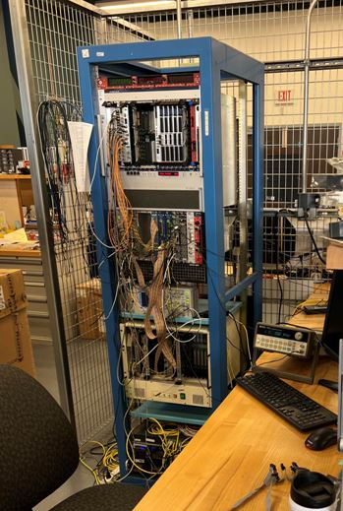
R&D on Polarimeter DAQ for moller and compton in halls A and C
Plan: Firmware design to support both counting mode and integrating (“accumulators”)
FADCs
VETROC
Scalers
I/O modules
Intel cpu
Signal distribution (SD)
Trigger Interrupt (TI)
Trigger processor (VTP)
Test Stand
Slide courtesy of R. Michaels

Slide 9
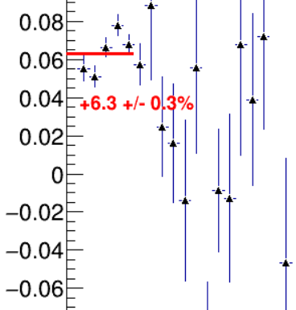
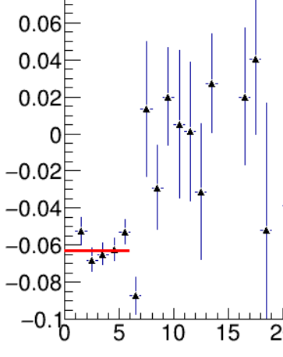
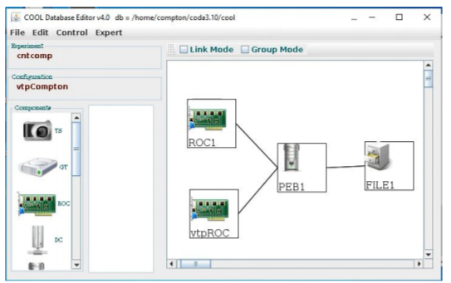
Initial version of the new polarimeter DAQ ran during (P)CREX
Bryan Moffit, Ben Raydo, Alexandre Camsonne, Iris Halilovic, Bob Michaels
That DAQ read out the microstrips (electron detector) and phototube signals (photon detector). It used a VETROC, VTP, FADC, and scalers.
Results
Asymmetries observed in electron detector.
CODA configuration
IHWP IN
IHWP OUT
asymmetry
-6.3 +/- 0.3%
microstrip
microstrip
Slide courtesy of R. Michaels

Slide 10
Beamline readout
Expect to use Berkley digital receivers for our primary BCMs
BPMs (and any BCMs we need to share with OPS) would (probably) go through JLab instrumentation
Discussion group: Yury, Kent, Mark P., Bob, Jim, Paul K., John Musson
PVES results published to date have relied on Switched Electrode Electronics for BPMs
With the sample and hold cards, the linac SEE effective analog bandwidth is ~30kHz.
SEE systems are gradually being replaced, but many likely to remain in use, such as in INJ
New BPMs in the hall would be instrumented by JLab digital recievers
Normally, stripline wire-pairs are multiplexed like in SEE, but at 1 MHz switching
16-bit 1 MHz analog outputs are available, with limiting bandwidth between 100-200 kHz.
Digital output processing would allow ~21 bits at 1 MHz sampling
New development work may allow removal of multiplexing and increase of sample frequency
Digital readout system development test stand is being set up
Plan to test new receivers in parallel with existing SEE systems on some devices

Slide 11
Planned Readout of Digital Data for Beam Monitors
https://userweb.jlab.org/~rom/digibcm
J. Musson’s electronics
CAEN V2495 PLU
Beam Monitor Electronics
Fiber
Electronics that sums the data in each integration window and can be read out by the DAQ
beam current (BCM) or
beam position (BPM)
Digital data
John Musson
Chad Seaton
Bob Michaels
Randall McClellan (initial version)
Integration gate
4 usec to ~1 hour
This development is supported by Hall Ops funds; would be needed for other experiments too
Slide courtesy of R. Michaels

Slide 12
Helicity generator boards and helicity pattern
New helicity boards being constructed (identical to current design) with new firmware
1920 Hz running: 520.85 μs period, such as 510.85 μs T_stable & 10 μs T_settle
64-event helicity pattern length with 128 event delay
Discussion group for helicity pattern: Kent, Caryn, Riad, Paul K., Prasanna N.
Plan to have three options for 64-event pattern structure: Thue-Morse; alternation of quad polarities; sequence of pairs. These could be changed in firmware if desired.
64-event Thue-Morse pattern: each doubling of the pattern adds inverse of previous
Numerical integration of sine & cosine waves over 500 consecutive patterns was performed as a function of frequency, collecting the RMS of pattern differences to evaluate noise sensitivity

Slide 13
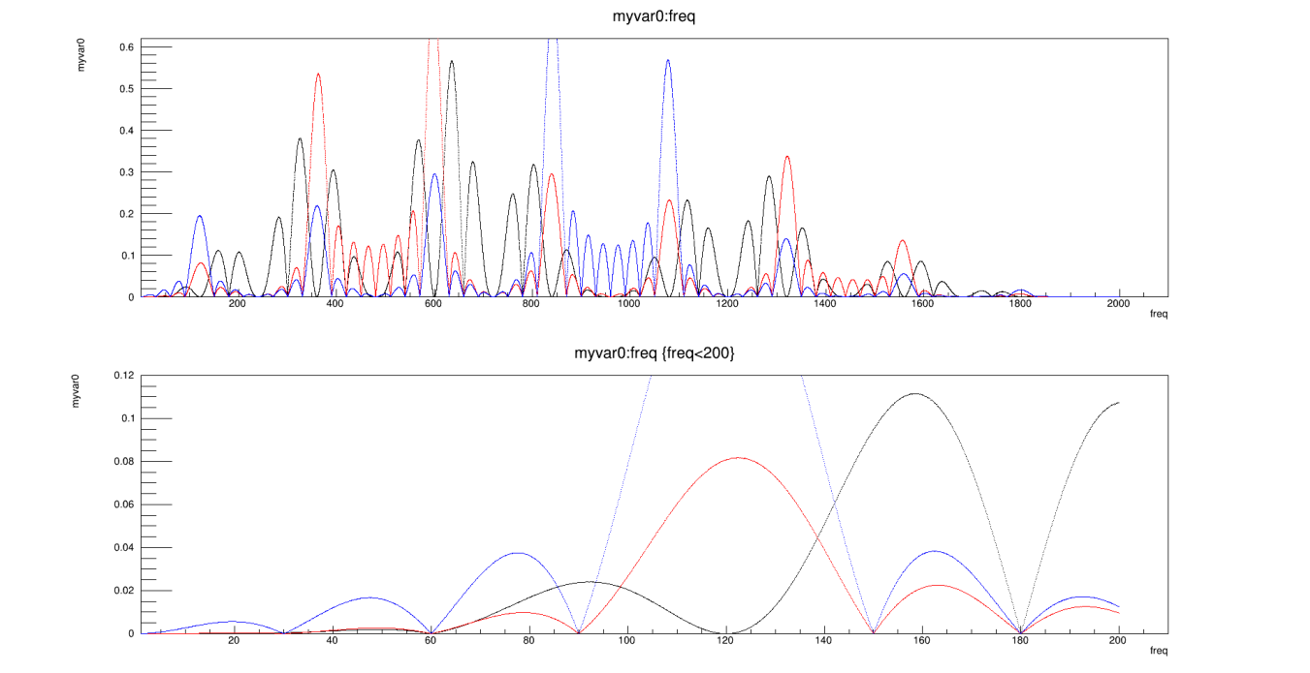
Modeled fractional pickup of several helicity patterns
Thue-Morse 64
Alternating paired quads: +--+ +--+ and compl.
Alternating quad pairs: +-+- +-+- and compl.

Slide 14
Mock-data and analysis testing
Mock-data generator within “japan” creates realistic data files with time-dependent and randomized generation of beam parameters and detector signals, including correlations
First model of the integrating ADC data-structure has been added; should be updated as we become familiar with the actual data stream
Analysis of these data files allows testing of throughput and processing algorithms
Processing time for initial mock-data (216 PMT channels and 50 beamline channels) is ~5µs per event; this is faster than we had expected from scaling arguments
We should restart the parity analysis group discussions
Starting point is the japan framework as used in PREX/CREX; should revisit what worked well and what was missing
Are there reasons to make major framework changes, or even start with new framework?
Should also be considering the tracking analysis; should look at what can be used from SBS

Slide 15
Summary
Paul King
pking@jlab.org
Integrating and counting DAQ working groups are continuing to refine the designs and prepare the design and interface documents
CODA development for integrating ADC to begin shortly
Plan to start bench testing of JLab digital beam readout soon
Aim for 90% design review at end of summer

Slide 16
DAQ development contributors
Integration mode
D. Bishop, B. Shaw; TRIUMF
B. Blaikie, M. Gericke, J. Pan; University of Manitoba
C. Cuevas, W. Gu; JLab
Counting mode
D. Armstrong; William and Mary
C. Ghosh, H. Liu; University of Massachusetts, Amherst
Digital BCM
J. Arrington, Y. Kolomensky, S. Li, Y. Mei, E. Sichtermann; LBNL
W. Gu; JLab
All three teams involve
R. Michaels, B. Moffit; JLab
P. King; Ohio University

Slide 17
Backup slides

Slide 18
Integration DAQ layout
Helicity trigger is formed in ISB, so that INJ gate is formed promptly
Gate timing adjusted per module to account for ~20μs electron transit or other signal latencies; need ~0.1μs resolution
TI Bridge feeds SD/TDs to distribute gates/triggers
TI to Integrator connection use one QSFP connection
10Gb/s network on QSFP connections
HVMAPS and digital BCMs planned to connect like the integrators

Slide 19
Integration ADC readout modes
Primary mode
Samples are accumulated into 4 “subblocks” in each helicity window, as well as the full window accumulation
Each subblock has the full window has: sum, sum of squares, minimum, maximum, and number of collected samples
Diagnostic modes are still being discussed. Some of the ideas we’ve mentioned.
Streaming of all samples for a small number of channels for continuous ~1 second
Purpose: to carry out FFT analysis over the range of Hz to MHz
Reporting of all samples in a window; there may be deadtime, with windows non-consecutive
Purpose: used with pulse mode beam to compare signal latency between different detector/monitor elements, and to adjust the gate timing
Reporting of all samples for two or more consecutive windows; could be the same as #2 with a “special definition” of the window start
Purpose: used to look at behavior of signals during the “settle” period

Slide 20
Signal levels in integration mode
The integrating ADC module base design uses a differential input with both pins accepting a -2V to +2V range, allowing a -4V to +4V signal range
PMT signals: the transimpedence preamplifiers are designed to match the ADC input.
Beam monitor signals from JLab instrumentation are available as single-ended signals. Alternate front-end panel for the ADC will take single-ended input on BNC with signal range of -4V to +4V.
Stripline BPMs: The S&H cards output a nominal 3V signal (potentially chosen in either polarity), but the signal can go to 5V. Plan to add in-line attenuators
BCMs: CREX saw nominal signal levels of ~1.3V from the analog BCM receivers
Cavity BPMs: CREX saw <2V on the Q signals and a range of +/-1V on the position signals
Raster pickoff: CREX saw triangle wave with <2V amplitude; the raster is being reworked & currents will be higher → Plan to add in-line attenuators

Slide 21
Why don’t we have the TDCs/VETROCs anymore?
In the counting mode DAQ in the CDR, we had discriminators and VETROC modules for timing. However, we think the FADC will give us sufficient timing resolution.
We need the timing to find coincidences between the scintillators, match to the quartz and GEMs, and have some gauge of accidentals
FADC250 waveform has 4ns time steps
Fitting a peak in the waveform can get better precision; some report as low as ~60ps
Considering only the 4 ns bins, a rough calculation gives accidental rate of 5% of coincidences at 100 nA (Moller rate ~30MHz/sector), so can likely do better by peak fitting
A more complete evaluation of the timing requirements is in progress.

Slide 22
Counting mode cable and crate layout
PMT signals go through event-mode amplifiers built into the base, then through high density cables to a patch panel, then 320’ RG58 cables to main electronics hut patch panel
From main electronics hut patch panel, 600” RG58 cables connect to the FADCs
Beam monitor signals run on RG58 cables (length TBD) from the standard Hall A electronics racks to FADCs
GEM signals from 30 modules (28 tracking, 2 pion) go to the 30 MPDs in their doghouses, then to a VTP in the main electronics hut

Slide 23
Counting mode crate layout
VXS #1: Rings 1 – 4, Ring 5 & 6
VXS #2: Shower max, Pion detectors, Trigger scintillators, Scanner, Alternates; Voltage-only signals
VXS #3: 30 MPDs readout through VTP
Crates of 16 or 14 MPDs in two doghouses
Trigger formation
Trigger thresholds defined in FADCs
FADC trigger information sent to VTP for processing
VTPs in VXS #1 & #2 send triggers to TI-master
FADC readout may be done through VTP or VME

Slide 24
Signal levels in counting mode
The FADC can have a negative going range of 0V to -2V (or similar for positive) A DAC offset allows software adjustment of the baseline.
PMT signals: Signals should be within the input range
Beam monitors
Stripline BPMs: The S&H cards output a nominal 3V signal (potentially chosen in either polarity), but the signal can go to 5V. Plan to use in-line attenuators and DAC offset
BCMs: CREX saw nominal signal levels of ~1.3V from the analog BCM receivers
Cavity BPMs: CREX saw <2V on the Q signals and a range of +/-1V on the position signals; Plan to use in-line attenuators and DAC offset
Raster pickoff: CREX saw triangle wave with <2V amplitude; Plan to use in-line attenuators and DAC offset

Slide 25
Rack space estimate for DAQ for 40U (70inch) racks
Integration mode: 71U in Hall, 31U in INJ
Integrators, 1U rackmount units, assume +1U for airflow
INJ: 6 modules → 12U: 0.3 rack
Hall A: 26 modules → 52U: 1.3 racks
VME/VXS: 11U height, front to back airflow
Trigger distribution in Hall
Trigger supervisor in INJ
NIM crate: 7U +1U
One each in Hall and INJ
Don’t have space needs for HVMAPS or digital BCM receivers yet
Doesn’t include integrator power supplies, or the HV and LV supplies
Counting mode: 44U (+16U) in SBS bunker, 22U in downstream doghouses
Three VXS crates: 11U each, front to back airflow → 44U
Two VME crates in two “doghouses”: 11U each, front to back airflow
Two NIM crates for amps in SBS bunker?: 7U+1U for airflow each → 16U
SBS bunker: 3+0.4? racks; Doghouses: 0.3+0.3 racks; INJ: 0.8+ rack

Slide 26
Dual-mode amplifier design from Mainz
This is the circuit diagram of the dual-mode amplifier designed by Mainz.
The counting mode amp performance was comparable (or better) than a commercial NIM amp.
Michael expects to include the counting mode amp in the next version of the base design
Would then check performance with ~100m cable
Integrating mode
Counting mode

Slide 27
CODA readout/control of custom modules
Integrating ADC modules, HVMAPS FPGA readout, and the digital BCMs should all act as independent CODA readout controllers with internal Trigger Interfaces
Trigger interface module functionality is being designed into the firmware for the integrating ADC, and TI connection will be made through QSFP on the main board
The HVMAPS readout is expected to use a similar FPGA/SOM as the integrating ADCs so will use the TI firmware development for the integrating ADCs. The QSFP connection likely through an FMC adapter board which has been designed by JLab
The digital BCM uses a different FPGA board and will not have a free FMC. LBNL is developing a special adapter board (similar to the JLab FMC TI) for the QSFP connection, and would incorporate the TI firmware in the design

Slide 28
Effect of gate time mismatch
If an integrator gate is not properly aligned with the spin flip then the measured asymmetry will be deceased by a percentage of about twice the fractional misalignment
Electron beam transit through the machine is ~20μs
Alignment within 200ns out of 500μs (0.04% misalignment) would bound this effect ~0.08% decrease in the asymmetry
If the detector and beam current monitor integrals are not aligned with respect to each other, then a false asymmetry is introduced which is equal to the charge asymmetry times twice the timing mismatch percentage. This would appear as a detector non-linearity
Using a narrow beam pulse at 60 Hz (tune mode) and the diagnostic waveforms from the detector and beam current monitor modules, we expect to be able to adjust the relative gate timing to 2 or 3 of the 15 MHz samples, which would be about 0.1-0.2μs

Slide 29
Setting Board Programmable Delays
With 10 µs T_Settle time, travel time from photocathode to Hall target becomes relevant. At 5th pass, travel time is ~21 µs. Helicity signal propagation to the hall is ~2.5 µs.
How to set input time delays:
Helicity Board: 60 Hz Line Sync
Electron Beam: VL, 60 Hz Line Sync, 50 ns pulses
Check VL Generator and Helicity signal on laser table
Adjust gate timing to match
60 Hz Line Sync
Check relative timing
ISB
Helicity Decoder Board
Check relative timing
Delayed
Helicity
Fiber
Helicity Generator
VL
Generator
Real
Helicity
Fiber
Trigger
DAQ
Board Input Delay (0-30 µs)
HV Supply
RTP
Cell
Hall
CEBAF
Target
Slide courtesy of R. Suleiman

Slide 30
Integration mode data rate calculation
Production mode:
Read out data for each helicity window separated into 4 blocks (4 data units)
Each data unit consists of 4 items:
The sum, sum of squares, minimum, maximum, and number of the collected samples
(calculating these is done in the FPGA) → 4+8+4+4+2 = 22 bytes
At 15 Msps ~7000 ADC samples per window from which to calculate these
4 data units x 22 = 88 bytes / channel / window
Add 8 bytes for one timestamp per helicity window -> 96 bytes / channel /window
With 16 channels per board with one readout link that’s about ~ 2kB / helicity window per board or ~4 MB / sec per board
Then 32 modules gives ~130 MB/s
For diagnostic purposes and during tracking readout every ADC sample for selected channels at ~34 MB/sec/channel
One uses is to check gate timing with tune mode beam; helicity windows can be prescaled

Slide 31
Counting Mode Triggering
GEMs/trigger scintillators inserted
reduced beam current ($≈$100 pA) [100pA → Moller rate is ~30kHz/septant]
use of thin ¹²C targets, and the lH₂ target
some measurements with “sieve” collimator to select scattering angles
Primary Counting-Mode Trigger
Trigger: “OR” of $i=1,7$of [${TSi}_{up}∙{TSi}_{down}]$
Quartz-triggered mode
Triggers: possibility to select:
OR of all thin quartz detectors in a given ring
OR of all ShowerMax detectors
Pion-triggered modes
Triggers: possibility to select from:
OR of all 7 pion detectors (cosmics, setup)
OR of the two $(i=1,2)$ANDs: [${πTSi}_{up}∙{πTSi}_{down}]$ (main pion dilution measurement)
[OR of all 7 pion detectors] $∙[OR of all {TSi}_{up}∙{TSi}_{down}]$ (rate symmetry of pions; $πTS$efficiency; enhance pion signal)

Slide 32
Counting DAQ rates & data size
FADC trigger window range: 100ns (25 samples)
GEM samples: 3 25-ns samples
Total Moller rate: 135 GHz@65 uA → ~300 MHz/sector/uA
At 100nA, ~30MHz/sector, 3 hits/sector/100ns
Likely use a pulser trigger at this beam current and find scint. hits in analysis
At 100pA, ~30kHz/sector
FADC raw mode data rate at 7kHz: 150 MB/s
336 FADC channels * ( 25 samples * 2 bytes/sample + 4 bytes for channel) → 127 MB/s
Estimate 8 particles with 5 detectors hit (2 scint, 1 quartz, 1 showermax, & 1 pion) in each sector per trigger; pulse parameter data would give ~23 MB/s

Slide 33
GEM data rate estimate
30 GEM modules (4 in each septant, plus 1 in each of two pion detectors)
1280 channels per module
Readout: 300 APVs to 20 MPDs
With 3 samples/chan & 16 bits/sample
→ 1.84Mb/event without data suppression
At 7kHz maximum APV rate with 3 samples
→ 12.9Gb/s; 0.645 Gb/s from each MPD
Occupancy (per 75ns window) expected due to Møllers at 100nA: ~2%
3 e-e scatters per sector in 100 ns
8 strips hit/module/track
24 strips hit per event out of 1280
With zero suppression at the VTP, and a 5% occupancy at 7kHz
→ 80.6 MB/s to disk

Slide 34
Online Analysis
Needed Tasks
Helicity correlated (HC) feedback
Feedback cycle likely 10 s
Monitor of data quality
Some issues only appear at high statistics, needing hours or days
Requires correction for HC beam properties
Monitor of transverse beam polarization
Requires corrections for HC beam properties
Requires accumulating multiple hours of data
Hardware needs
One workstation for helicity-correlated feedback
10 workstations for full analysis to support #2 and #3 (~50 concurrent jobs)
100 TB fileserver provides space for several days of raw data and analysis results (raw data rate is 450 GB/hr, outputs are similar in size)

Slide 35
Data reduction and visualization
The total raw data volume will be at the petabyte scale
Creating ROOT TTrees of all elements would also result in petabyte scale output files
Several parallel data reduction choices
Average yields and asymmetries for all data elements over short period (~1 minute?) and store in a database
Generate ROOT TTrees for only the key elements for all helicity patterns
Keep the full ROOT TTrees for a small subset of data files
Anticipate needing a few hundred TB of disk space to work with the output files
We will also need robust ways to monitor system performance and present output results to analysis workers

